Slide 2
Overview
State structure of Belgium
Flanders:
At a glance
Foreign policy
Foreign network
> South Africa

Slide 4
State structure
Belgium is a federal state without hierarchy between governments
1 Federal government
Defense, Migration, Social Security,…
3 Regions: Flanders, Wallonia, Brussels
Transport, Environment, Business,…
3 Communities: Flemish, French-speaking, German-speaking
Education, Culture, Tourism,…
Flanders = Region + Community

Slide 5
FLEMISH COMPENTENCES
Assistance to persons
Ports
Integration of migrants
ENERGY POLICY
Tourism
Land development and conservation
Living and housing
Daycare
Economy
…
Agriculture and sea fisheries
Spatial planning
Municipalities, provinces and intermunicipal partnerships
Culture
Employment
WATER POLICY
Elderly and disability policy
ENVIRONMENT
Justice (partially)
Healthcare (partially)
Animal welfare
EDUCATION
Youth and family policy
Media

Slide 6
Flanders is externally competent for internal competences
Full
treaty-making power
No hierarchy between Flemish and federal legislation
IN FORO INTERNO,
IN FORO EXTERNO
(Art. 167 Constitution)

Slide 7
Flanders at a glance
A knowledge region
like no other
6.7
million inhabitants
(58% of Belgian population)
60%
of the Belgian GDP
80% share of overall Belgian goods exports
4 world-class strategic research centres (VITO, imec, VIB, Flanders Make)
77% employment rate
11% poverty risk, among the lowest in the EU
3.65%
of GDP
to R&D
High quality
universities and
research (Ghent, Antwerp, Brussels, Leuven, Hasselt)

Slide 9
Foreign policy in 5 dimensions
Partner for development
Trade & investment
Diplomatic actor
Culture, science & tourism
Human rights, peace & security

Slide 10
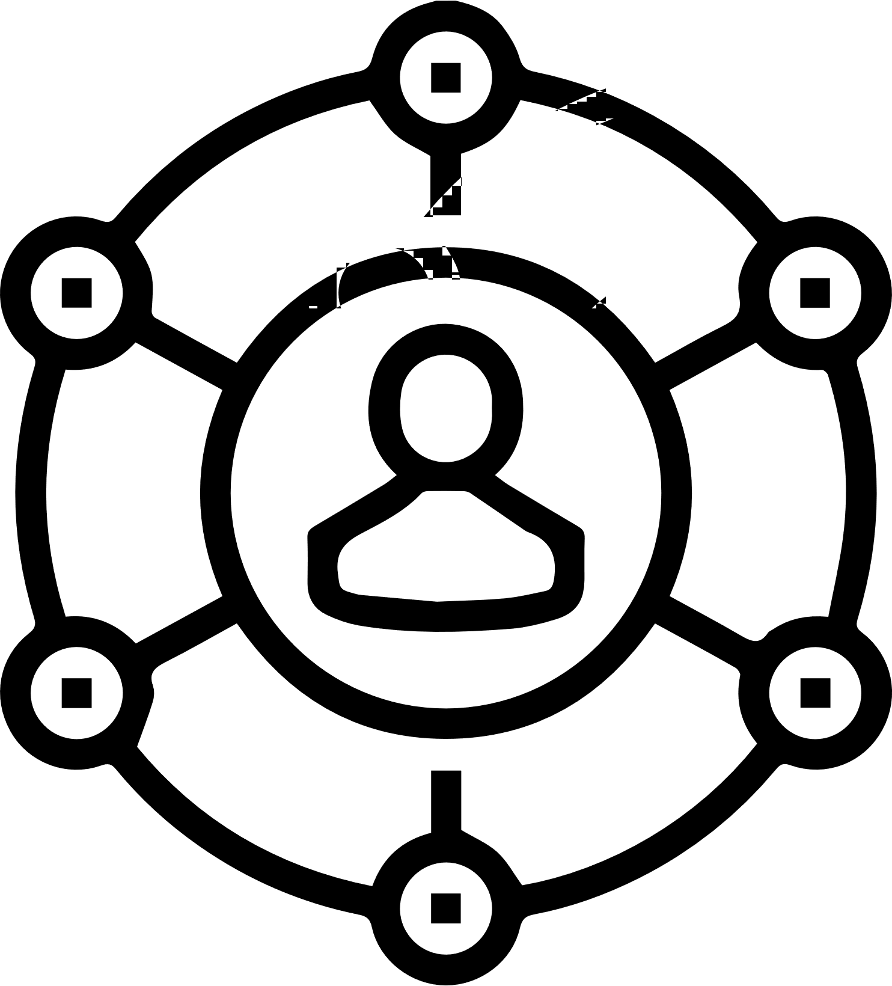
Diplomatic actor
Bilateral dialogue with countries and regions
Actively promoting Flanders’ interests abroad, in line with the 2030 SDG agenda
The EU as an essential lever for Flanders’ relations worldwide
Active participation in multilateral organisations

Slide 11
Sustainable Development Strategy of Flanders
Vision 2030: medium-term objectives – SDG’s translated to Flanders (monitored by indicators)
Vision 2050: long-term vision
> 7 transition priorities to achieve the objectives of Vision 2030 and Vision 2050
circular economy
living, learning and working
industry 4.0
living together
mobility
energy and climate
environment for the future
Cooperation with partners like you!

Slide 13
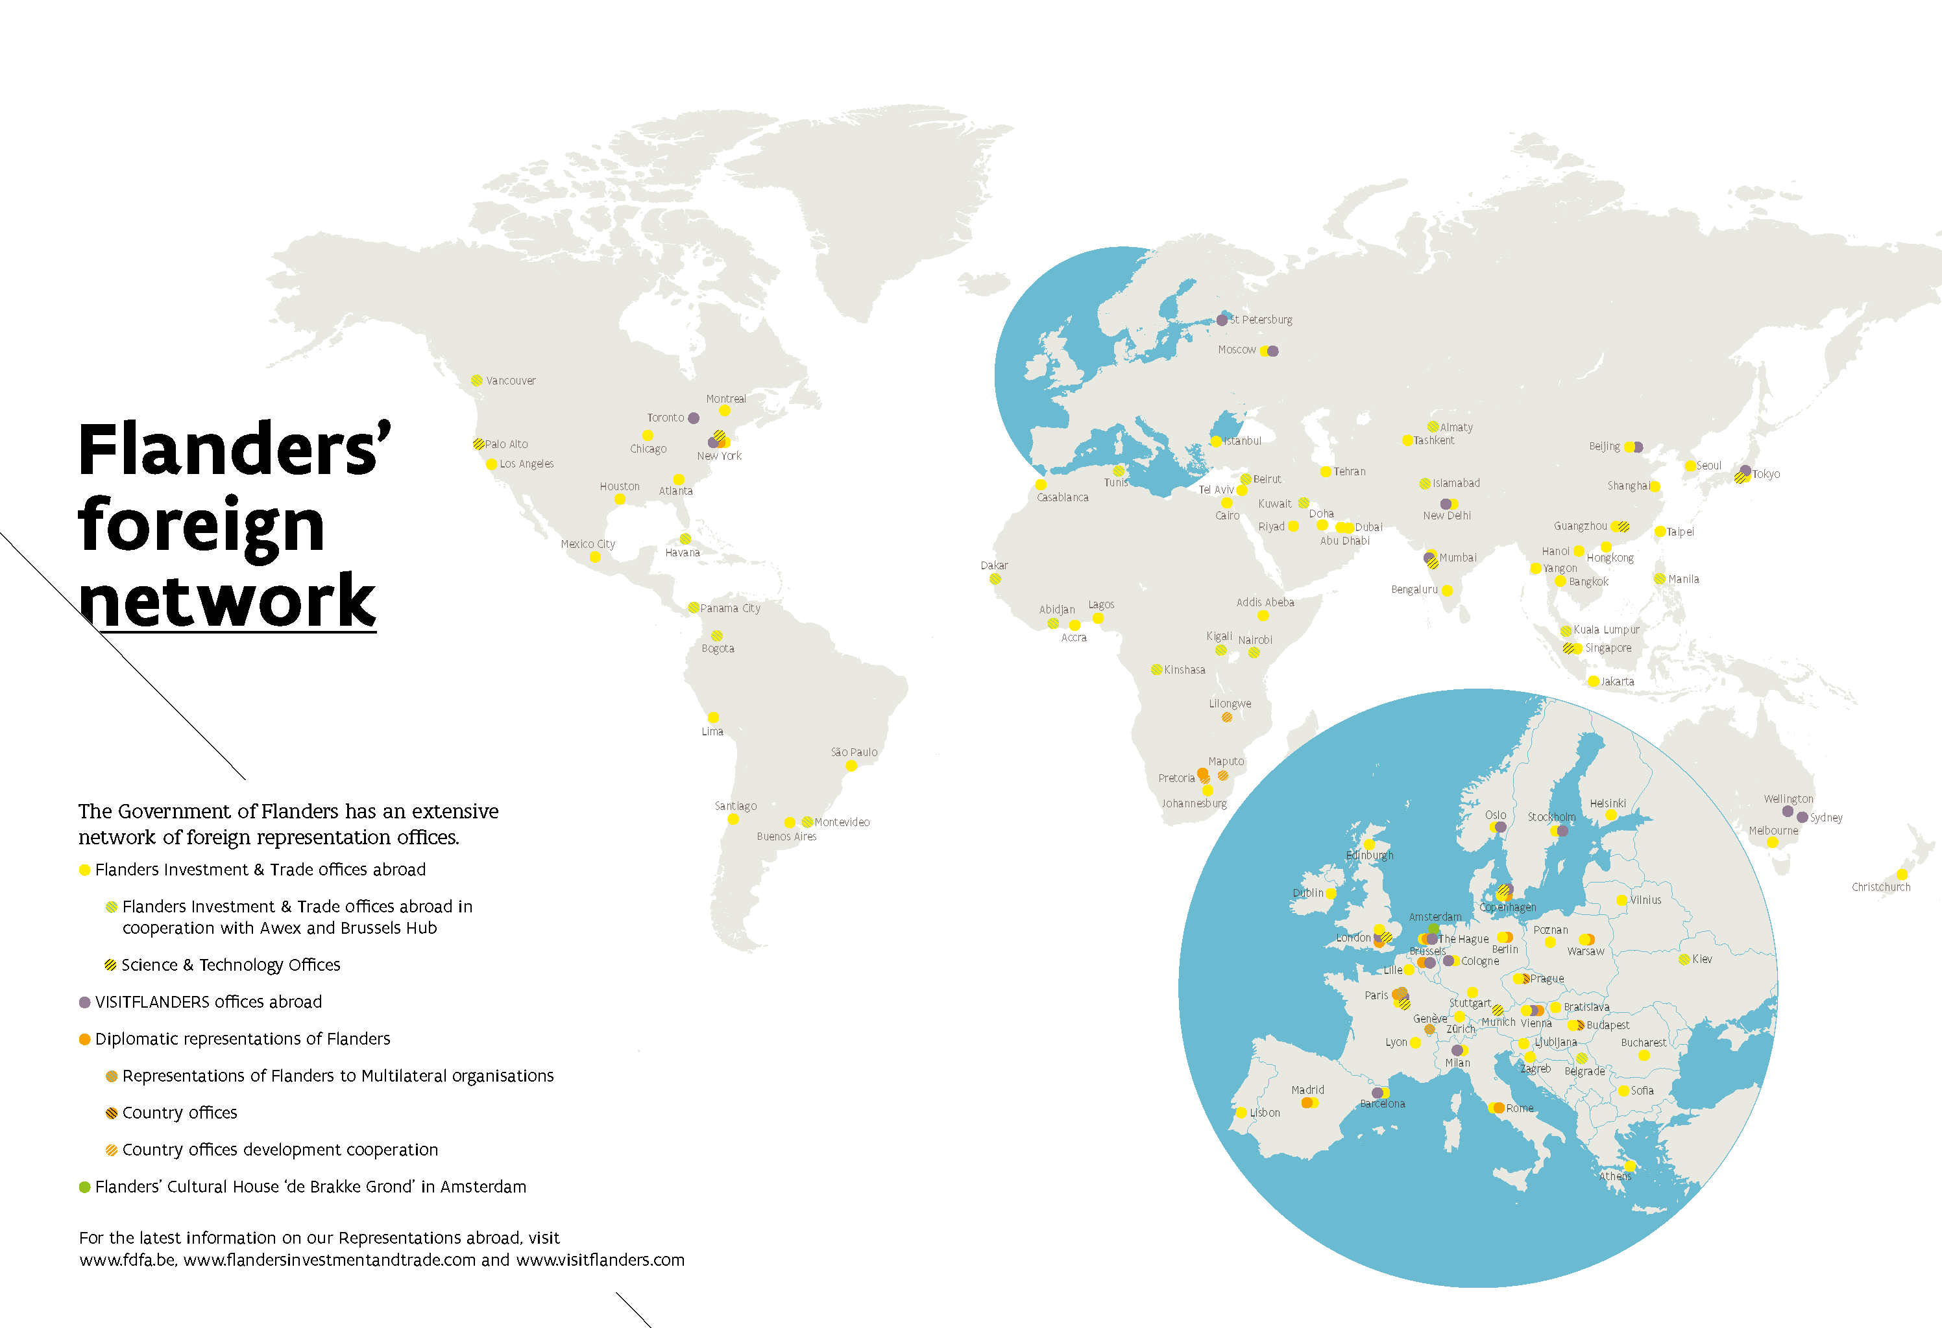

Slide 14
Flanders’ foreign network
13 Diplomatic Representations
DHG, PAR, BER, LON, ROM, WAR, VIE, KOP, PRT, NYC, BRU (EU), GVA (UN), PAR (OESO/UNESCO)
±50 Economic Representations
Science & Technology Attachés
8 Tourism Offices

Slide 15
Flanders’ foreign network: Pretoria
Diplomatic Representation of Flanders in South Africa
Development cooperation, cultural/academic/economic/public diplomacy, good governance and human rights, science, technology & innovation,…
Main office: Pretoria
Development cooperation offices in Lilongwe and Maputo
FIT office in Johannesburg
Relations with Western Cape province as priority
Missions
Location
Pretoria
Jurisdiction
South Africa, Malawi, Mozambique, Namibia, Botswana, Lesotho, Eswatini
Diplomatic Representative
Geraldine Reymenants -> September: Thomas Castrel

Slide 16
THANK YOU FOR YOUR ATTENTION
Contact:
rhiannon.buyens@vlaanderen.be
+32473563108

