Slide 1

Team Flemish Government Architect
Marie Swyzen

Slide 2
What does a Government Architect?
Our mission is to improve and promote the architectural quality of the built environment by achieving an excellent architectural policy and exemplary public commissioning practice.
Notes:
We do this
by advising and guiding clients (governments and other public authorities) with the aim to improve the quality of their projects;
by creating chances for young and international designers;
by Actively contributing to vision and reflection in the field of architecture, urbanism and landscape.
Quality = broad definition > sustainability, aesthetics, user comfort, cultural importance, …
Only advice; NO power to decide.
FGA can talk about everything because they have nothing to say (neutral position)

Slide 3
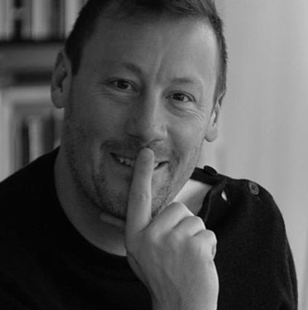
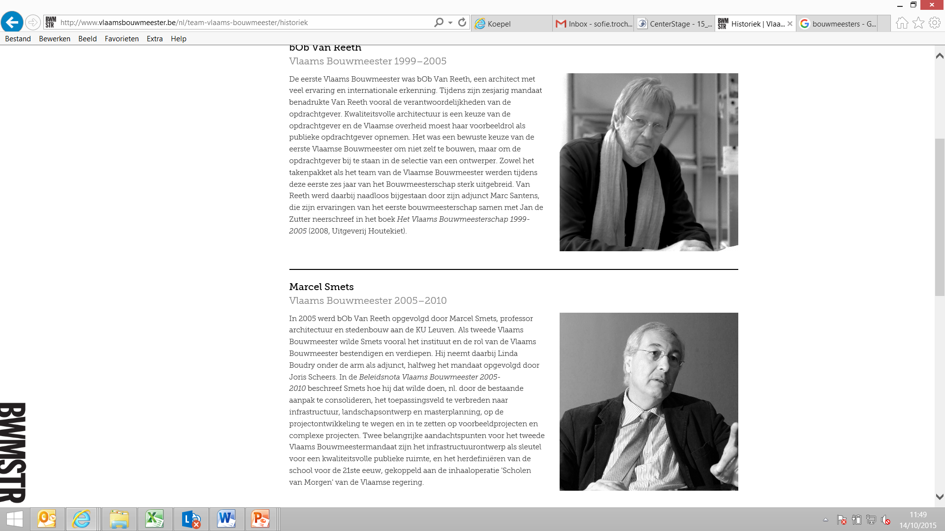
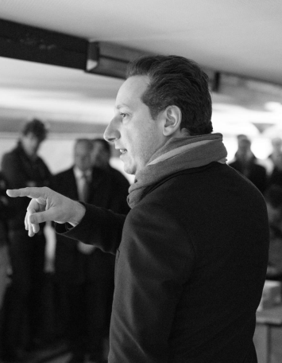
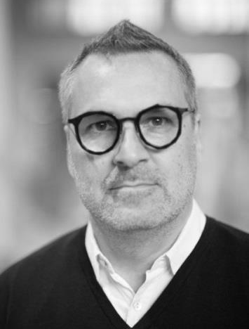
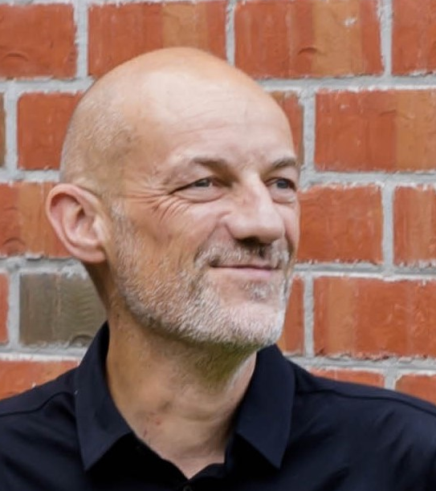
Flemish Government Architects
bOb van Reeth
1999 - 2005
Marcel Smets
2005 - 2010
Peter Swinnen
2010 - 2015
Stefan Devoldere
2015 - 2016
Leo Van Broeck
2016 - 2020
Erik Wieërs
2020 - 2025
Notes:
Government architect = appointed by the Flemish government as an expert for 5 years. Each with their own accents.
bOb Van Reeth: put architecture on the map of policy makers, developed the Open Call procedure
Marcel Smets: public space, infrastructure, and collaborations between private and public actors
Peter Swinnen: Labo Ruimte en Pilootprojecten, mixed use & program
Stefan Devoldere: Save the Bouwmeester institution, at that time discussion on taking down the government architect
Leo Van Broeck: focus on densification
Erik Wieers: collective housing, the in between spaces,
We are now weating for the first female FGA

Slide 4
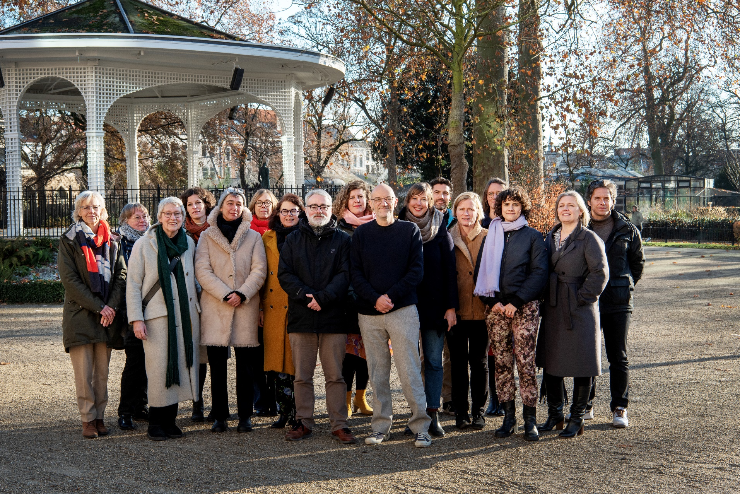
Team
Eline Aerts
Eva Amelynck
Annelies Augustyns
Pieter Degrendele
Christa Dewachter
Stijn De Vleeschouwer
Tania Hertveld
Julie Mabilde
Kathleen Machtelinckx
Jouri De Pelecijn
Celine Oosterlynck
Cateau Robberechts
Marie Swyzen
Hedwig Truyts
Oda Walpot
Erik Wieërs
Notes:
Erik is supported by a team of 16 architects, urbanists and landscape architects to advise public authorities in their approach to spatial assignments.
The team stays during every government architect, so
In our team we have more than 20 years of knowlegde about public commissioning
We are a part of the flemish government and we work under the prime minister. So not under culture or spatial planning.
4

Slide 5
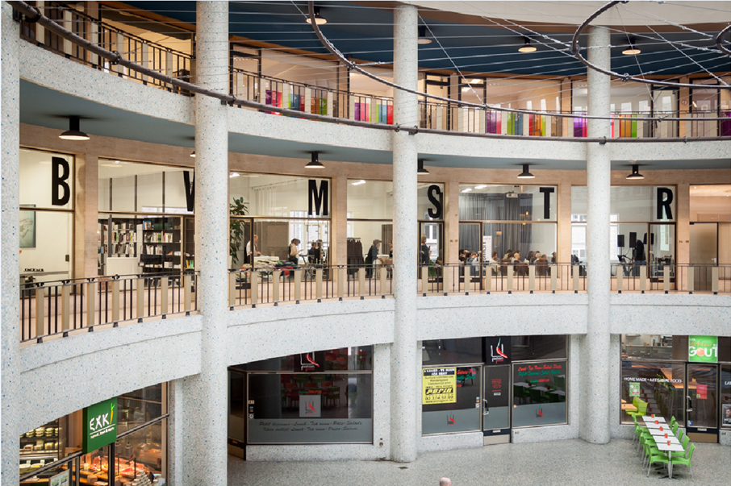
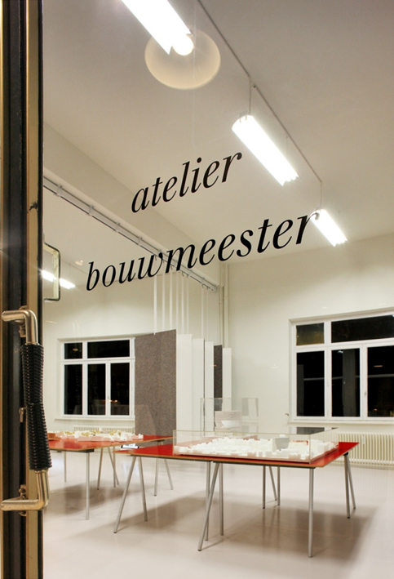
Atelier BWMSTR
Notes:
Atelier is a place for public debate, juries,… : visibility in the city + accessibility to the public, to other public authorities,…

Slide 6
Tools
Open Call (since 2000)
Call for interest (since 2017)
Advice, juries, customized guidance, …
Meesterproef (since 1999)
Award ‘Wivina Demeester’ for excellent public commissioners (since 2003)
Pilot Projects (since 2012)
LABO RUIMTE - Laboratory for spatial research (since 2013)
BWMSTR label (since 2013)
Communication: Atelier, SmallTalks, debate, opinion, publications, international collaboration,…
Notes:
Open Call: First and most important tool
Call for interest (since 2017)
Advice, juries, customized guidance, …
Meesterproef (since 1999)
Award ‘Wivina Demeester’ for excellent public commissioners (since 2003)
Pilot Projects (since 2012)
LABO RUIMTE - Laboratory for spatial research (since 2013)
BWMSTR label (since 2013)
Communication: Atelier, SmallTalks, debate, opinion, publications, international collaboration,…

Slide 7

Open Call
Notes:
Renewed procedure
With the Open Call we guide motivated public authorities with their project, in defining the scope and the ambitions, and help them during the procedure and selection of a design team.

Slide 8
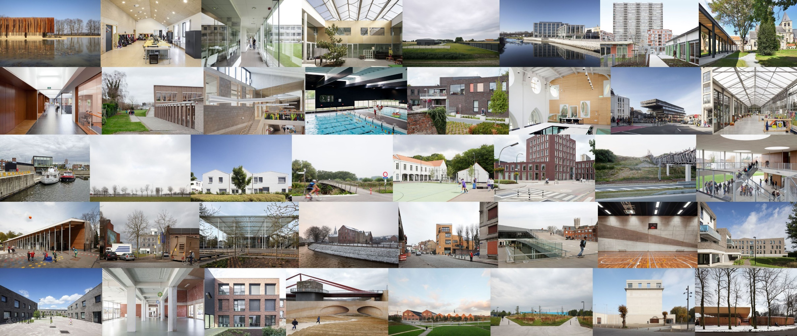
Open Call – since 2000 more than 350 built public projects
Notes:
The open call resulted in more than 350 built public projects

Slide 9
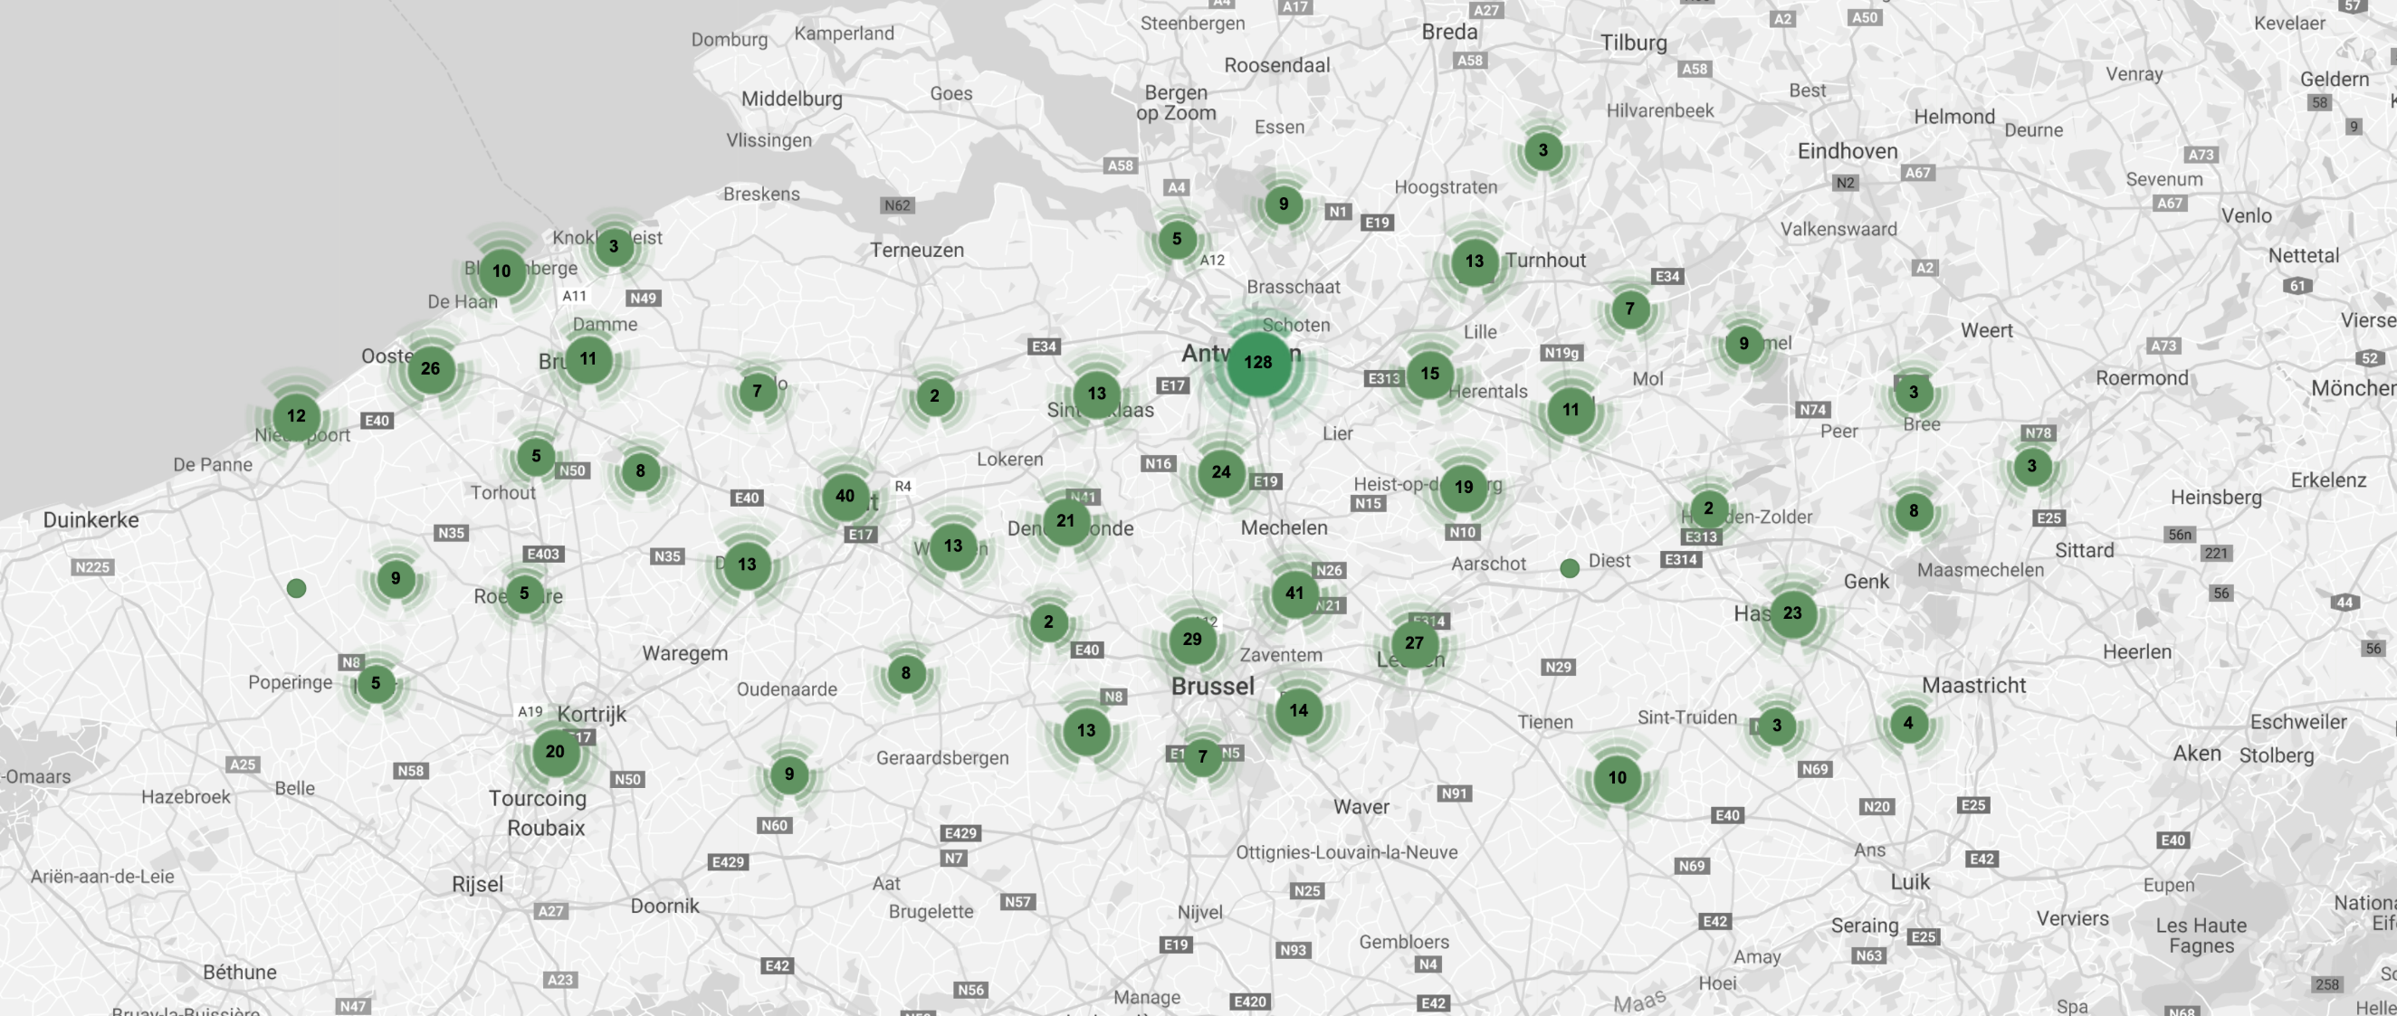
Open Call
Notes:
Across Flanders and Brussels

Slide 10
What the Open Call stands for:
Responsible commissioning
Ambitions as a guide
Responsible use of space, materials and resources
Bringing public assignments widely to the attention of the design community
Showing diverse design attitudes
The importance of dialogue
Choosing a designer with a design vision, not a final design
Integral approach and assessment
Knowledge exchange
Notes:
Responsible commissioning by the public authorities in which they use
Ambitions as a guide throughout the whole procedure and design process
With a focus on Responsible use of space, materials and resources now and in the future
The OC brings public assignments widely to the attention of the design community
And shows a pallet of diverse design attitudes
dialogue between the public authority and the designers is also very important during the open call
End of OC we choose a designer with a design vision, not a final design
In this we use an Integral approach and assessment, so only a few criteria to assess a vision
Finally Knowledge exchange between designers, public authorities and the wider public

Slide 11
Open Call – in 10 steps
1
The client contacts the Team Flemish Government Architect about their project.
Notes:
The client contacts the Team Flemish Government Architect about their project.
As it is voluntary, nobody is obligated to work with us. This already show the motivation of the client.

Slide 12
2
The TFGA and the client tailor the procedure to the assignment.
Notes:
The TFGA and the client tailor the procedure to the assignment.
By making agreements on budget, timing, amount of candidates to select, etcetera

Slide 13
3
The TFGA guides the client with writing the project definition.
Notes:
The TFGA guides the client with writing the project definition, so setting the ambitions on sustainability, program, use, …

Slide 14
4
The TFGA launches the open call to design teams through E-procurement (twice / year).
Notes:
The TFGA launches the open call to design teams through E-procurement (twice / year in March and October).
By collecting the different open call assignments and publishing them together, the designers can choose with more focus on which assignment is best for them.

Slide 15
5
National and international teams apply on the assignment with references and a short text.
Notes:
National and international teams apply on the assignment with references and a short text.
On average we have 50 candidates per assignment.

Slide 16
6
The TFGA makes a preselection of ten teams of which the client retains five on average.
Notes:
The TFGA makes a preselection of ten teams of which the client retains five on average.

Slide 17
7
The client organizes two site visits to brief the selected teams.
Notes:
The client organizes two site visits to brief the selected teams.
This is the start of the dialogue between the client and the teams.

Slide 18
8
After three months the teams submit their proposal. The teams present the proposal, and answer questions from the jury.
Notes:
After three months the teams submit their proposal. The teams present the proposal, and answer questions from the jury.
The teams get a fee for making this proposal (minimum 10.000 euro)

Slide 19
9
The jury evaluates the proposals and selects a winning team which the client awards with the assignment
Notes:
The jury evaluates the proposals and selects a winning team which the client awards with the assignment

Slide 20
10
The TFGA remains involved to monitor quality.
Notes:
The TFGA remains involved to monitor quality after the designer is appointed the project.

Slide 21
47 calls
716 projects
364 built projects
ca. 5000 unique candidates
20 to 200 candidates per project call
€ 269.000.000,- biggest investment budget
Notes:
So this procedure resulted in 47 calls

Slide 22
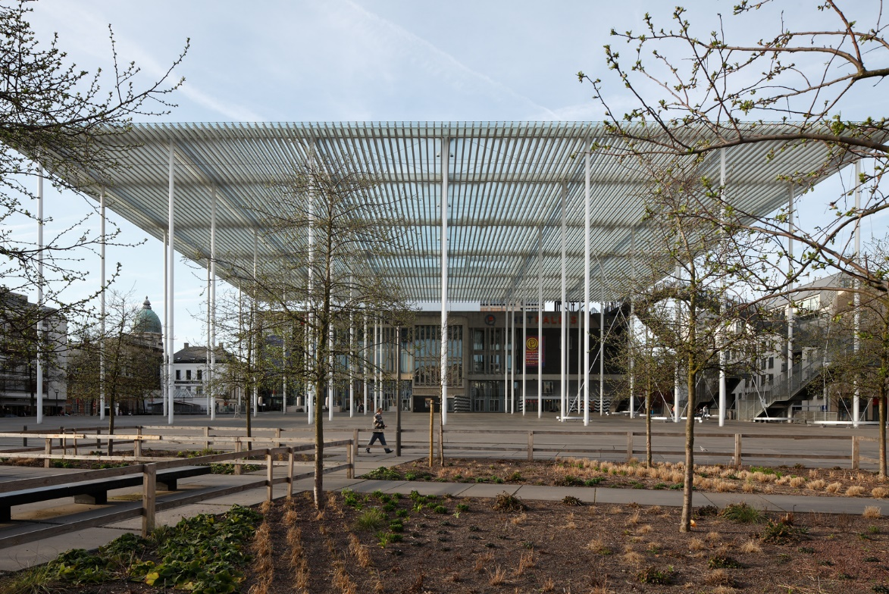
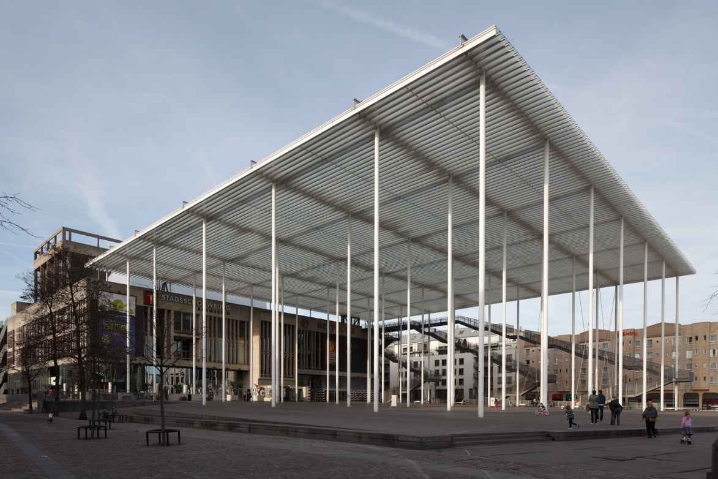
Theatre square, Antwerp – Secchi-Vigano
Notes:
theatre square Antwerp

Slide 23
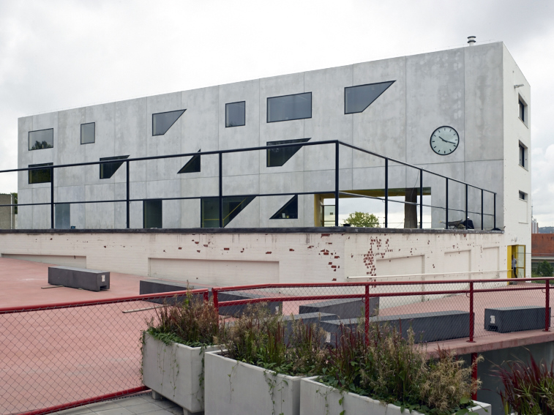
School ‘De Wijnpers’, Leuven – Office KGDVS
Notes:
School Leuven

Slide 24
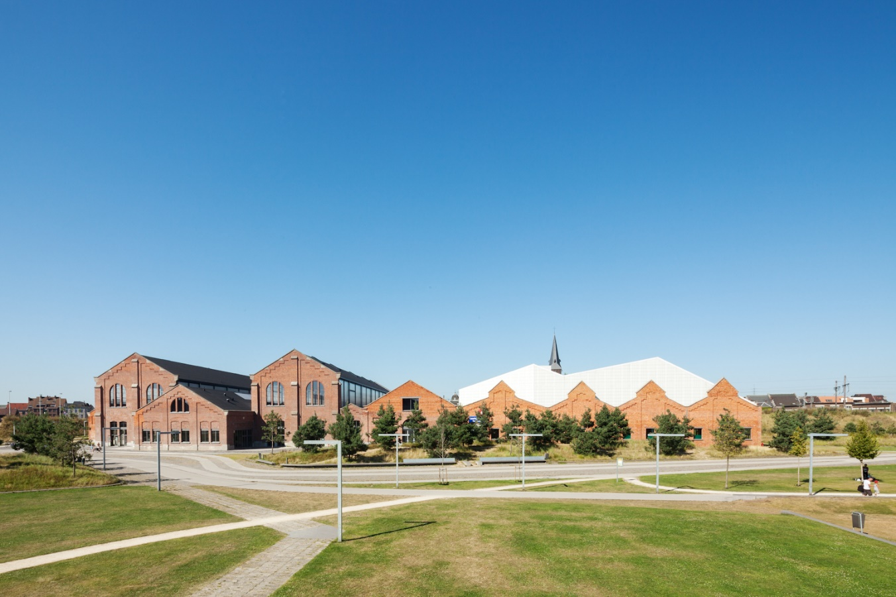
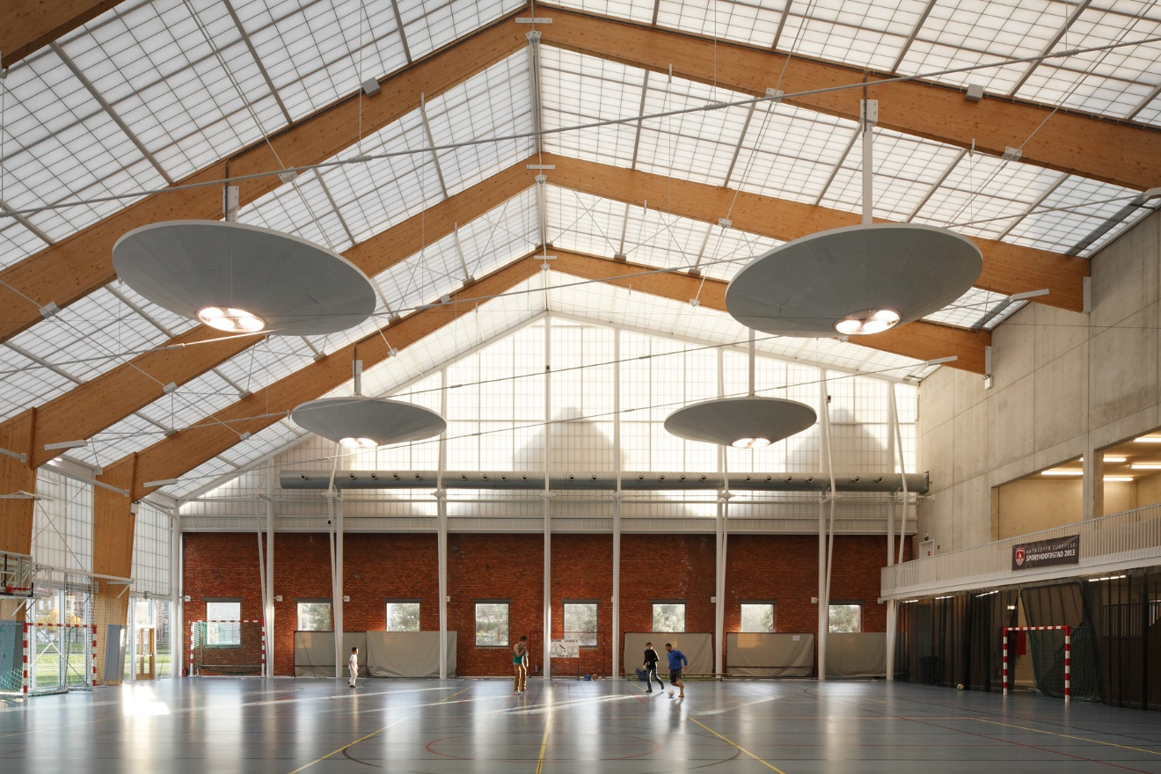
Restoration of the industrial sheds in Park Spoor Noord, Antwerp – Verdickt & Verdickt Architecten
Notes:
Restoration of the industrial sheds in Antwerp,
connected to a new parc on former railway area

Slide 25
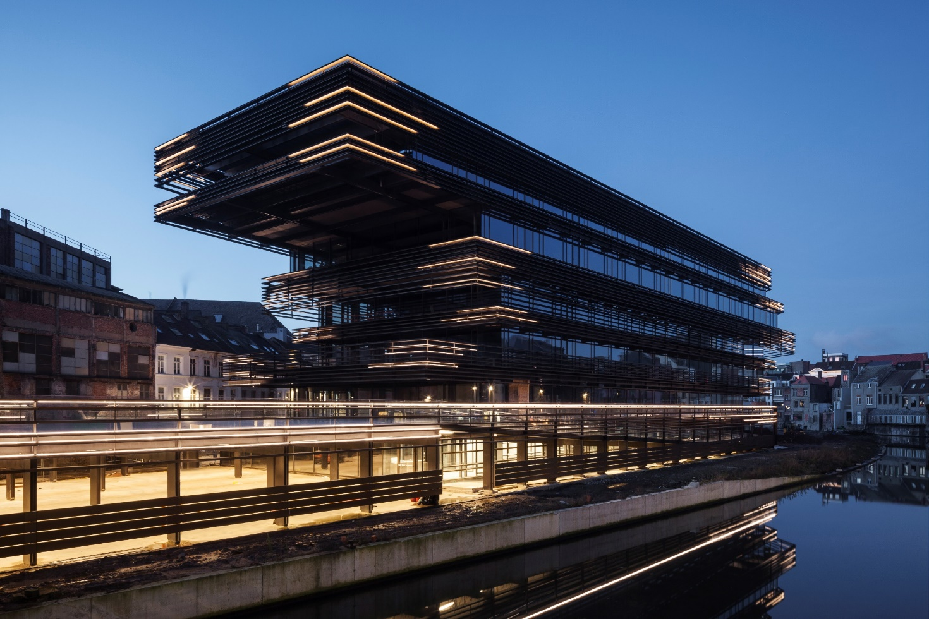
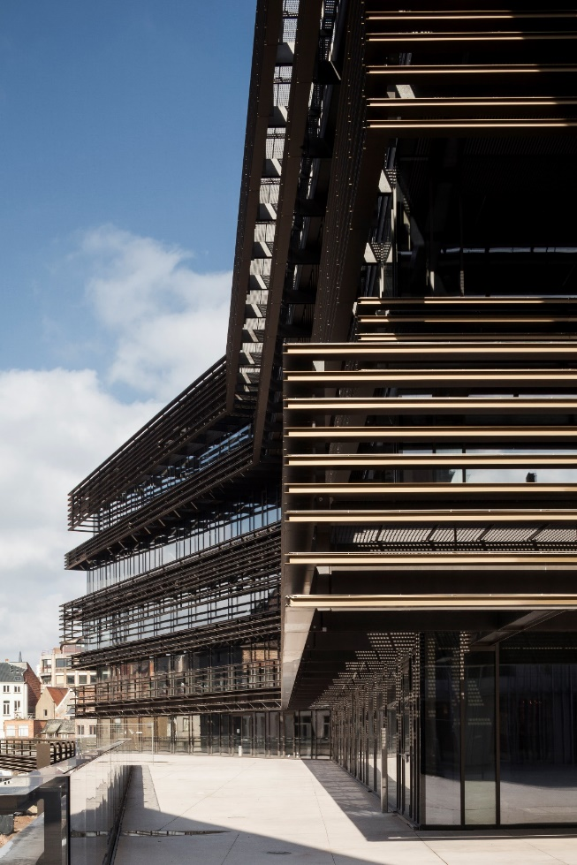
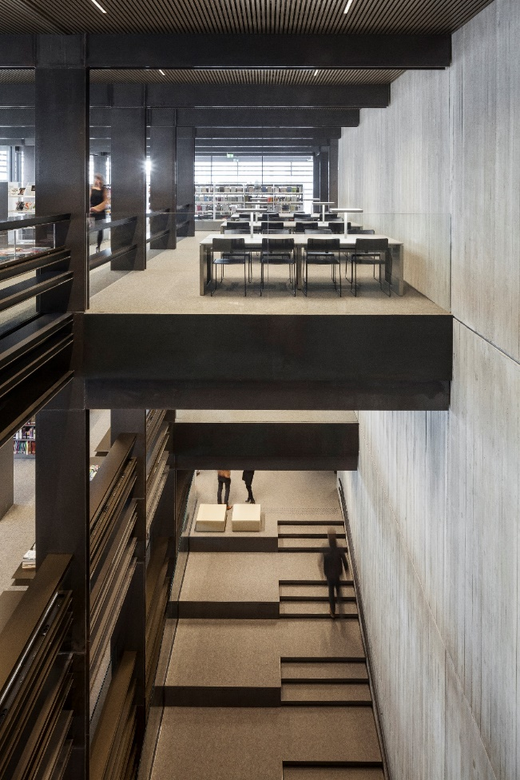
Library ‘De Waalse Krook’, Gent – Coussée & Goris + RCR
Notes:
Library de Waalse Krook in Ghent

Slide 26
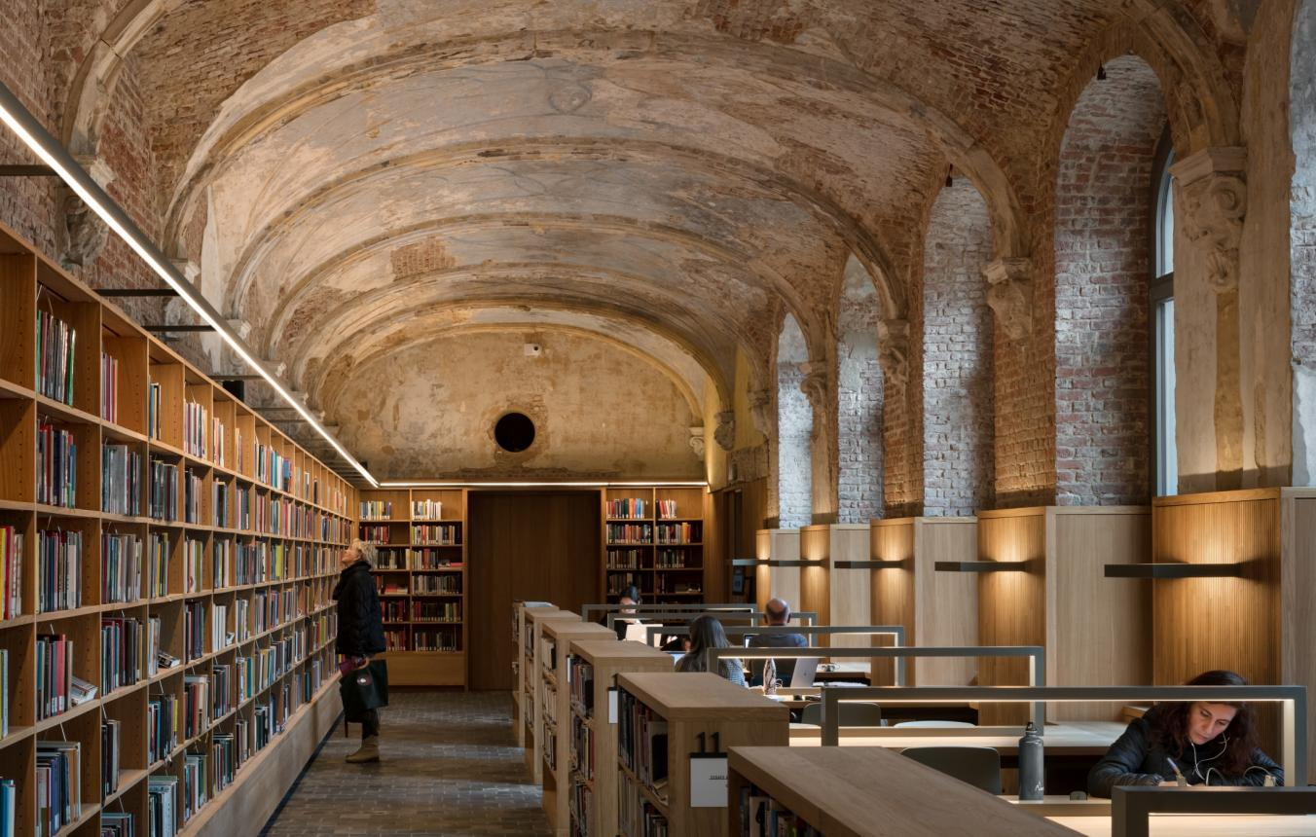
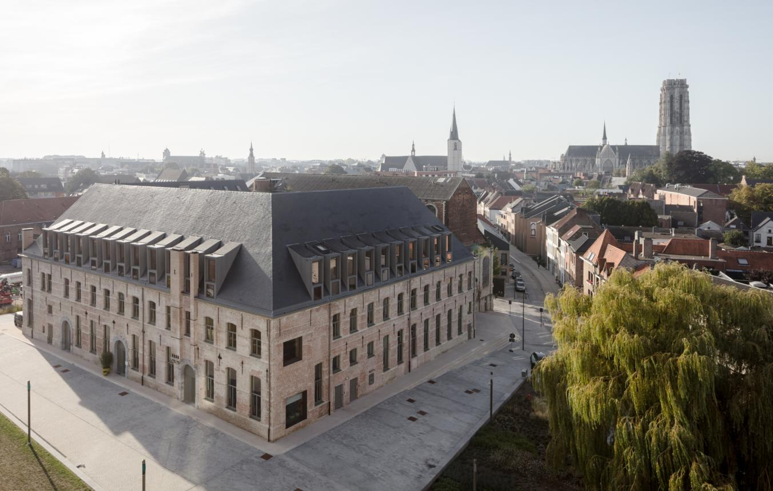
From monastery to library ‘Predikheren’, Mechelen - HildundK Architekten, Korteknie Stuhlmacher Architecten BV
Notes:
Restoration and répurposing of monastery to library in Mechelen

Slide 27
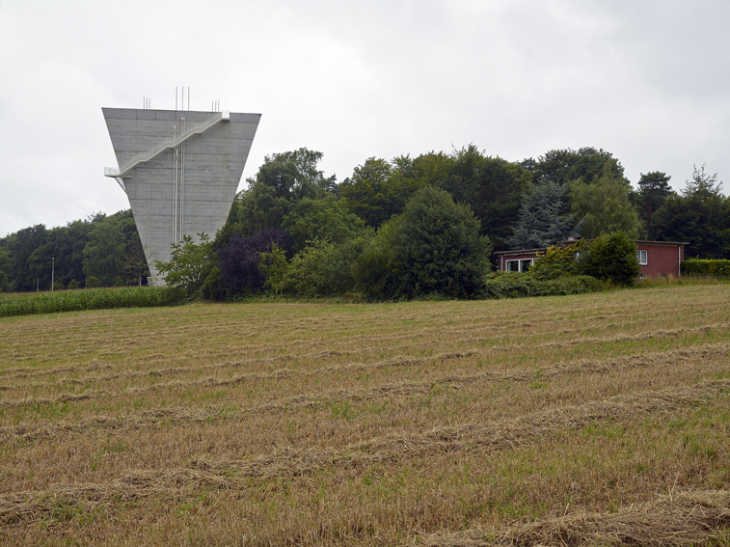
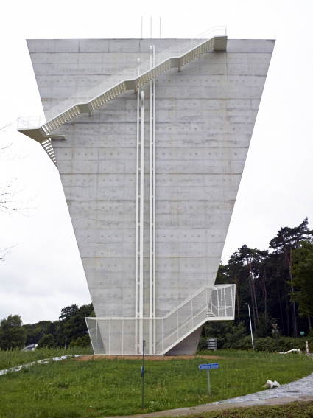
Watertower, Beersel – BEL Architecten
Notes:
Watertower in Beersel

Slide 28
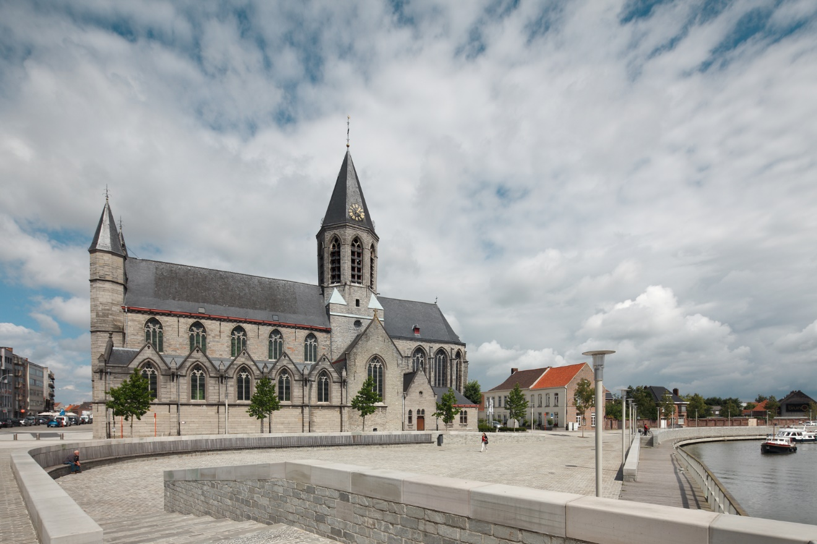
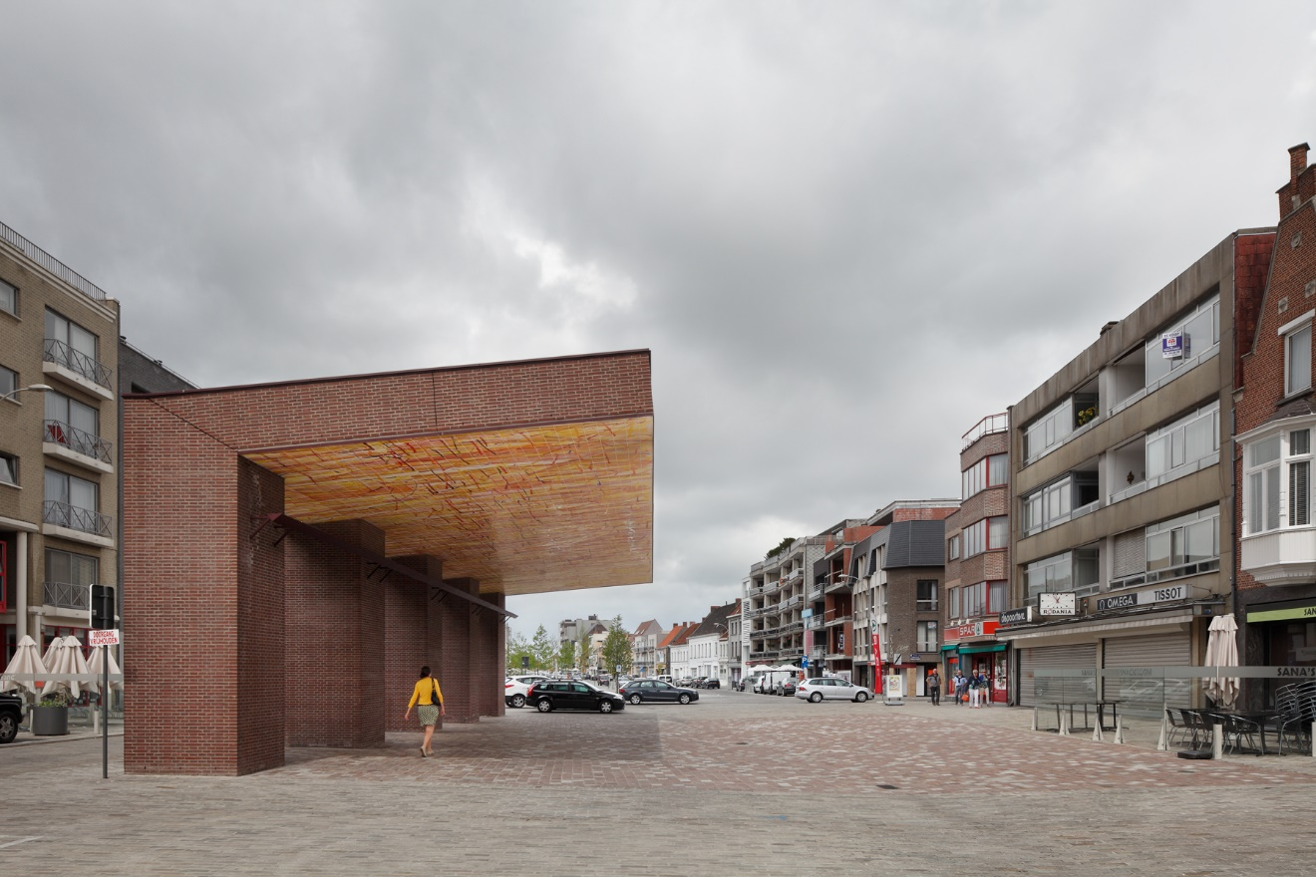
City centre renewal, Deinze – Robbrecht & Daem, Marie-Josée Van Hee and artist Benoît Van Innis
Notes:
City centre renewal in Deinze

Slide 29
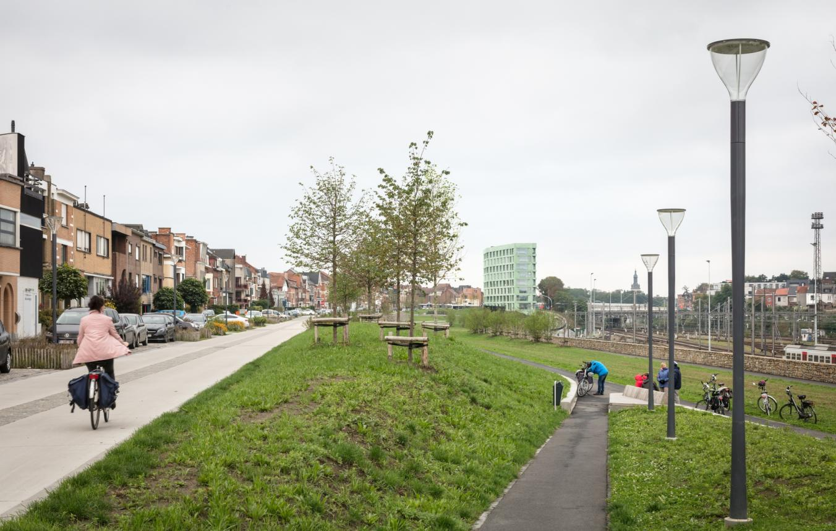
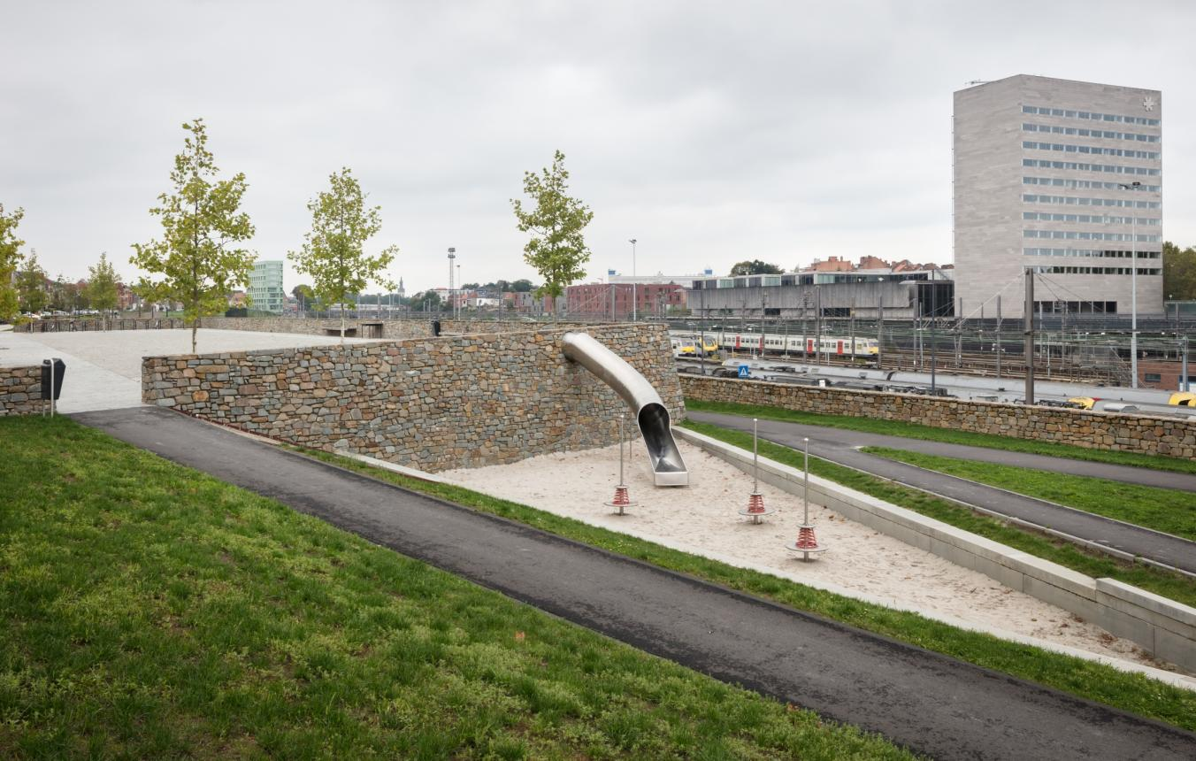
Design for a new road profile and parc Park Belle Vue in Leuven – Artgineering, H+N+S Landschapsarchitecten
Notes:
Design for a new road profile and parc in Leuven

Slide 30
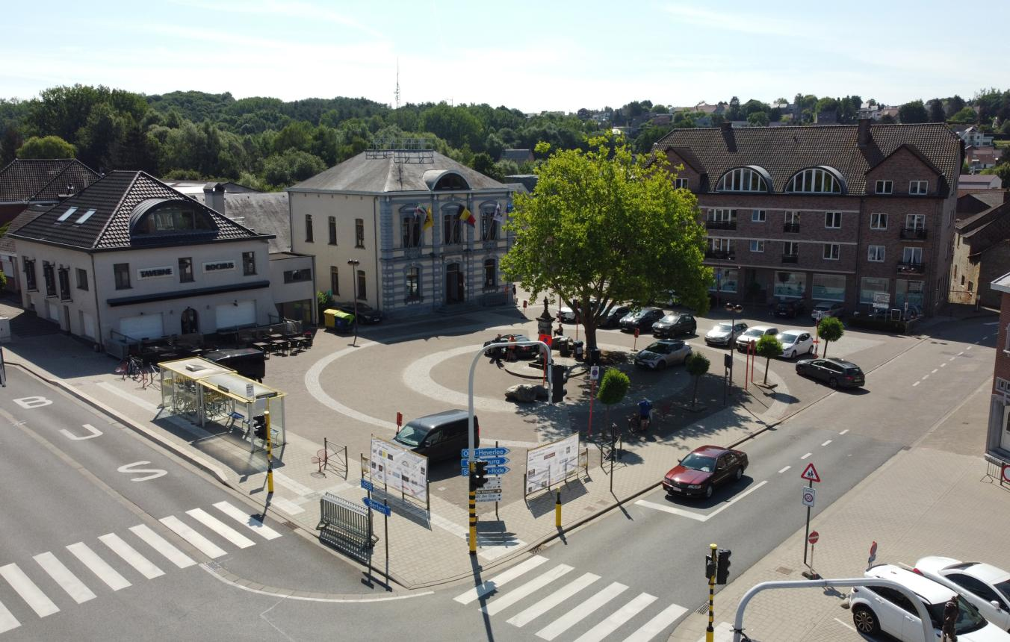
Call for interest
For projects with an honorarium below 140.000 euros
The TFGA assists the client with the project definition.
The TFGA publishes the project on the website, newsletter and social media.
Interested teams can candidate for the project with a one pager.
The TFGA and the client select 3-5 teams to make a concept proposal.
The TFGA and the client choose a winning team which the client awards with the assignment
Notes:
For projects with an honorarium below 140.000 euros
The TFGA assists the client with the project definition.
The TFGA publishes the project on the website, newsletter and social media.
Interested teams can candidate for the project with a one pager.
The TFGA and the client select 3-5 teams to make a concept proposal.
The TFGA and the client choose a winning team which the client awards with the assignment

Slide 31
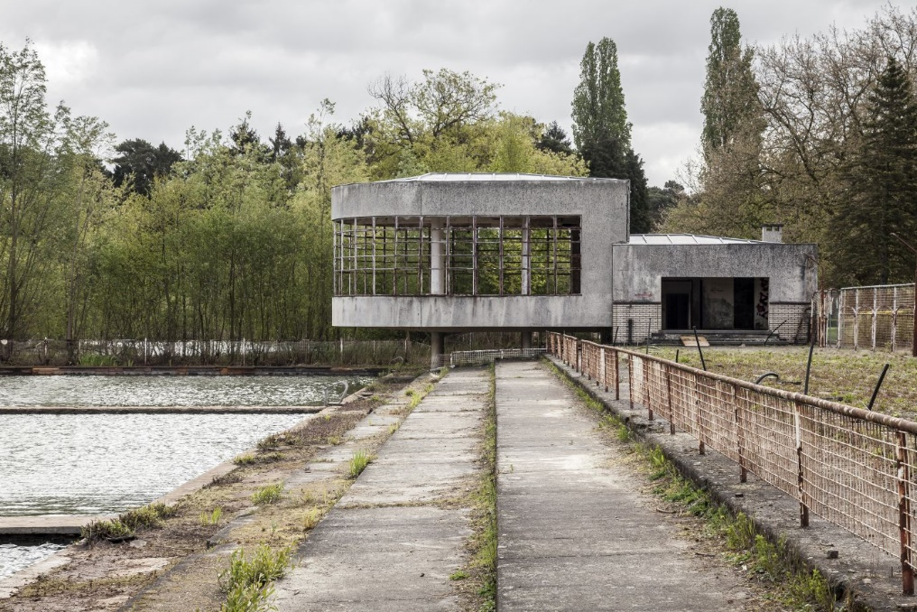
Meesterproef: an opportunity for young architects
Recently graduated architects and artists get the chance to design and realise a real public commission.
Supervised by experienced architects and experts
Different themes
  2017: repurposing heritage buildings
  2019: public housing
  2022: public housing
Meesterproef 2017 – Former open air swimming pool © Tim Van de Velde
Notes:
Recently graduated architects and artists get the chance to design and realise a real public commission.
Supervised by experienced architects and experts
Different themes
2017: repurposing heritage buildings
2019: public housing
2022: public housing

Slide 32
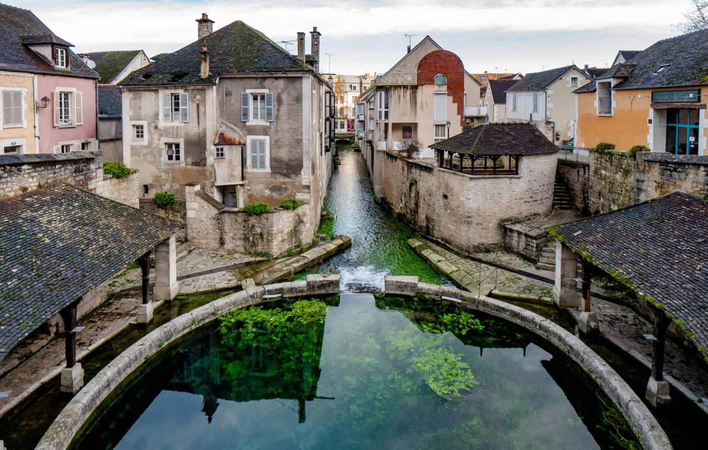
Bouwmeester Label: a small research subvention
Putting something on the agenda
Research proposal formulated by the candidates themselves
Wide range of subjects
Goal: lecture and/or exhibition
Sometimes surprising results and effects
Bouwmeesterlabel 2020 Sources of encounter – B architecten
Notes:
Putting something on the agenda
Research proposal formulated by the candidates themselves
Wide range of subjects
Goal: lecture and/or exhibition
Sometimes surprising results and effects

Slide 33
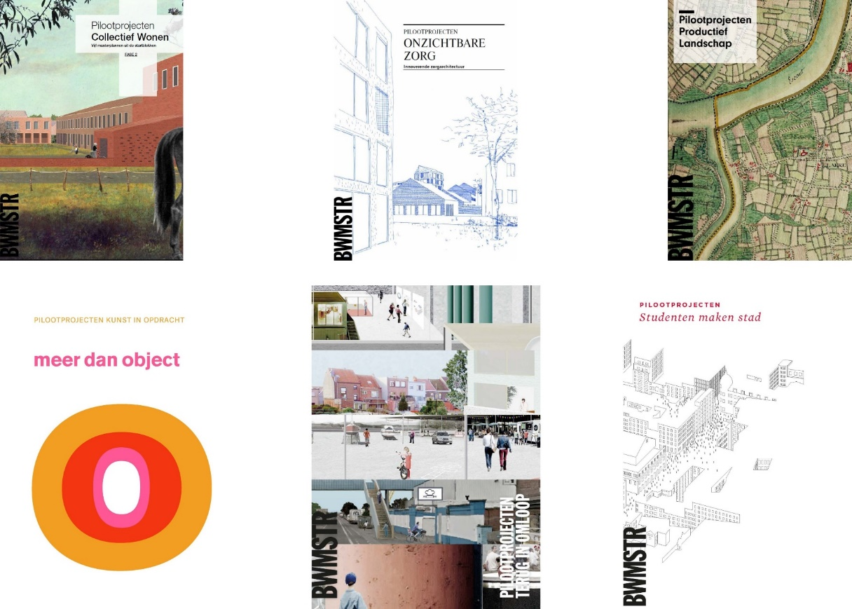
Pilotprojects
Around current and urgent themes
Link design research with the policy for the realization of groundbreaking projects.
For each Pilot project, specific alliances with the involved and relevant partners.
Elderly care, collective living, agriculture, commissioned art, student housing, reconversion of brown- and blackfields, climate districts, living neighborhoods, ...
Harbour of Zeebrugge
Notes:
Around current and urgent themes
Link design research with the policy for the realization of groundbreaking projects.
For each Pilot project, specific alliances with the involved and relevant partners.
Elderly care, collective living, agriculture, commissioned art, student housing, reconversion of brown- and blackfields, climate districts, living neighborhoods, ...

Slide 34
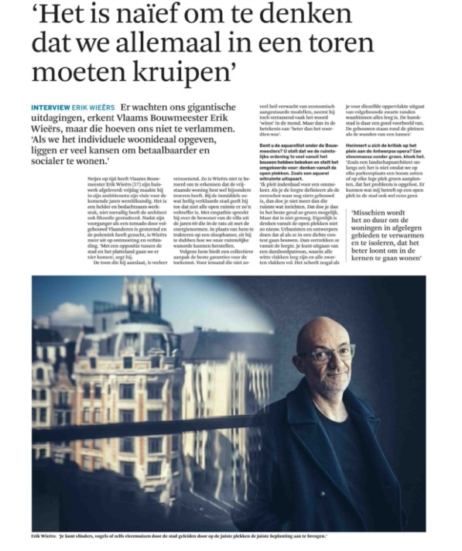
Opinions and publications

Slide 35

www.vlaamsbouwmeester.be

