Slide 1
Management Systems
07/2024 West-Kaap
Tine Moens
Het Facilitair Bedrijf
Notes:
OK

Slide 2
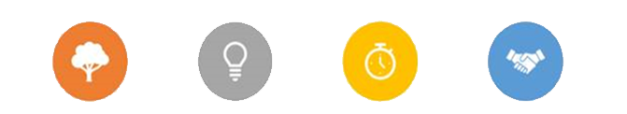
What is important to us?
We want to create a sustainable and inspiring environment for our colleagues of the Flemish government
Together we are building a government of the future
SUSTAINABLE INSPIRING EFFICIENT PROFESSIONAL

Slide 3
ISO-standard
ISO standards are a tool, not a target!
basic principles
Show commitment in words and actions
Complying with legal obligations
Controlling and continuously improving performance
Focused on significant processes in the organization
Control through processes, roles and responsibilities
Improve through measured and monitored objectives
Internal and external audits
Certification based on annual external audits

Slide 4
Continuous improvement
MANAGING BOARD
PROPERTY
TECHNICAL MANAGEMENT
Policy​
ACT
PLAN
Plan​
Management review
PURCHASE
COMMUNICATION/HR
BUILDING PROJECTS
Implementation and execution
DO
FACILITY MANAGEMENT
INTERNAL CONTROL
Check
CHECK
Notes:
Continuous improvement is central to our environmental, energy and quality management . Our environmental impact, energy efficiency and quality level must not only be guaranteed, but must also continually improve. We use the PDCA cycle for this.
Plan – we plan our actions based on our priorities
Do – we carry out our actions
Check – we check whether we will achieve our objectives with these actions
Act - we improve our actions and the way we work

Slide 5
Notes:
Waar draait het écht om?
Waarom = doelstelling
Hoe = proces
Wat = product

Slide 6
Notes:
ISO 50001/ ISO 14001/ ISO 45001: maximum reuse of people and resources, including joint certification

Slide 7
Why an ISO standard?
Guidance thanks to a systematic approach: working according to international ISO standards.
Instill confidence with an ISO certificate : We are externally certified. With this certificate, we create confidence among our stakeholders that we approach our environmental and energy management professionally and that the objectives we communicate are not empty promises.
Continuous improvement: As a government we have an exemplary role and we must be 100% compliant with the legislation. But that is not enough, we also want to continuously improve.

Slide 8
Notes:
Waar draait het écht om?
Waarom = doelstelling
Hoe = proces
Wat = product

Slide 9
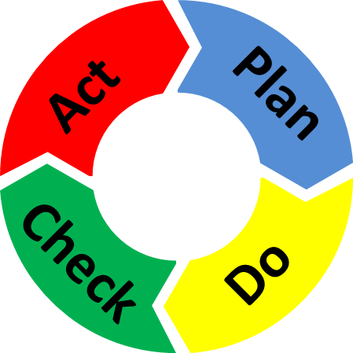
Why an ISO standard?
Promise
Achieve
Retain
Improve

Slide 10
Collaborate!
Culture Competence Tools Communication Responsibility
Notes:
OK

Slide 11
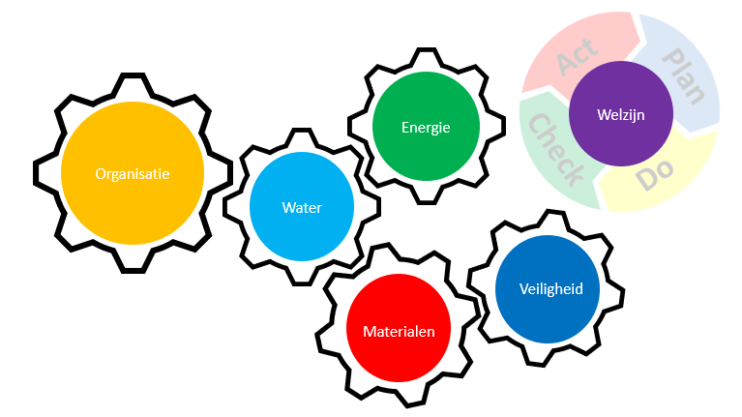
Integrate!
Notes:
OK

Slide 12
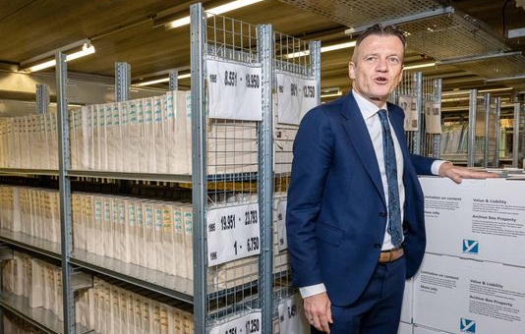
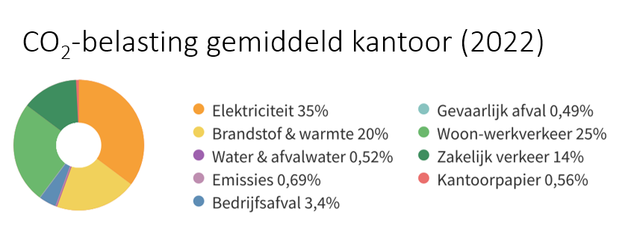
Dealing with complexity!
Notes:
Source: Environmental Barometer
Shift of environmental burden over the life cycle from energy to materials
Source: National Environmental Database Foundation

Slide 13
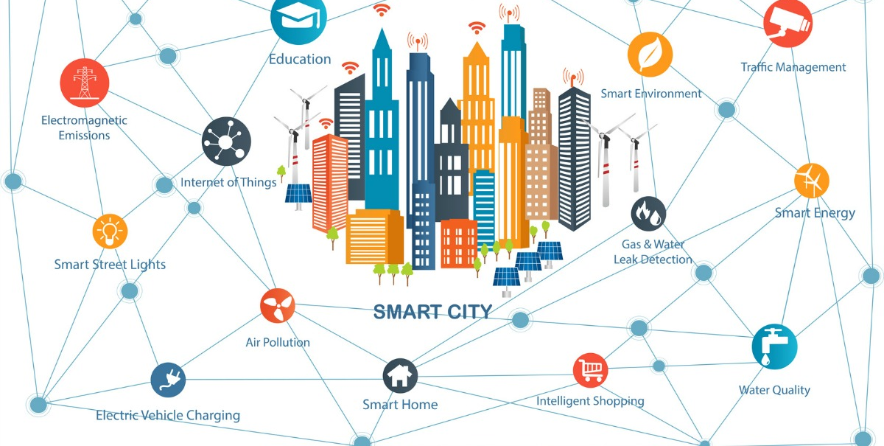

Slide 14
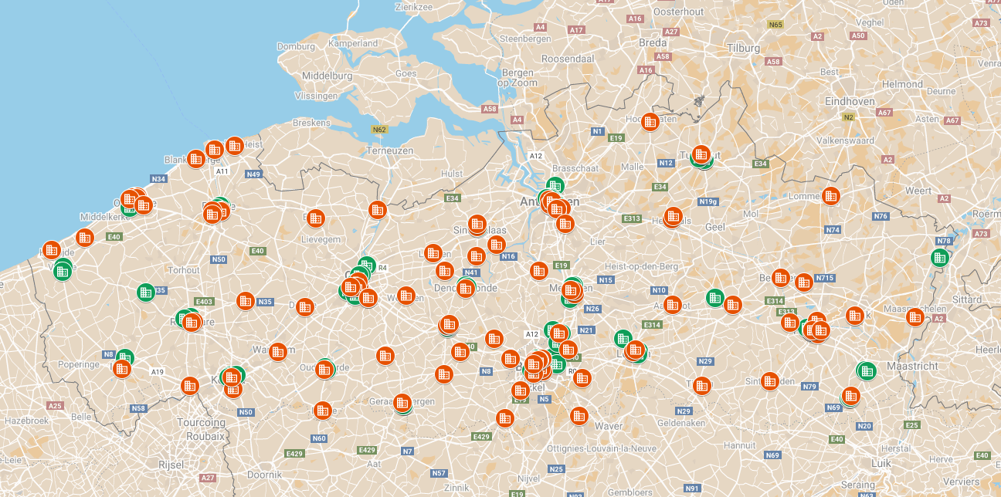
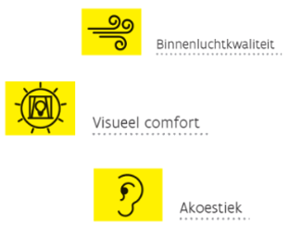
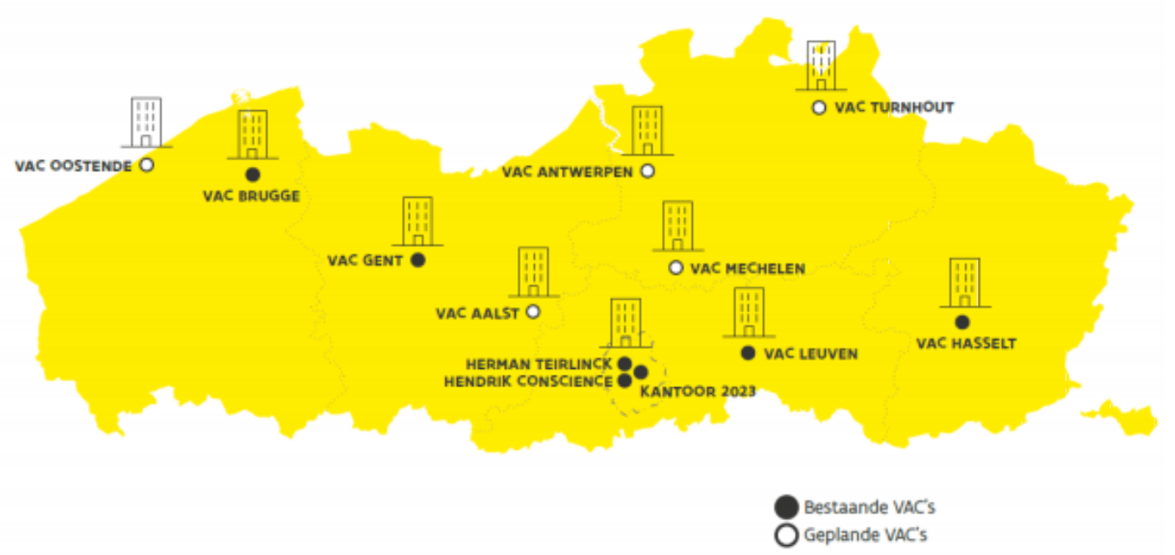
The only constant is change (Heraclitus)
Notes:
A building is a dynamic element in a dynamic context -> We need a plan

Slide 15
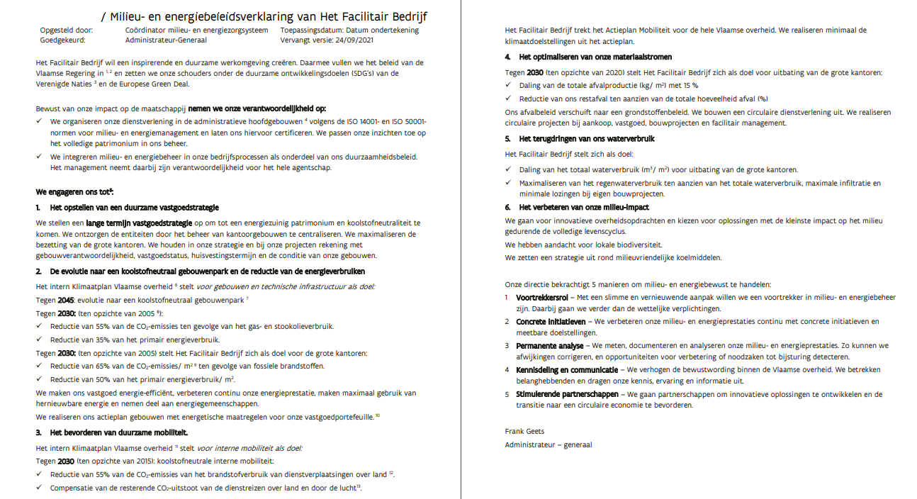
Commitment!
Large offices
2005 – 2030
- 65% CO₂
- 50% primary energy

Slide 16
Commitment!
Notes:
A thorough energy policy is not a one-hit wonder at HFB. The Facilities Department strives for higher energy efficiency in all its major projects than is stated in the current energy performance regulations . the role model of the Flemish government. Comparison of E-level building with E-level requirements that the building must meet.
Building with year of permit submission. Epeil requirement (EPB) corresponding to the period in which the building application was submitted. Since 2008, HFB has been building at least twice as efficiently as required by the government.

Slide 17
Strategy!
1. From 136 (2020) to 256 (2024) locations under management
2. Towards fewer, but more sustainable office buildings
3. Concentration in Brussels/Central cities

Slide 18
Manage!
Cost
Benefits
Cost changes
& management
Influence costs
of a project
Initiative
Design
Performance
Commissioning
Management
Amendments
Management
Design
€1
Performance
€20
Operation
€60
Time
Notes:
The quality of strategy and its implementation can only be seen and guaranteed AFTER a building has been put into use
Does the building deliver the desired performance?
Are there opportunities for improvement?
What about maintenance and management?

Slide 19
Manage!
! On average uildings consume 20% more than expected .
!70% of HVAC installations works suboptimally . - This causes 90% of comfort problems
- This are 60% due to changes during use​

Slide 20
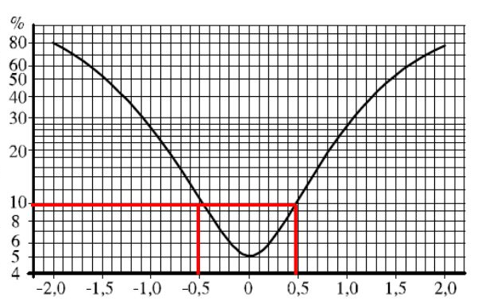
Manage!
Voorspeld % Ontevredenen
Voorspelde Gemiddelde Uitspraak (PMV)
Notes:
HSE requirements , the legislative framework surrounding Safety , Health and the Environment

Slide 21
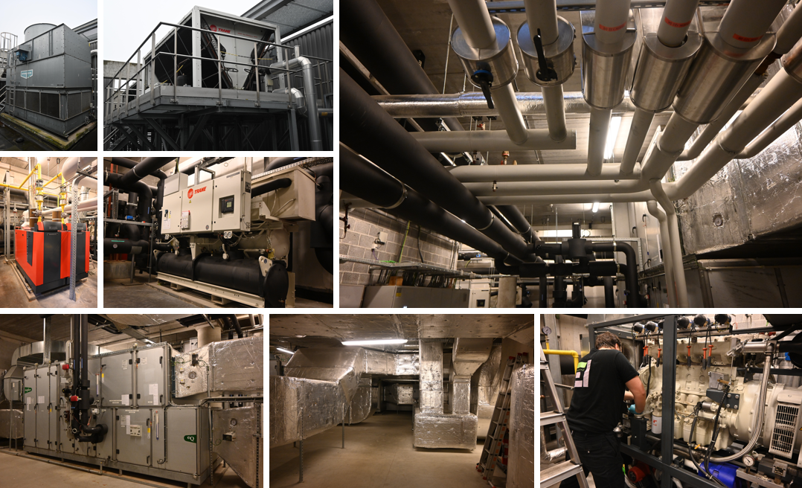
Notes:
How do we get this managed?

Slide 23
Safety and Health
For our head offices we take on the role of building manager for the employees of the Flemish government. This implies taking on the employer's obligations.
An employer must at least comply with the HSE requirements . The employer must set up, apply and manage the necessary processes.
There are projects, processes and activities for Safety and Health, but the structural framework is lacking.
ISO 45001 Safety and health management of HFB and the working environment of the employees of the Flemish government

Slide 25
Scope
Processes with significant impact
Based on context
Legislation
Sustainability policy HFB
Environmental risks
Stakeholder expectations
Notes:
OK
In all our activities with a major impact on the environment and energy
We focus on activities with a major impact on the environment . We determine this based on:
Legislation and circulars For example, we ensure that the conditions in environmental permits are complied with in our buildings.
Stakeholder survey We take into account the input of the users of our buildings and specialized entities such as the Environment Department.
Our sustainability commitments Our environmental policy is integrated into our sustainability policy.
Environmental risks We limit the risk of refrigerant gas leaks through work instructions that determine optimal maintenance of refrigeration installations.

Slide 26
Scope (2015)
HFB pays energy bills in 57 buildings
Main administrative buildings
84% of the surface area
93% of electricity consumption
86% of natural gas consumption
Local team > energy team > environmental team
Future: ISO light project for other buildings
Notes:
OK
At the start of the ISO50001 project, the Facilities Department managed approximately 140 buildings and paid the energy bills of 57 of these buildings.
the main administrative buildings were responsible for more than 80% of energy consumption.
The local team in these buildings was trained first as an energy team and then as an environmental team .
It was therefore a logical choice to define the ISO 50001 scope at the outset for these large administrative office buildings and to involve the local team in energy management.
Our large administrative buildings cover 84% of the surface area of all our buildings under management.
Our large administrative buildings have a share of 93% of our total electricity consumption.
Our large administrative buildings have a share of 86% of our total natural gas consumption.

Slide 27
Scope
Facility management of the large offices
Processes in real estate, construction projects and purchasing with a significant impact on environmental and energy management
Scope ISO 50001 = ISO 14001 = ISO 45001
Notes:
OK

Slide 28
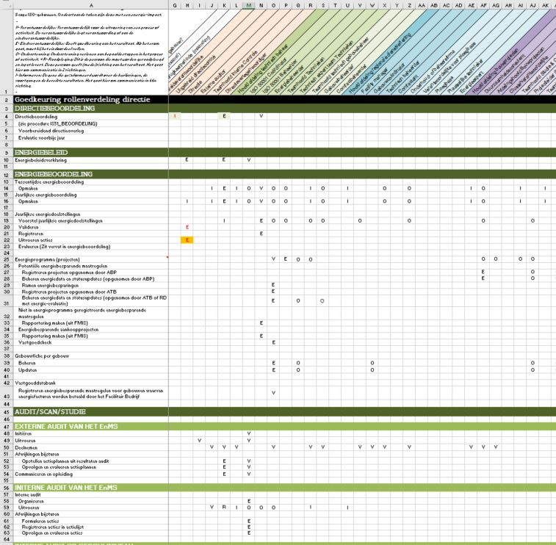
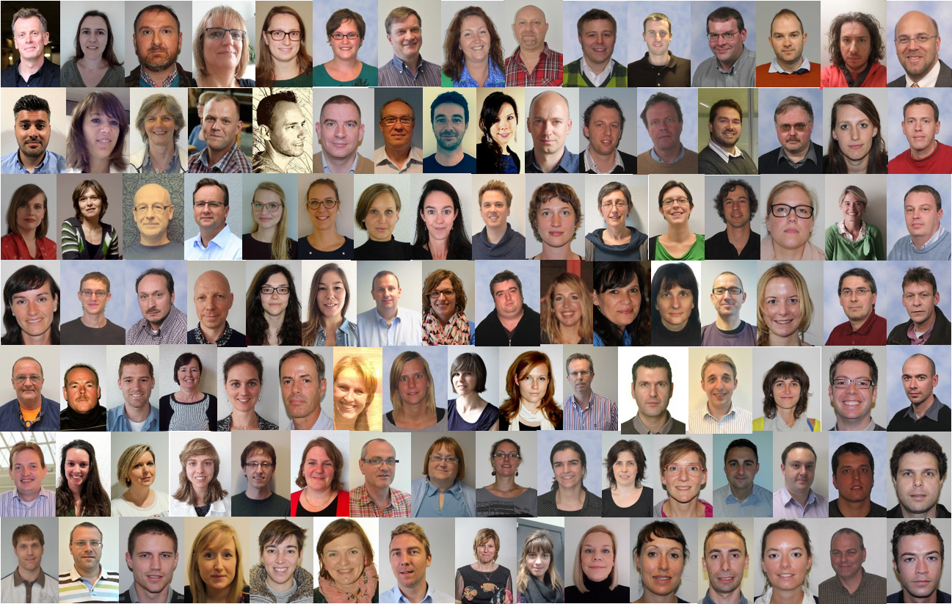
Roles and responsibilities
Notes:
OK
Culture eats strategy fior breakfast P. Drucker

Slide 29
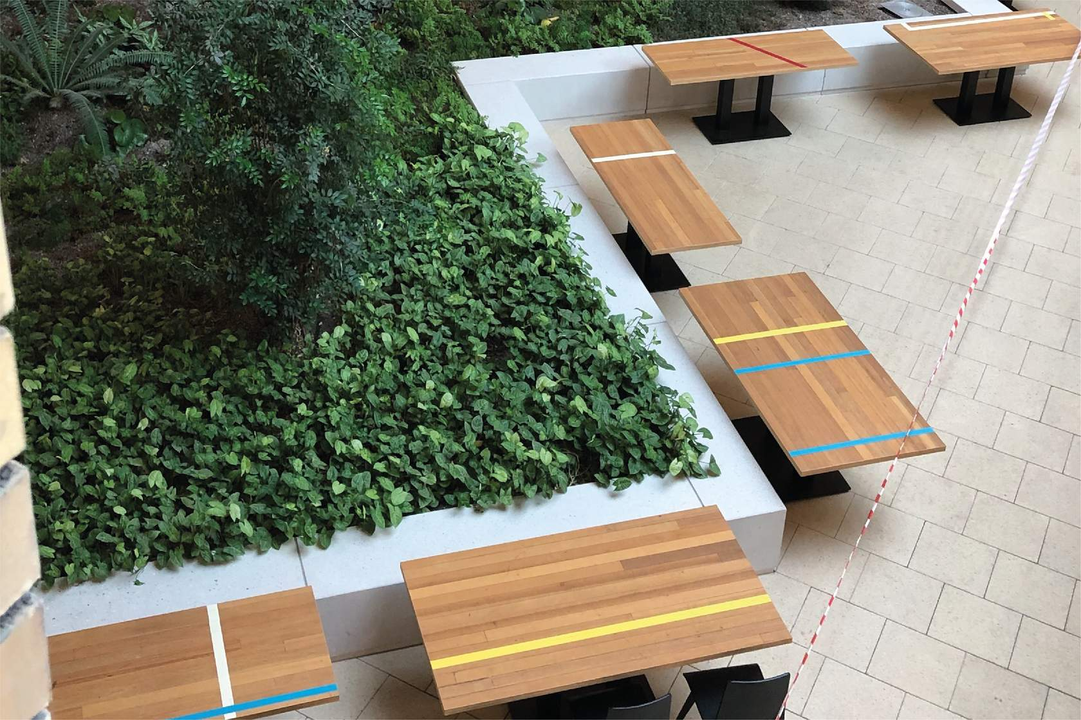
Purchase
Flemish government: major environmental impact of almost 30,000 employees and its many buildings
Environmental requirements in framework contracts provide a strong leverage effect.
Examples of environmentally friendly framework contracts: Sustainable office materials, Circular paper, Circular furniture, Green management , Mobility , Waste
Notes:
OK
With almost 30,000 employees and its many buildings, the Flemish government has a major environmental impact. These employees move, create waste, consume, ...
The impact of HFB reaches further. When purchasing products and services, the purchasing center takes environmental requirements into account. This creates a strong leverage effect. Every cutlery with attention to the environment inspires several suppliers to give the best of themselves.
Examples of framework contracts with attention to the environment: Sustainable office materials, Circular paper, Circular furniture, Packaging material , Green management , Mobility , Waste

Slide 30
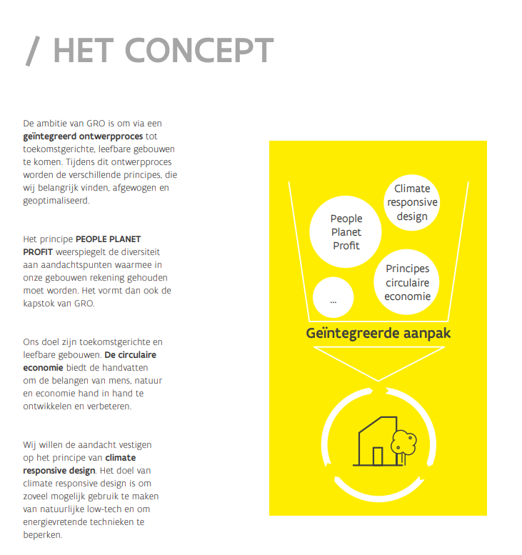
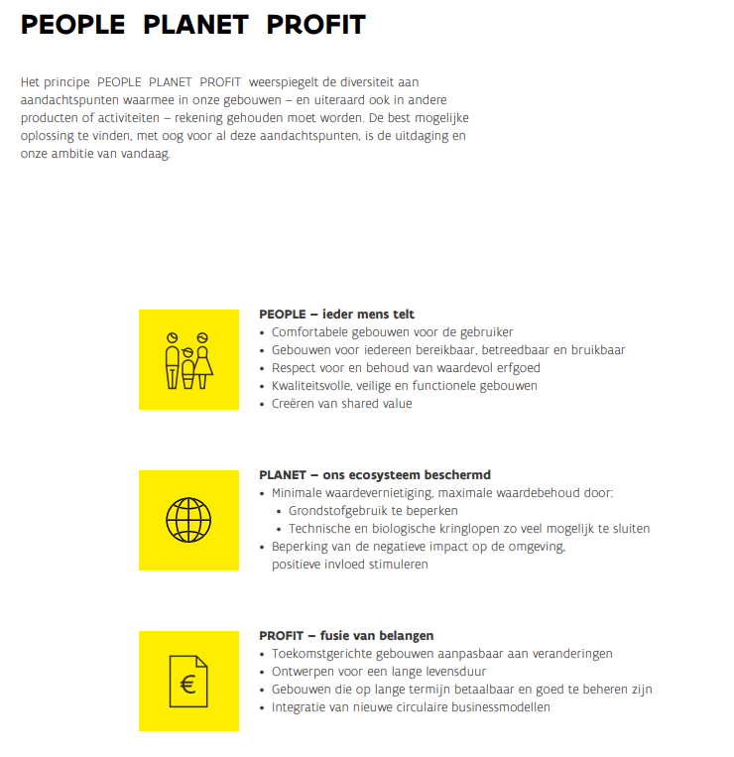
Building projects
Notes:
OK

Slide 31
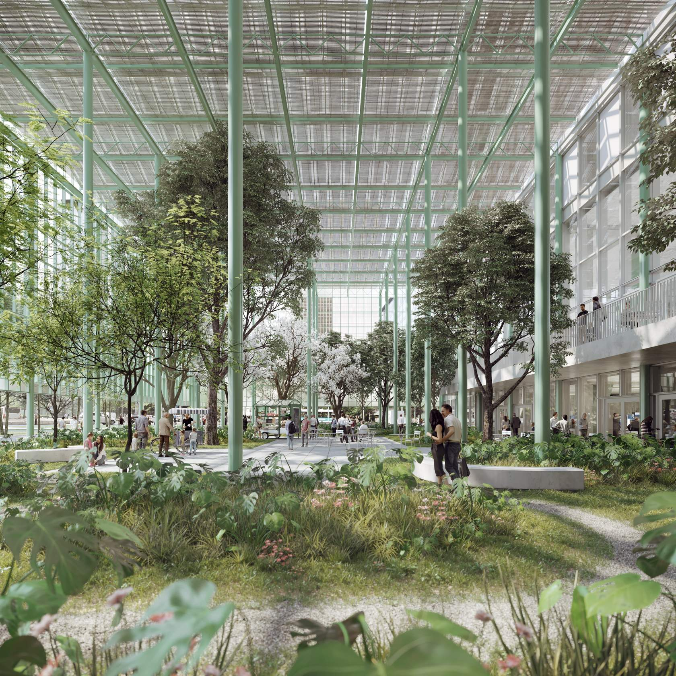
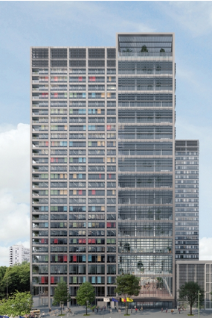
Belpaire building
Sustainability meter GRO: certificate "excellent"
E-level: E15 Cold-heat storage system in the underground, solar panels on the roof and side walls
Circularity of the construction project, Underground floors and the circulation cores of the original building are retained. What is desambled is given a new life. The new building consists of 65% reused or recycled materials
Notes:
OK
From 2023 we will move into 'Office 2023' - our new office building in the North District in Brussels: a unique, sustainable and circular building.
The design achieves the "excellent" certificate according to the GRO sustainability meter.
The E-level - which reflects the energy performance of a building - is the lowest of all our buildings (E15), partly thanks to the cold-heat storage system in the underground and the extensive applications of solar panels on the roof and side walls.
The bar is also high in the field of circularity . The underground floors and circulation cores of the original building will be retained. What is torn down is given new life. The new building will consist of 50% reused or recycled materials on site.

Slide 32
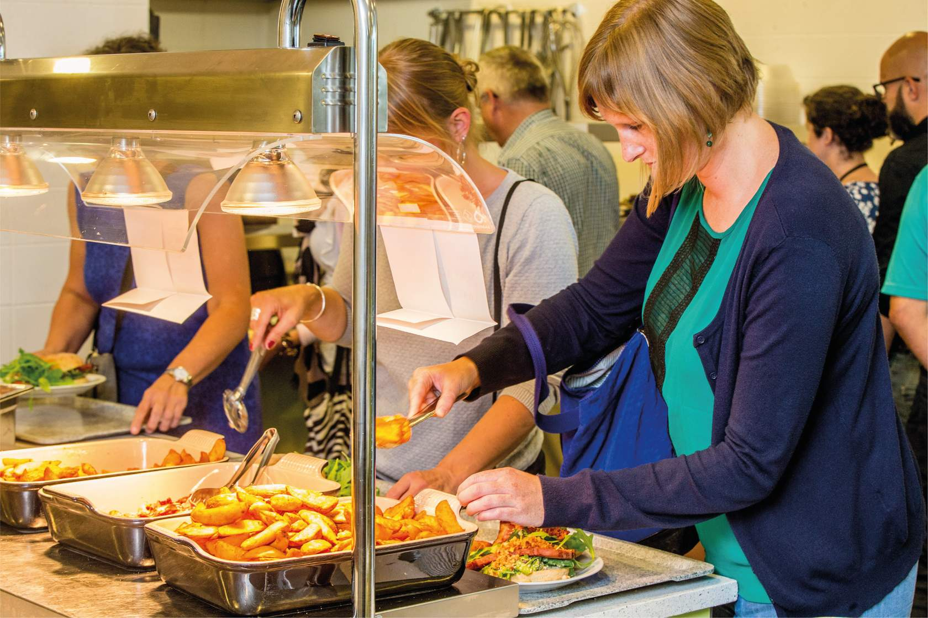
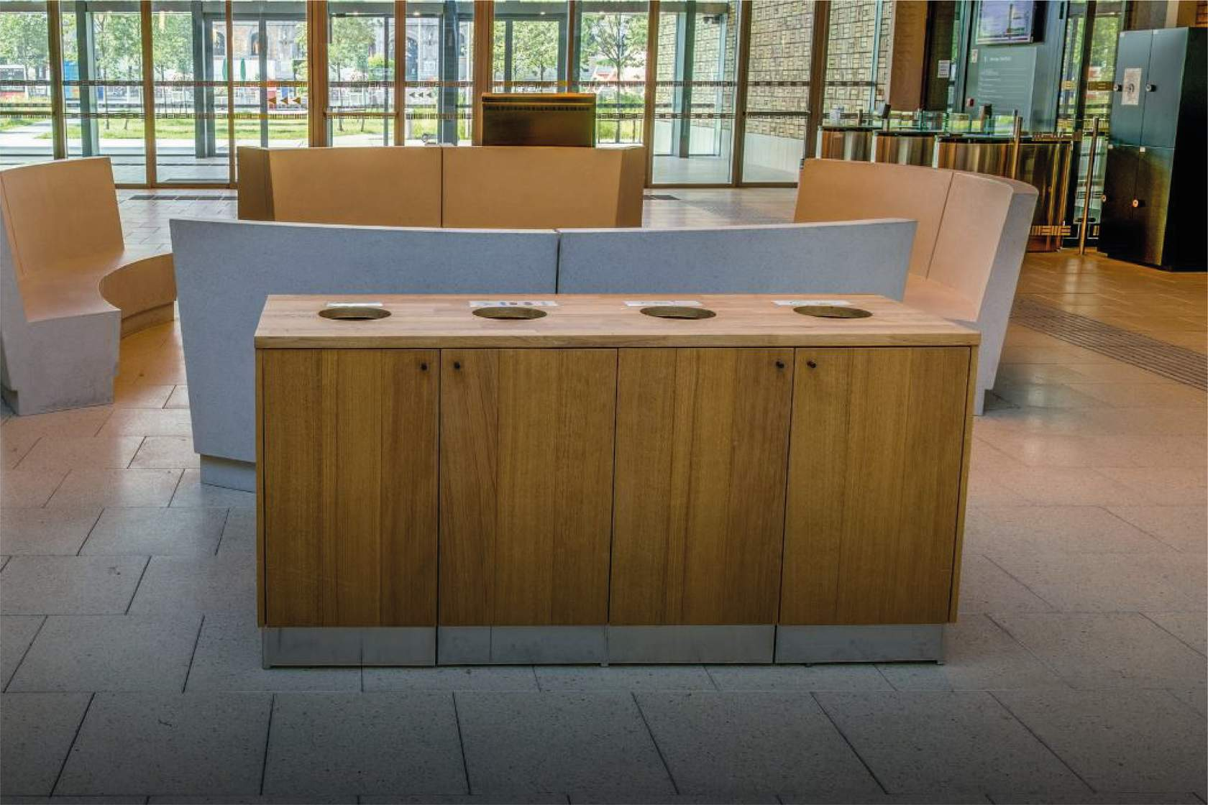
Facilities
Catering: We have a sustainable offering with an emphasis on fair trade . There is always a vegetarian and vegan alternative. In addition, we limit food loss and reduce single-use packaging to a minimum.
Cleaning: We clean with products based on good bacteria, minimizing water use. We make every effort to recycle equipment and materials.
Waste management: We strive for as little waste as possible and as much reuse of raw materials as possible. We sort as much and as cleanly as possible. Innovative solutions for high-quality recycling are sought in collaboration with suppliers.
Notes:
OK
Catering: We strive for a sustainable offering in restaurants and coffee bars. There is always a vegetarian and vegan alternative. In addition, we limit food loss and reduce single-use packaging to a minimum.
Cleaning: We clean with products based on good bacteria, reducing the use of water to a minimum. We focus on recycling for equipment and materials: toilet paper, among other things, consists of 100% recycled paper and cleaning carts consist of 90% recycled plastic.
Waste management: The waste policy in the large office buildings of Het Facilitair Bedrijf is aimed at as little waste as possible and the aim of reusing raw materials. The Facilities Department is committed to sorting waste as efficiently and as cleanly as possible. In collaboration with suppliers, innovative solutions are sought for high-quality recycling.

Slide 33
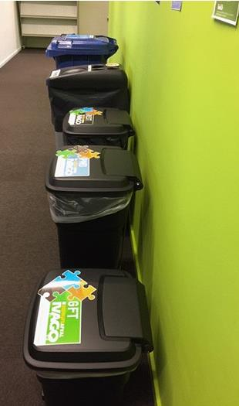
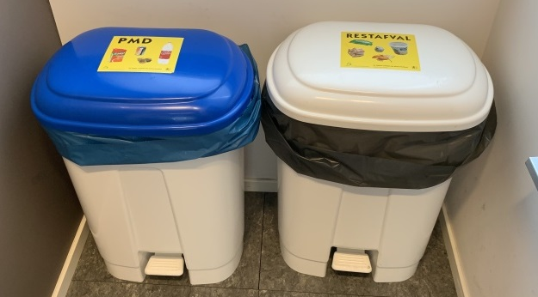
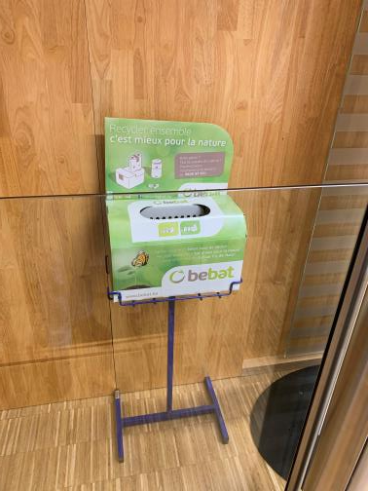
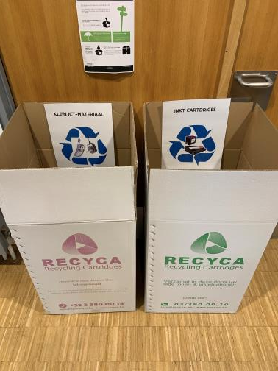
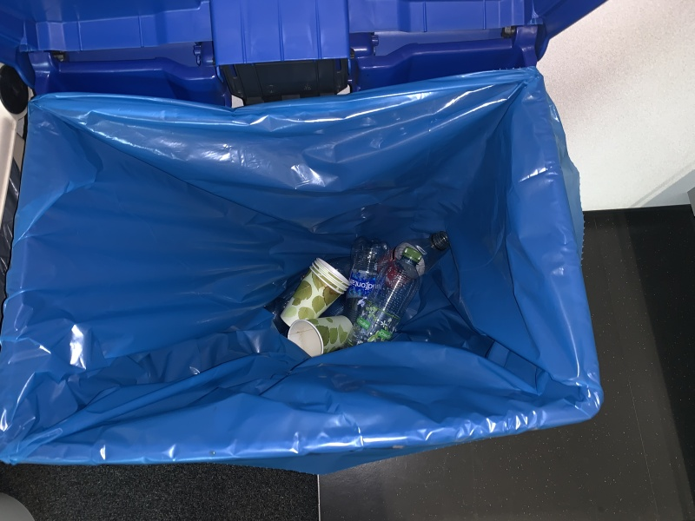
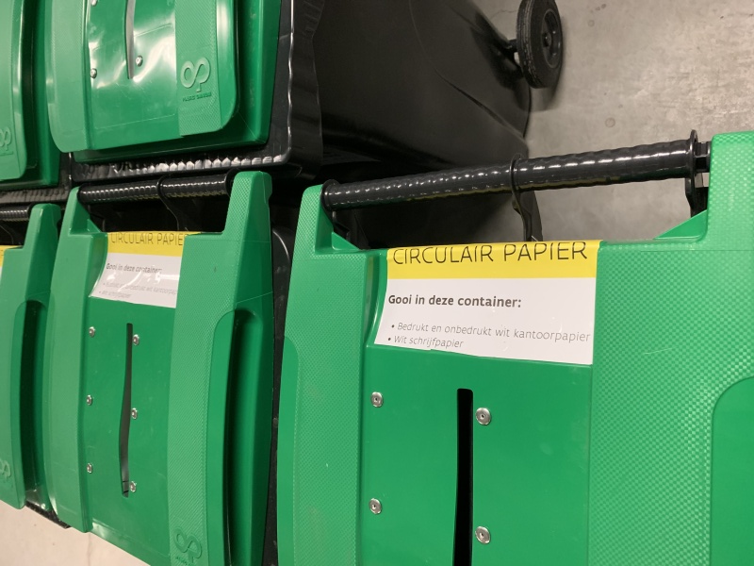
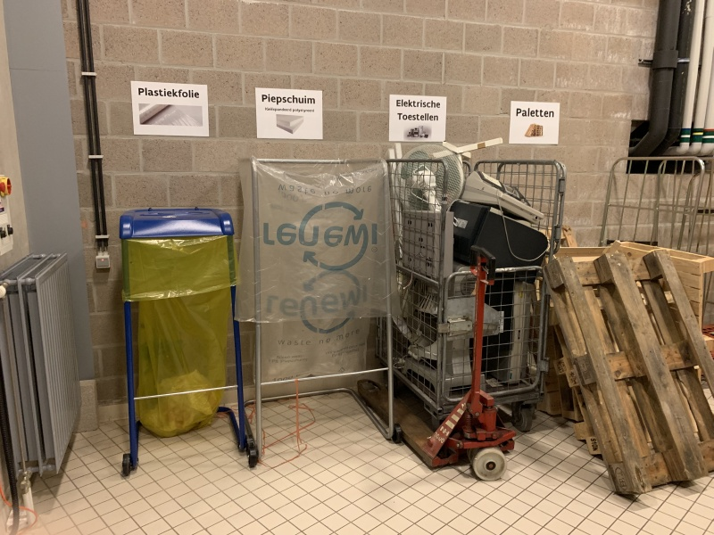
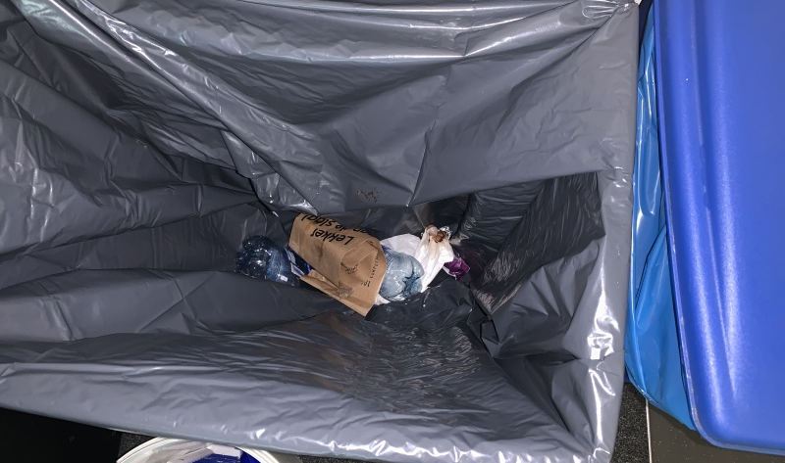
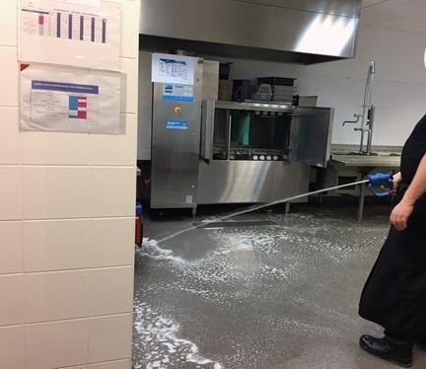
Notes:
OK

Slide 34
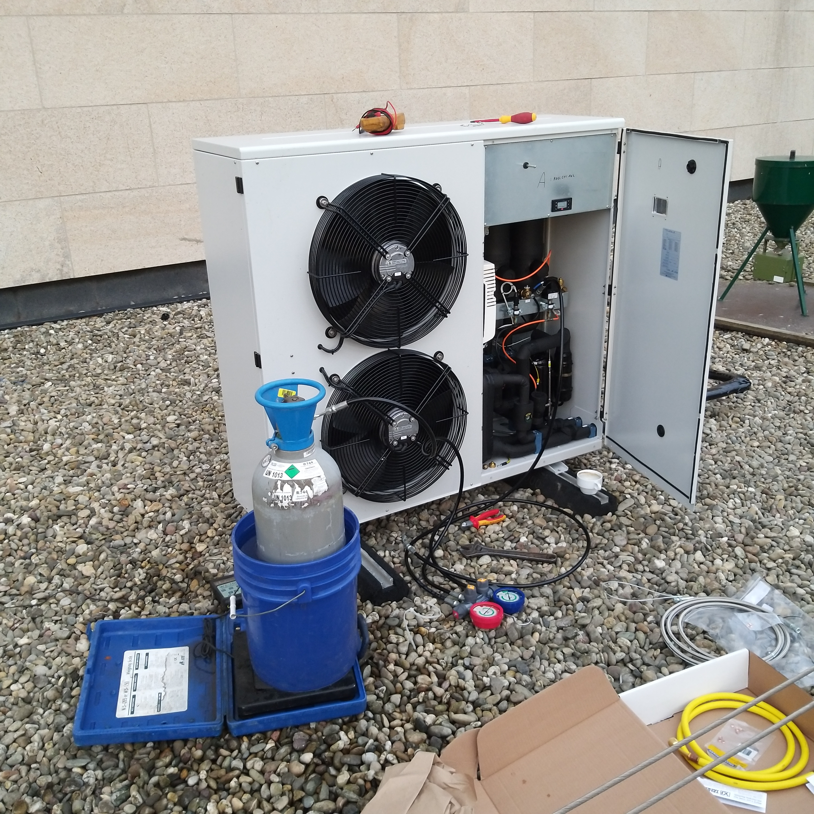
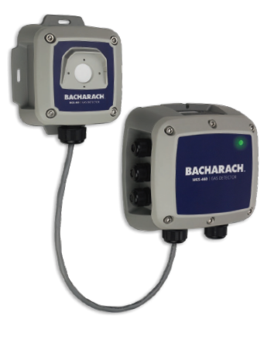
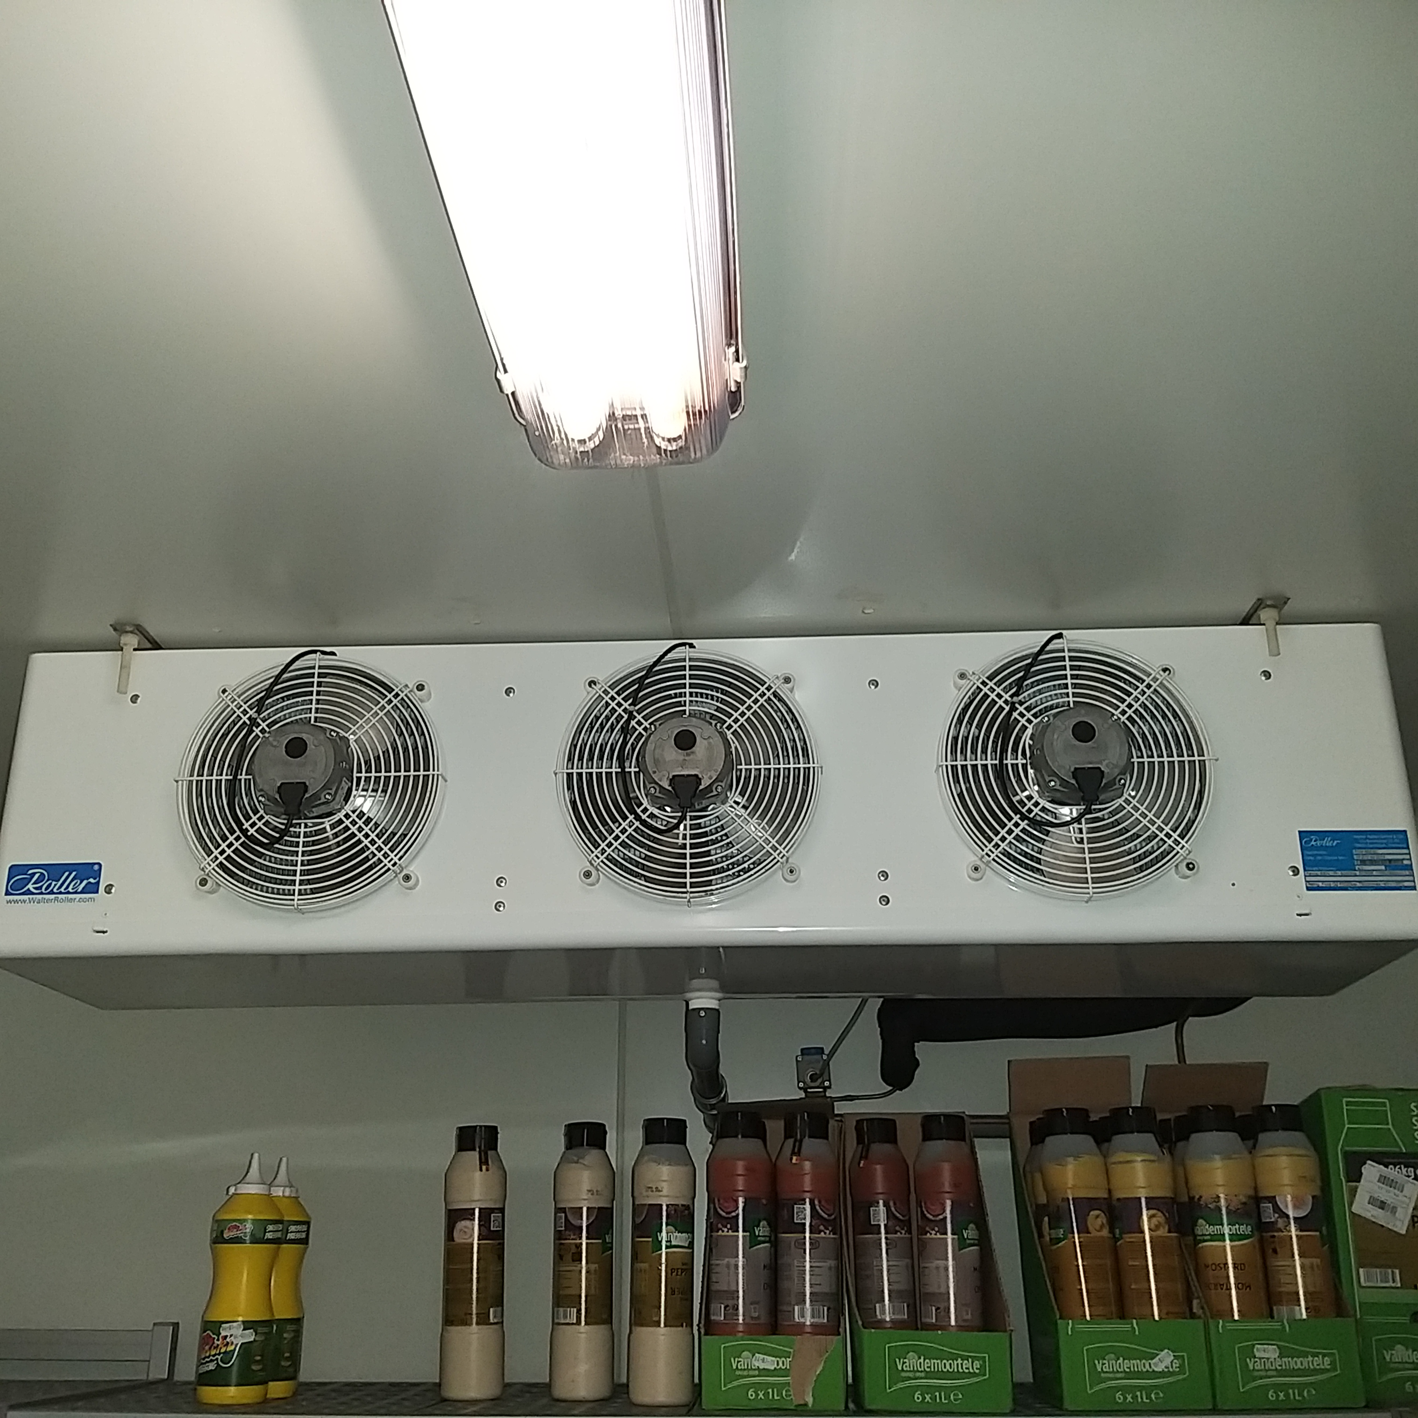
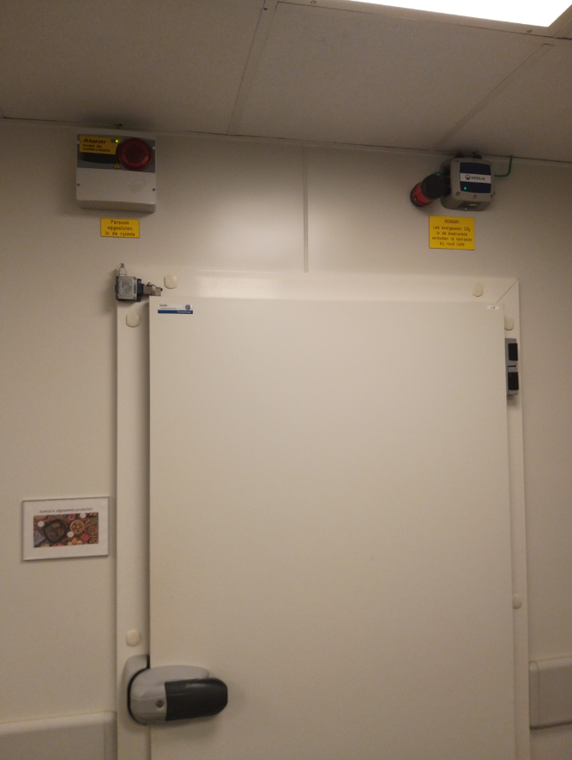
Facilities
Retrofit lighting 451 fixtures
Armature is preserved and interior is becoming replace ( LED platines )
Built-in radio module for wireless communication between modules
Payback period through energy savings is 2.6 years
Saving of ± 1 ton of plastic waste
Disposal old platines via Recupel
CO2​ cold rooms
Cold rooms controlled with 2 outdoor units on natural refrigerant _{CO2}
+ CO ₂ detection!
Notes:
OK

Slide 35
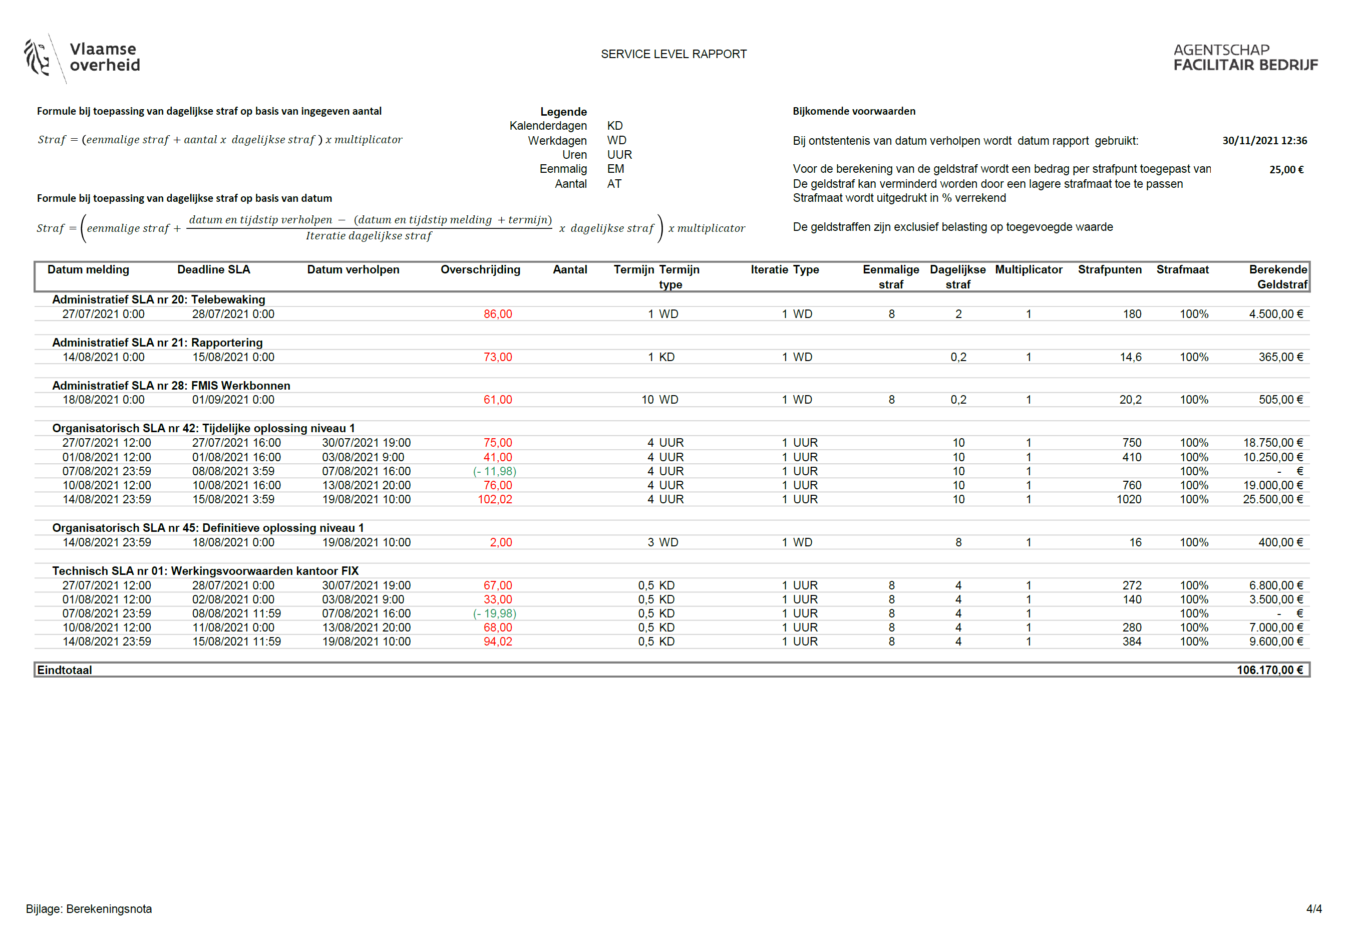
Maintenance contracts
ACTIEF ENERGIE & MILIEUBEHEER
OPVOLGING VERBRUIKEN
VERIFICATIE METERS
LOGBOEK & WERKINGSBESCHRIJVINGEN
REGELTECHNISCHE MAATREGELEN
DOELSTELLINGEN & ENERGIEBESPARENDE MAATREGELEN
OORZAAKANALYSE BIJ AFWIJKINGEN
WETGEVING BEHEERSEN
ALARMEN
DESKUNDIGHEID BIJ OPDRACHTNEMER
MANAGEMENTSYSTEEM
KOELMIDDELEN
MILIEUTECHNISCHE RONDGANG VAN DE INSTALLATIES
SERVICE LEVEL RAPPORT
Notes:
Het wetgevingsrapport is
Een generiek geautomatiseerd wetgevingsrapport met
Specifieke wetgeving per gebouw (per installatie) met opvolging
Het regionale team bewaakt het wetgevingsrapport.
Het regionale team en de onderhoudsfirma vullen aan welke attesten, keuringen,… aangeleverd werden en of er non-conformiteiten zijn met de wetgeving. Ook zorgen ze ervoor dat de vergunningen, keuringen en attesten terug te vinden zijn op de SharePoint-pagina per gebouw.
De energiebeheerder en de onderhoudsfirma zijn verantwoordelijk voor updates wanneer de wetgeving verandert.

Slide 36
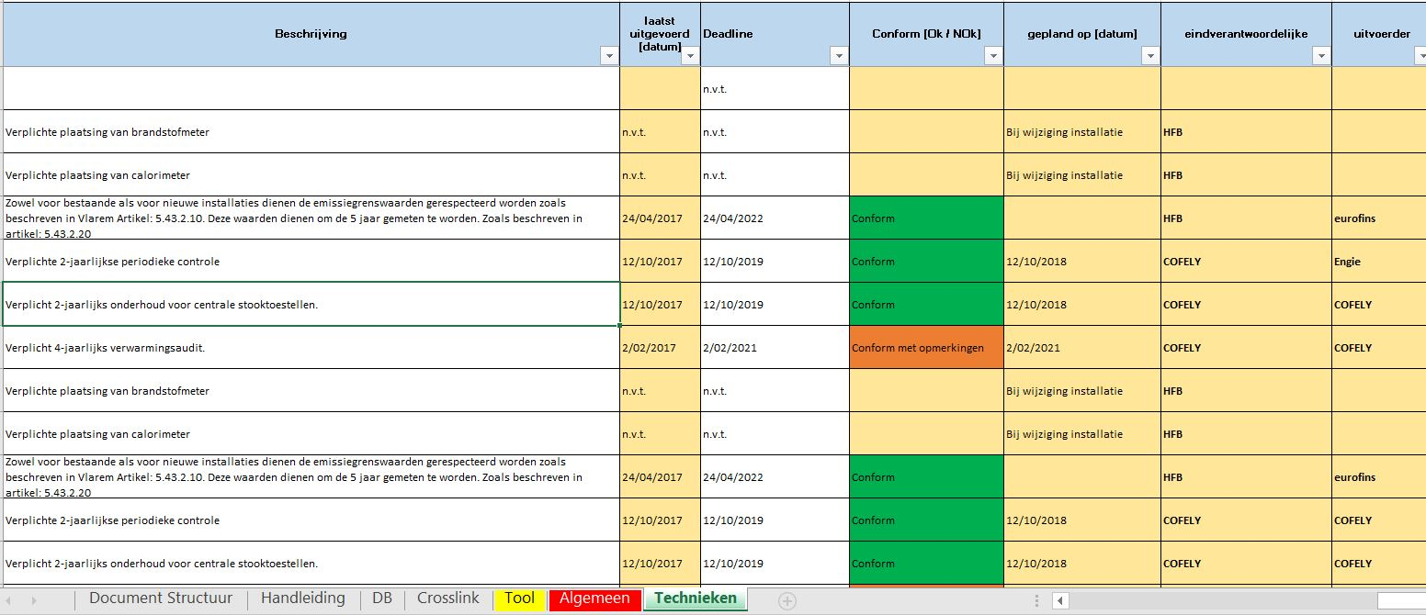
Legislative report
Notes:
The legislative report is
A generic automated legislative report with
Specific legislation per building (per installation) with follow-up
The regional team monitors the legislative report.
The regional team and the maintenance company supplement which certificates, inspections, etc. have been provided and whether there are any non- conformities with the legislation. They also ensure that permits, inspections and certificates can be found on the SharePoint page per building.
The energy manager and the maintenance company are responsible for updates when legislation changes.

Slide 37
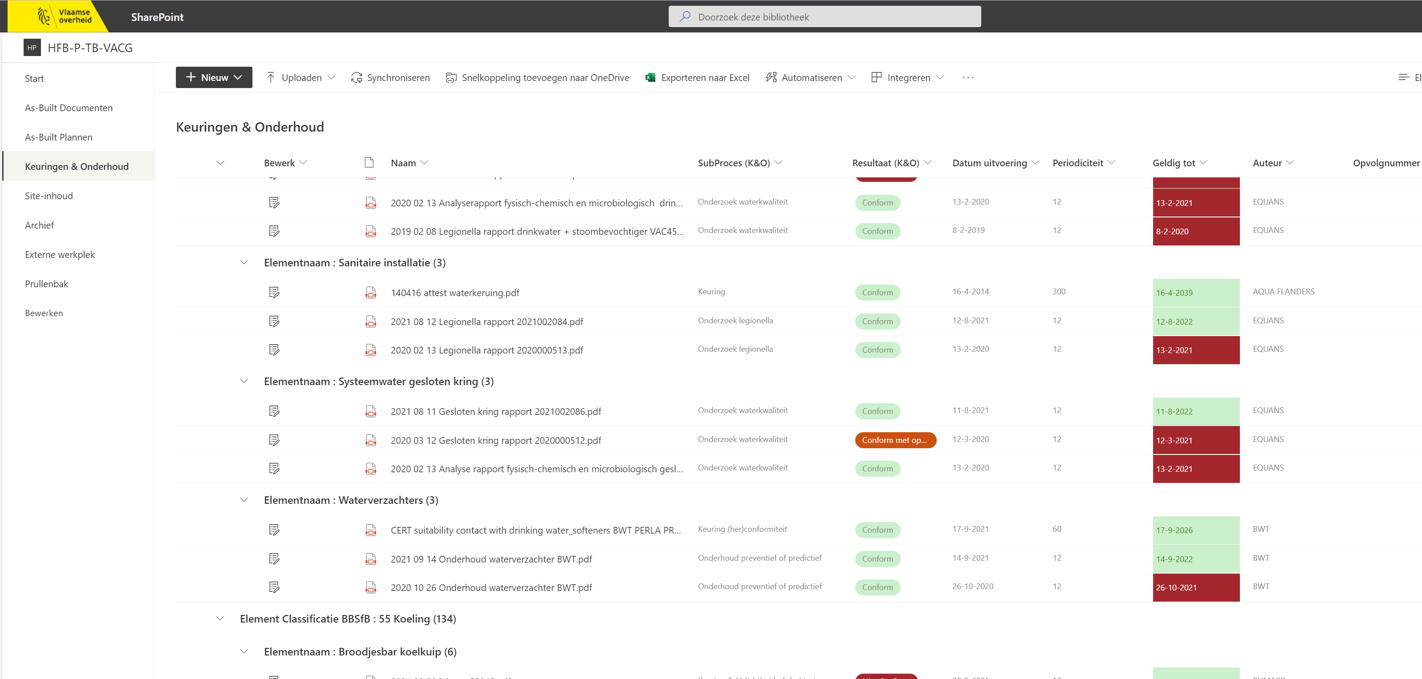
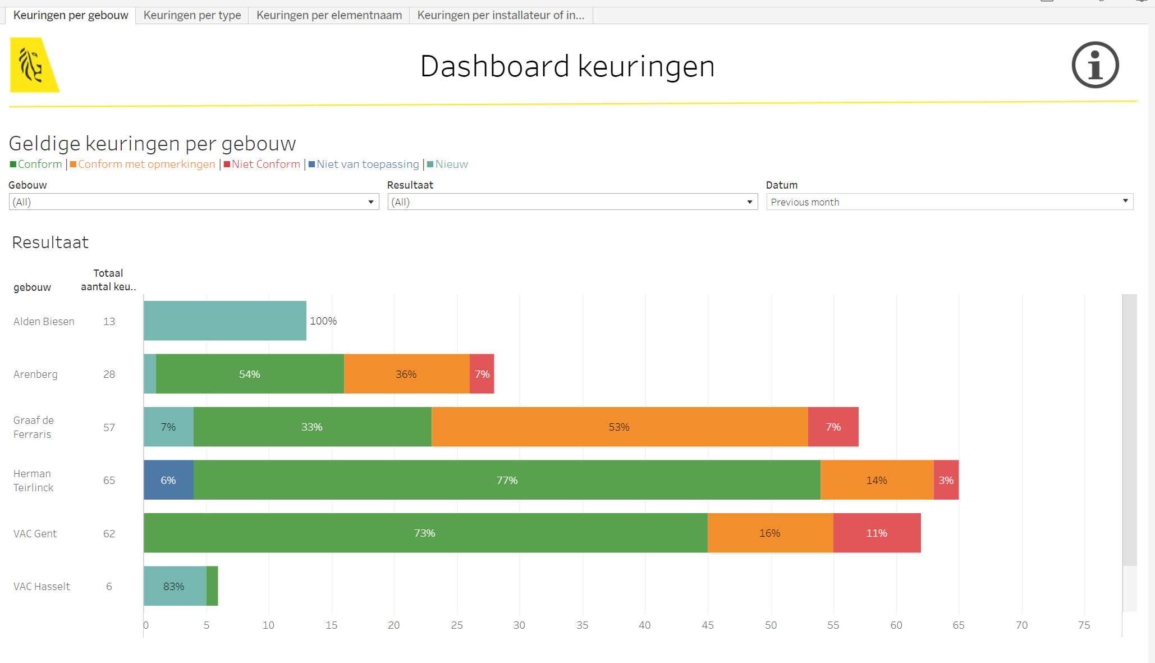
Tests and certificates
Notes:
Document management via SharePoint
To leave from the document
Information legislative report as metadata
Charging location per building
Classification system as common sharer
Naming based on name generator
Extensive sorting , filtering and search functions
Uniform approach
Dashboard reporting
At document level
Based on metadata
Monitoring trends in legal compliance
Detecting a drop in compliance
Detecting increased deviations
Compare buildings

Slide 38
Conformity Audits
Transformers, Permanently installed batteries, Charging stations for electric vehicles, Emergency groups (diesel engine and diesel tank), Vehicle storage, Refrigeration installations, Combustion installations, Storage of hazardous products or waste, Air compressors, Gas extinguishing systems, Water purification, Ventilation,...
Framework contract
Compliance
Notes:
Conditions for classified establishments may apply to
Support through framework contract compliance

Slide 39
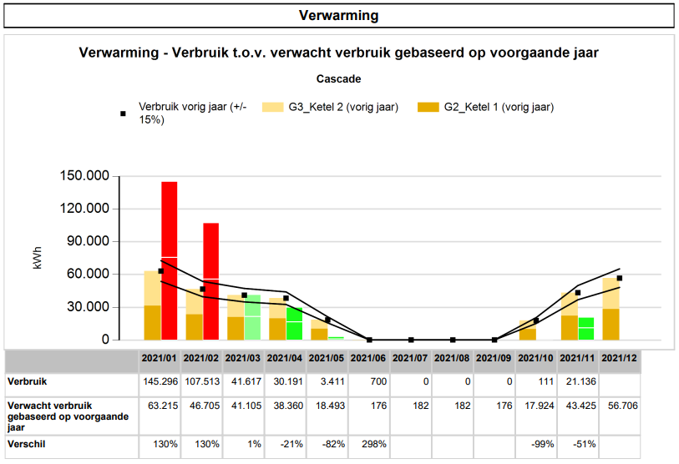
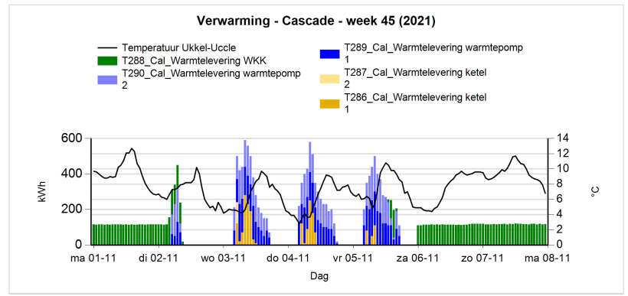
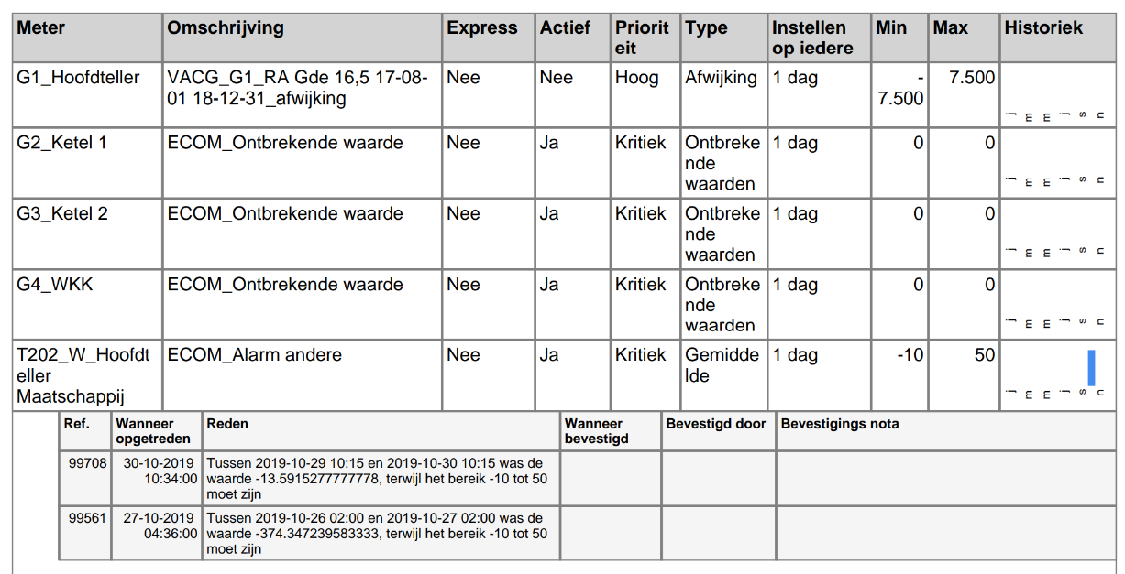
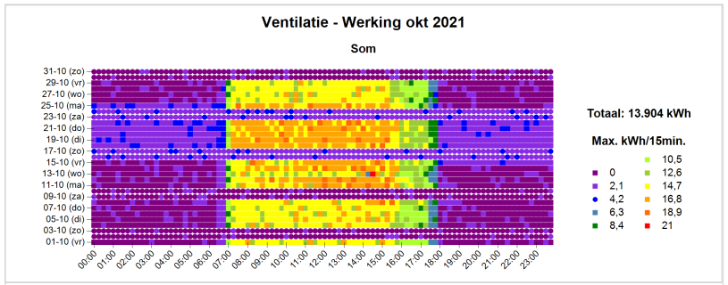
Performance reports and alarms
Notes:
1. Performance follow-up vs. reference
consumption last year, expected consumption and reference
outside tolerance band => deviation
2. Color plot
consumption per quarter in color scale
detection deviations e.g.:
Correct clock settings
Operation at night, weekends & holidays
Sleep consumption
3. Analysis of cascade systems
heat & cold production
with 2 or more ≠ production units
knowledge required about operating description
weekly basis per hour & monthly basis per day
detection abnormalities e.g.:
Part
Moment of operation based on average. outside temperature
Operation at night, weekends & holidays
4. Alarms
1. Continuous follow-up
Quickly detect abnormal energy & water consumption
Listing in energy performance report
2. Set alarms
effective & accurate:
↑ alarms -> effectively detect problem
↓ false alarms
≠ factors (e.g. occupancy, time, temperature, events, etc.)
trial & error -> time spent!

Slide 40
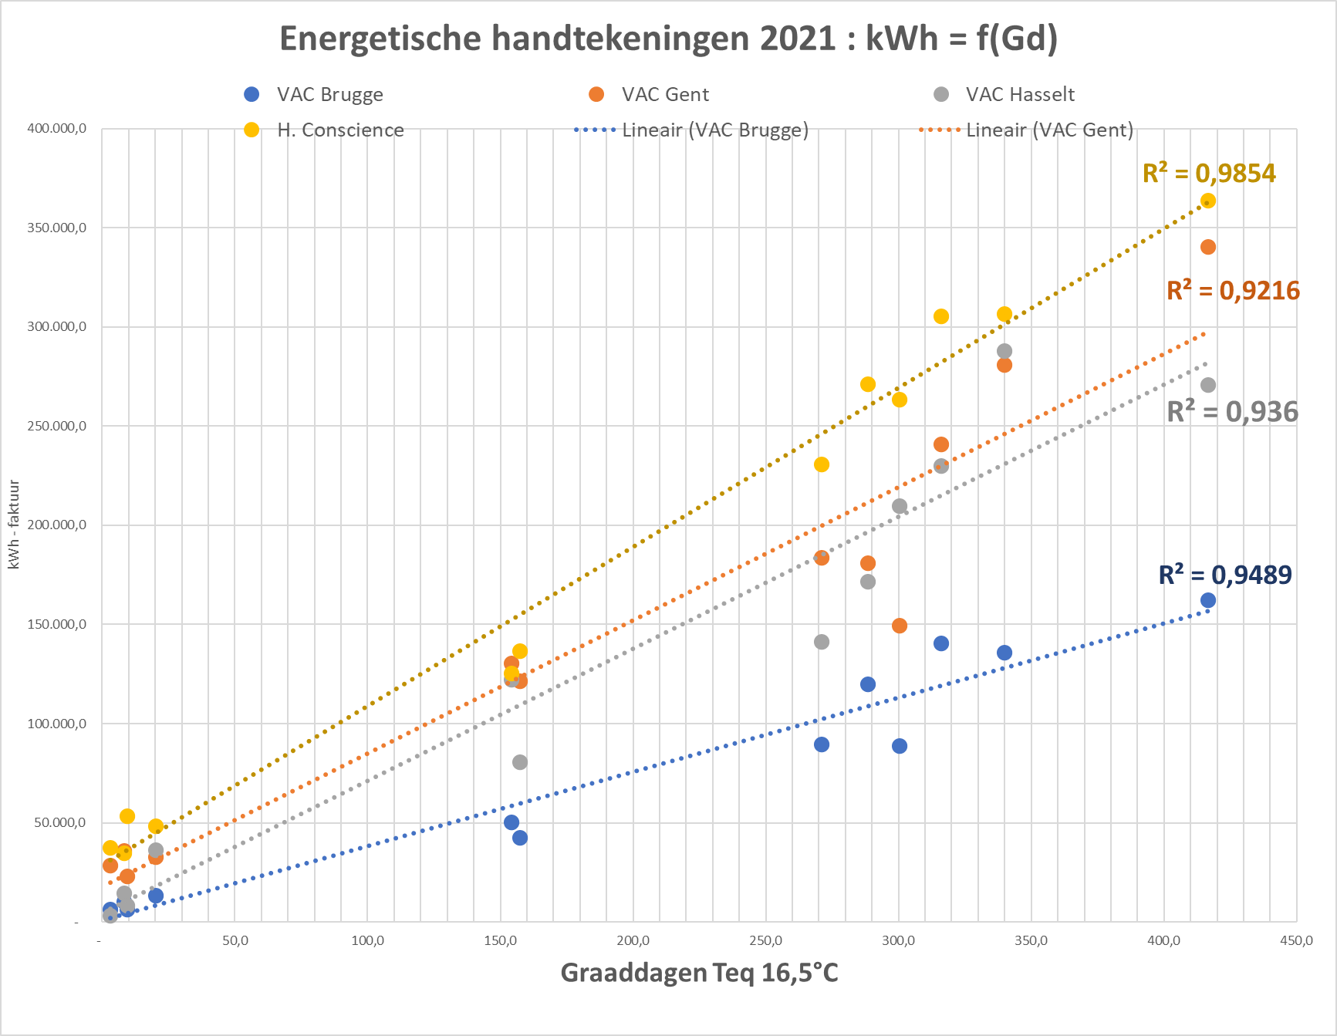
Energy Performance Reporting
kWh (factuur)
Notes:
From now on, the absolute error on the calculated consumption is known with 90% certainty. Most useful for performance contracts (bonus-malus)

Slide 41
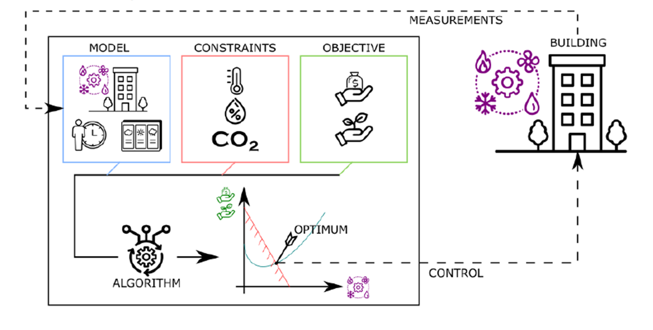
Pilot projects
Building model with optimization of setting parameters for valves, installations and control systems
Model predictive control
From reactive to predictive
Based on predicted climate, occupancy,…
Machine learning & Real data
Pilot project: Shayp ( water consumption algorithm )
Detection of deviations/interrupted consumption
Notes:
No more heating in the morning and cooling in the afternoon

Slide 42
Lessons learned
Notes:
OK

Slide 43
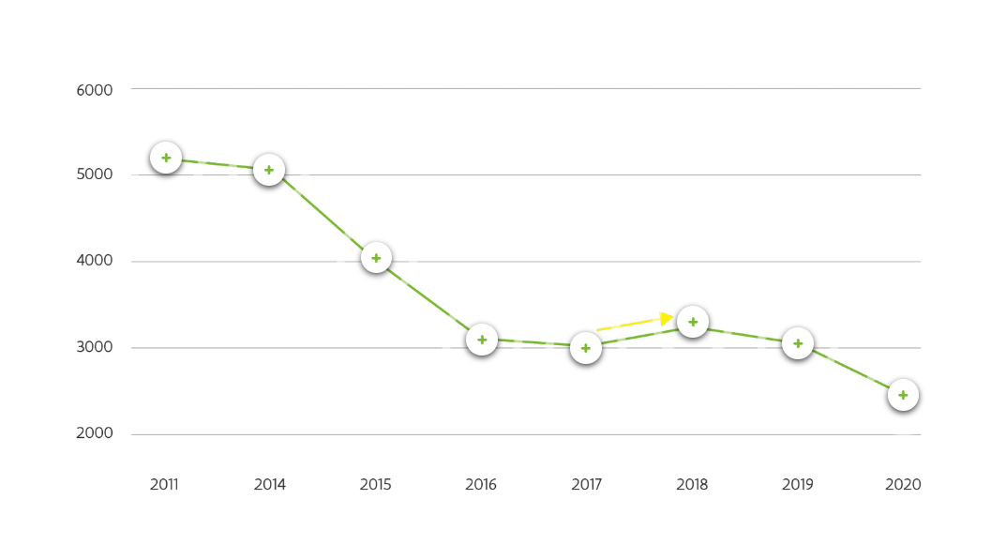
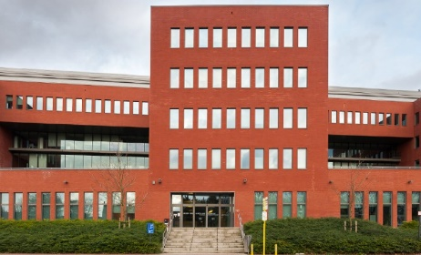
VAC Bruges 2011
Commissioning Jacob Van Maerlant
Calculated energy consumption 20% lower than required by legislation
Notes:
OK
2011
Commissioning of the Jacob van Maerlant building (VAC Bruges)
The calculated energy consumption of the VAC Brugge was 20% lower when the building was designed than what the legislation imposed.

Slide 44
VAC Bruges 2014
Improvement of electrical control
Costs 30,000 EUR
Savings EUR 60,000/year
Payback period is half a year
Rental agreement 25 years
Savings over the rental period of EUR 1.5 million
Notes:
OK
2014
Energy saving measures
After the building was completed, we looked at whether the HVAC and electrical controls could still be improved. The cost for this improvement was EUR 30,000, but would mean a saving of EUR 60,000 per year. In other words, we earned back the investment after just six months.
The building's lease is 25 years. Over this entire period, the improvement would save us 1.5 million euros. At least if the improvement was thoroughly monitored by daily energy management…

Slide 45
VAC Bruges 2014
Improvement of electrical control
Costs 30,000 EUR
Savings EUR 60,000/year
Payback period is half a year
Rental agreement 25 years
Savings over the rental period of EUR 1.5 million
Energy consumption fell by more than a third over 5 years!
Notes:
OK
2014
Energy saving measures
After the building was completed, we looked at whether the HVAC and electrical controls could still be improved. The cost for this improvement was EUR 30,000, but would mean a saving of EUR 60,000 per year. In other words, we earned back the investment after just six months.
The building's lease is 25 years. Over this entire period, the improvement would save us 1.5 million euros. At least if the improvement was thoroughly monitored by daily energy management…
2018
Sharply decreasing energy consumption
Energy consumption fell by more than a third over 5 years. The results of the improvements and energy management were promising. But...

Slide 46
VAC Bruges 2018
Increase in consumption by 7.5%
Causes
New warm kitchen
Warm summer with change in set points
Problems with lighting control and no parts in stock
Notes:
OK
2018
Sudden increase in consumption
In 2019, energy consumption suddenly increased by 7.5%. The causes of this increase:
We installed a warm kitchen.
We fine-tuned the electrical control for an average Belgian climate. However, 2019 was a very warm summer, with many comfort complaints. We adjusted the cooling set points, which caused the building to consume more.
There were problems with the lighting control. Spare parts were not immediately in stock and took a long time to arrive. The light often stayed on.
We could not foresee all these causes, but with preventive maintenance and a critical inventory of spare parts , we could have prevented part of the problem. Furthermore, it is important that we return the set points to their original settings as quickly as possible after a change.

Slide 47
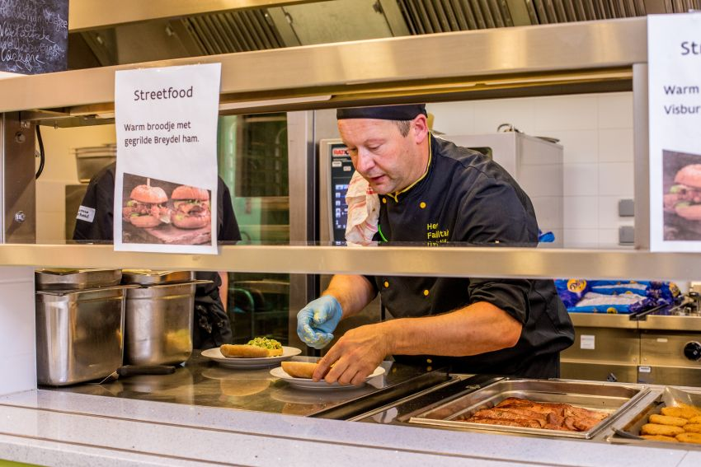
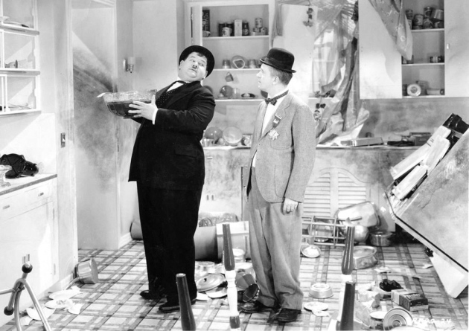
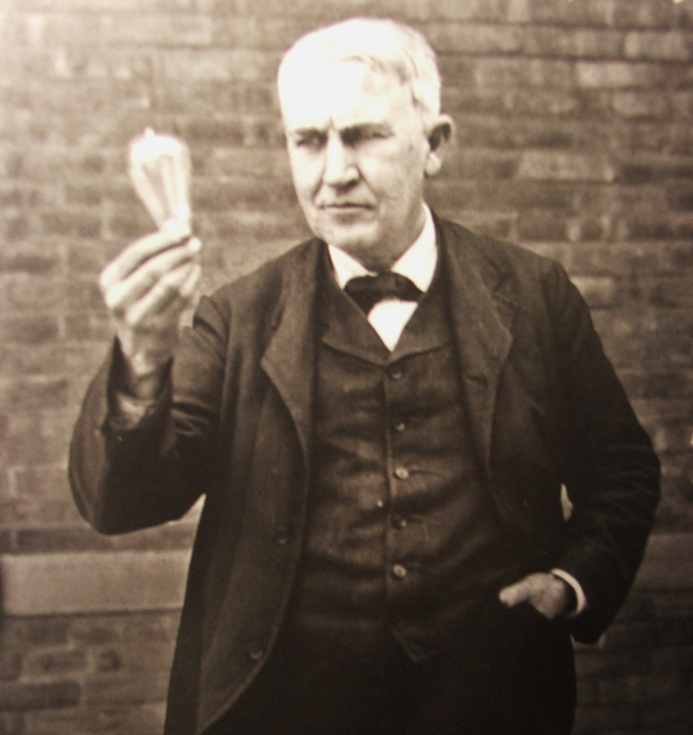
VAC Bruges Lessons Learned
IMPORTANCE OF MANAGEMENT
Preventive maintenance
Critical stock of pieces
Return set points to original setting
Notes:
OK
2018
Sudden increase in consumption
In 2019, energy consumption suddenly increased by 7.5%. The causes of this increase:
We installed a warm kitchen.
We fine-tuned the electrical control for an average Belgian climate. However, 2019 was a very warm summer, with many comfort complaints. We adjusted the cooling set points, which caused the building to consume more.
There were problems with the lighting control. Spare parts were not immediately in stock and took a long time to arrive. The light often stayed on.
We could not foresee all these causes, but with preventive maintenance and a critical inventory of spare parts , we could have prevented part of the problem. Furthermore, it is important that we return the set points to their original settings as quickly as possible after a change.

Slide 48
Notes:
OK

Slide 49
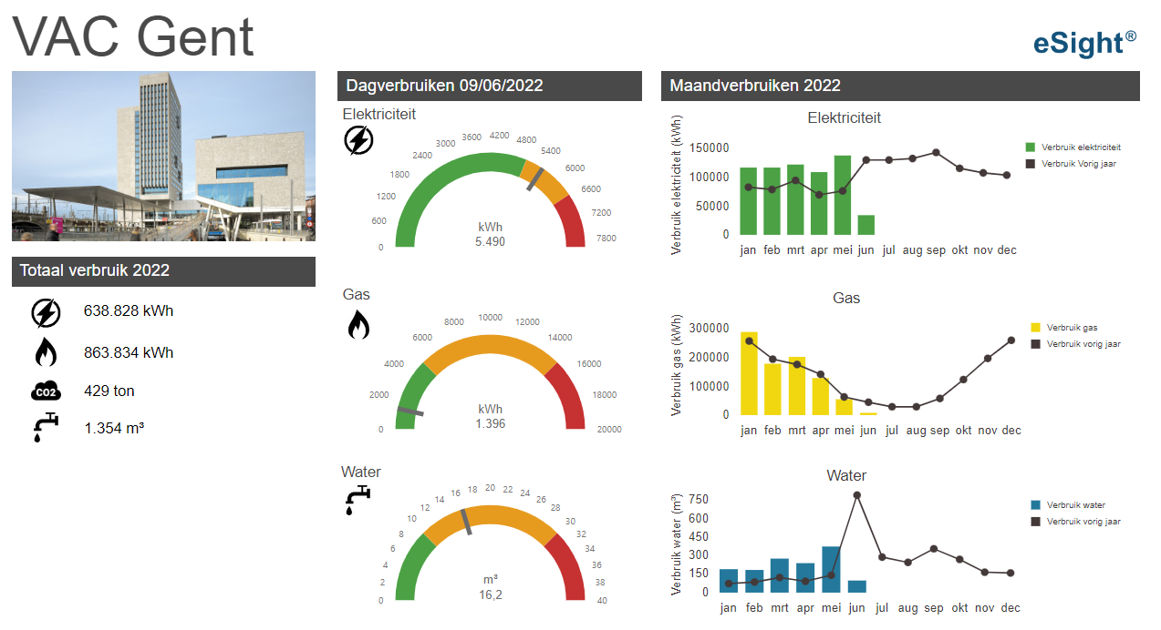
Dashboards
Notes:
OK

Slide 50
Notes:
OK

Slide 52
Management review
Notes:
OK
Reduction of 50% of primary energy consumption/m2
The target for primary energy consumption per m² is currently 50%.
Due to the strong increase in occupancy in our buildings (+93%), there was an expected significant increase in electricity consumption and therefore also in primary energy consumption, but due to the additional measures in the context of the energy crisis, there is primarily a status quo achieved.
Given the temporary nature of the additional measures in the context of the energy crisis, this status quo is a better result than in a standard year. The reduction in primary energy consumption per m² that we are currently achieving as a result of increasing occupancy is around +/- 47% in a standard year.
Reduction of 65% of CO2 emissions/m2
The target for CO2 emissions per m² due to fossil fuels is currently 65%.
Due to the additional measures in the context of the energy crisis, in particular the reduction of the comfort temperature to 19°C, a large reduction in CO2 emissions has been achieved in 2022. Given the temporary nature of this measure, this large reduction is probably a one-off . The actual CO2 emissions that we have to take into account are those of 2021 and amount to -56.3%.

Slide 53
Energy consumption [ kWh _{pr} /workplace]
Notes:
OK
Reduction of 50% of primary energy consumption/m2
The target for primary energy consumption per m² is currently 50%.
Due to the strong increase in occupancy in our buildings (+93%), there was an expected significant increase in electricity consumption and therefore also in primary energy consumption, but due to the additional measures in the context of the energy crisis, there is primarily a status quo achieved.
Given the temporary nature of the additional measures in the context of the energy crisis, this status quo is a better result than in a standard year. The reduction in primary energy consumption per m² that we are currently achieving as a result of increasing occupancy is around +/- 47% in a standard year.
Reduction of 65% of CO2 emissions/m2
The target for CO2 emissions per m² due to fossil fuels is currently 65%.
Due to the additional measures in the context of the energy crisis, in particular the reduction of the comfort temperature to 19°C, a large reduction in CO2 emissions has been achieved in 2022. Given the temporary nature of this measure, this large reduction is probably a one-off . The actual CO2 emissions that we have to take into account are those of 2021 and amount to -56.3%.

Slide 54
Energy consumption ISO 2023
CO2: - 65% (2005-2030)
- 69% (2023)
Primary energy consumption: - 50% (2005-2030) Despite increasing occupancy: - 55% (2023)
Notes:
Reduction of 65% of CO ₂ emissions/m2
The target for CO ₂ emissions per m² due to fossil fuels is currently 65% and will be achieved in 2023.
Reduction of 50% of primary energy consumption/ ^{m2}
The target for primary energy consumption per m² for the ISO application area is 50%.
The occupancy in the buildings has increased by 34% compared to 2022. This also implies an increase in electricity consumption and therefore primary energy consumption, but due to additional energetic measures, electricity consumption has decreased and the target has been achieved.

Slide 55
Rising energy costs vs. energy management
EUR 3,050,000
Notes:
OK
Energy prices are skyrocketing. In January 2022, we paid approximately 2 times the average unit price of 2021 and 3 times that of 2020 for both electricity and natural gas.
The impact of active energy management on the total energy cost is estimated at EUR 3,050,000 (comparison of situation with and without active energy management for the period 2015-2021). This is equal to the energy cost of the entire ISO scope (2020) or the annual energy cost of 1120 families (2021).
The preconditions that were taken into account for the situation without active energy management are:
Annual reduction in energy consumption: 3.5%
Same reduction in energy consumption due to the commissioning of Herman Teirlinck
COVID: additional gas consumption: 3.5% and minimum electricity consumption: 3.5%

Slide 56
Bedankt Vragen ?
Notes:
OK

