Slide 1
Sustainable Construction at HFB
Eliah Mallants
Consulent duurzaam bouwen
Het Facilitair Bedrijf
4 juli 2024

Slide 2
Sustainability

Slide 3
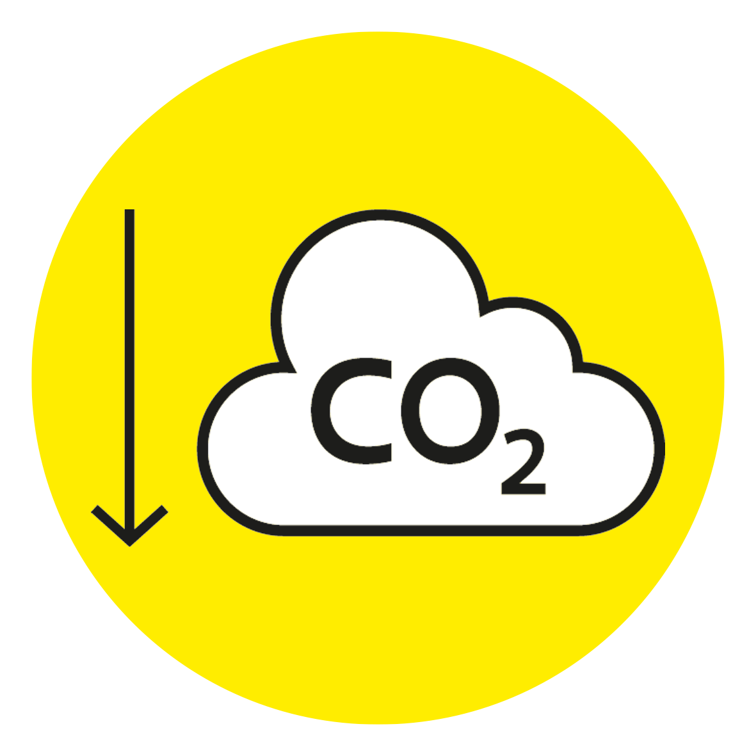
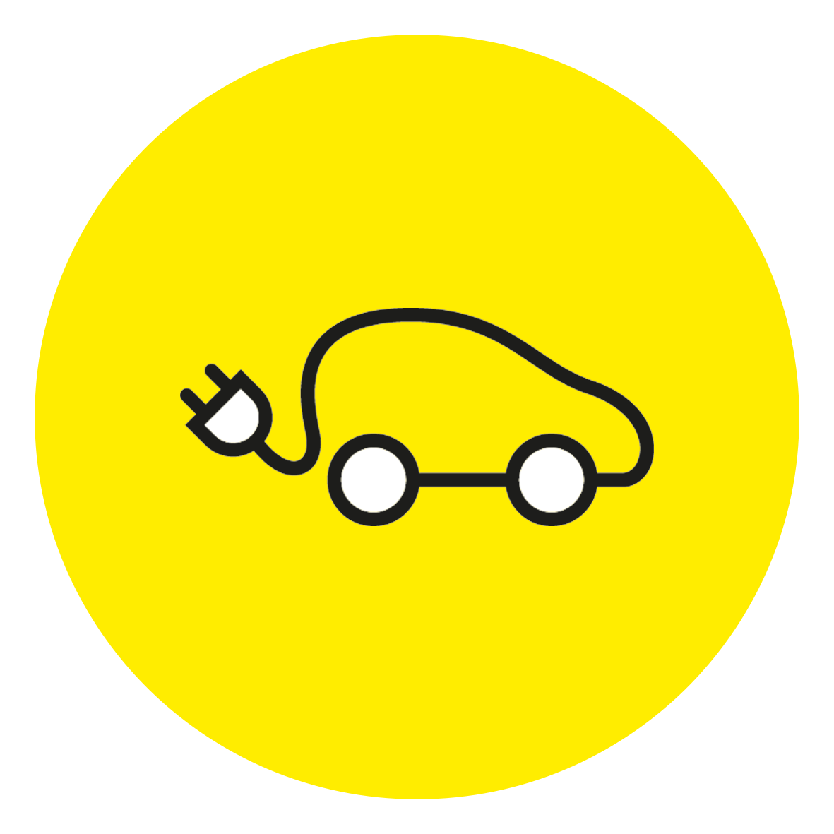
Sustainability: high on our agenda
Smart energy management:
Spectacular drop in primary energy consumption
ISO 14001: environmental management
To become the most circular facility service provider in Flanders:
Belpaire building, circular coffee bar, circular paper
Sustainable mobility

Slide 5
HFB: active partner in the field of sustainability in the construction sector
Technical Committee 'Smart and sustainable buildings' (WTCB) Smart buildings in use (WTCB) Green Deal Circular Construction: pilot project, compas group Living Lab Circular Concrete …

Slide 6
Sustainable and circular ...
What does sustainable (and circular) mean to us?
Environment
Footprint Biodiversity Mobility Synergies
User
Comfort Accessibility Wellbeing
Circular
Closed loops Value retention Added value
Building
Environmental impact Energy, water,... Safety
Operations
Manageable Profitable Adaptable

Slide 7
HFB as client
Assignments – annual budget: fluctuates between 110 – 170 million euros
Examplary function
Challenging the market

Slide 8
Influence of the client

Slide 9
From ambition to assignment
Project description
Vision Ambition Performance requirements Priorities …
Procedure
Fit for specific project
Assessment
What is mandatory? What is scored?
Qualitative <> quantitative
Classic tender split design team / contractor Design & Build …
Project-specific approach requested with examples.
GRO
Notes:
Opdracht-omschrijving: GRO, circulair, ..
Procedure: Klassiek: aanstelling ontwerpteam/uitvoerder, Design & Build, Geïntegreerde opdrachten/bouwteam
Beoordeling: Projectspecifieke aanpak gevraagd met voorbeelden.

Slide 10
How do we realise our ambitions?

Slide 11
Ambition to specifications
Achievable
Minimum requirements:
Area requirement Location Requirement Accessibility Energy Sustainability Timing
Challenge the market
Score:
Quality Total cost (incl. maintenance) Location

Slide 12
Circular procurement
To enable circularity in terms of Procedure
Ability to negotiate Other forms of cooperation (integrated assignments or construction team)
Project description
Performance-oriented description instead of solution-oriented Functional/activity-oriented instead of m² and spaces

Slide 13
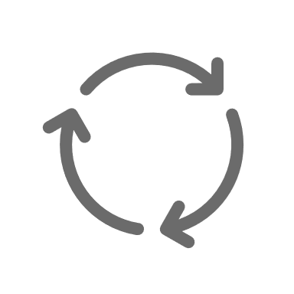
Ambition: energy
Minimum (must have)
Optimum
GRO ‘excellent’
Target: Energy-neutral
Energy-positive
Feasible in an urban context? → Simulation Material impact versus energy? → TOTEM Translation to specifications
Minimum GRO requirement 'excellent' (> 20% better than the legislation) Energy neutrality as a score criterion (the closer to energy neutral, the better)

Slide 14
Ambition: sustainable and circular construction
Minimum
Optimum
GRO 'better'
Reuse, C2C, low-emission, change-oriented, demountable, closed water cycle, zero waste, ...
100%
Bottlenecks
Few reference points for what is feasible Guarantees, certificates, etc. for the reuse of materials? Dismantling <> performance requirements (e.g. acoustics, fire safety) Measuring ‘sustainability’ …

Slide 15
Circularity in specifications
Minimum
Optimum
GRO 'better' TOTEM Material Passport BIM BOM
Score criterion Circularity
Circular building concept Material impact Dismantling Reuse after EOL Contractual agreements
100%
→ qualitative and quantitative aspects

Slide 16
Material passport as a tool
Origin of the materials
Preserved, reused, new, ... Certifications
Material with label? On which aspects (health, recycled materials, reuse in the future, others)? What level?
Harmful substances
% stricter than legislation for materials in contact with indoor air
Design for disassembly
10 principles of Design for Disassembly (cfr. Brad & Ciarimboli)
Burden of proof

Slide 18
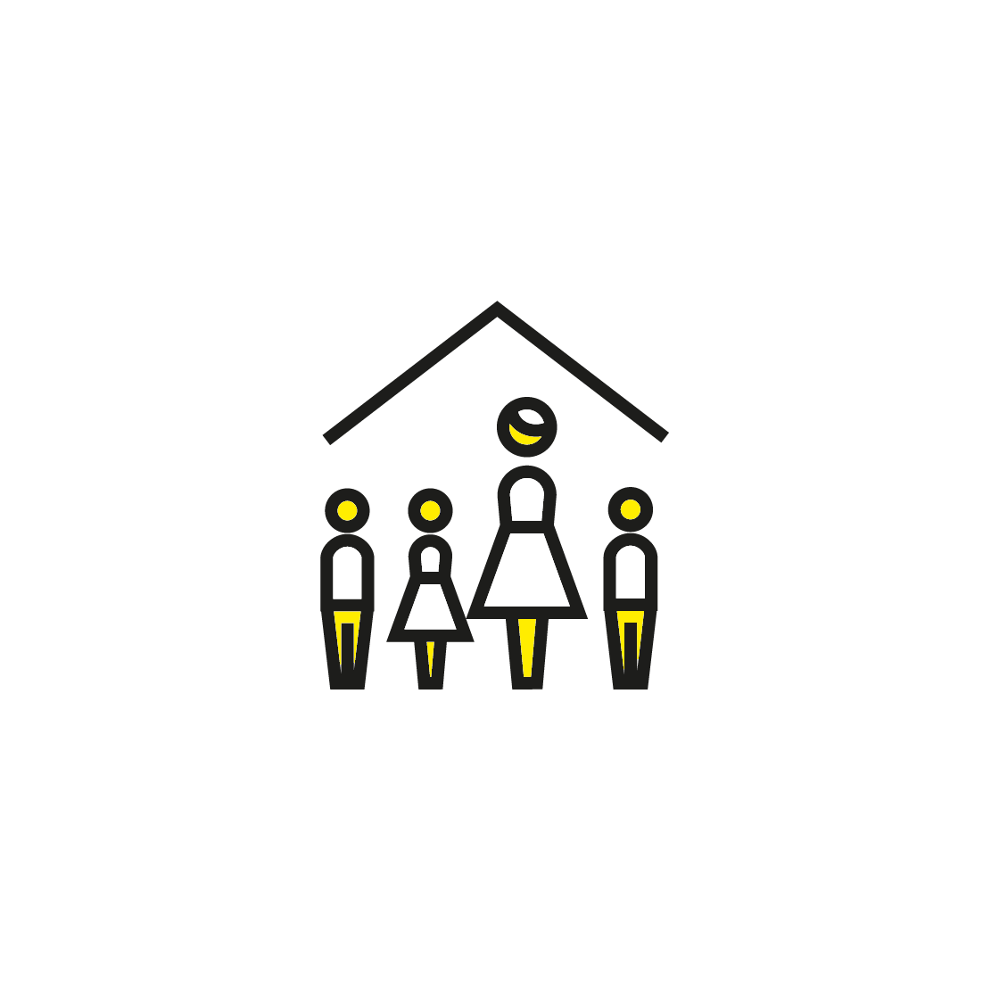
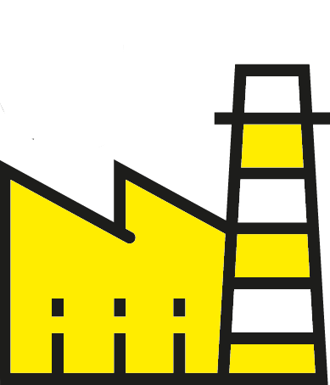
GRO is our building sustainability instrument
for all sizes
Separate rating of building / site
for all functions

Slide 19
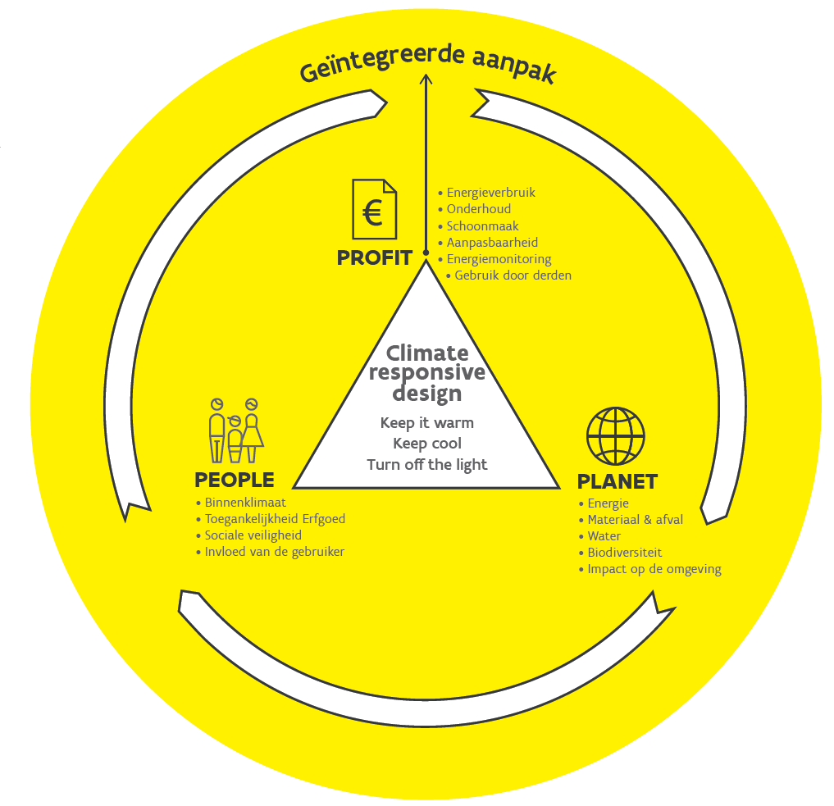
Goals
Raise awareness
Entire life cycle Circular principles Climate-responsive design
Requirements
Qualitative criteria Quantitative criteria
Assessment
Continuous follow-up and evaluation

Slide 20
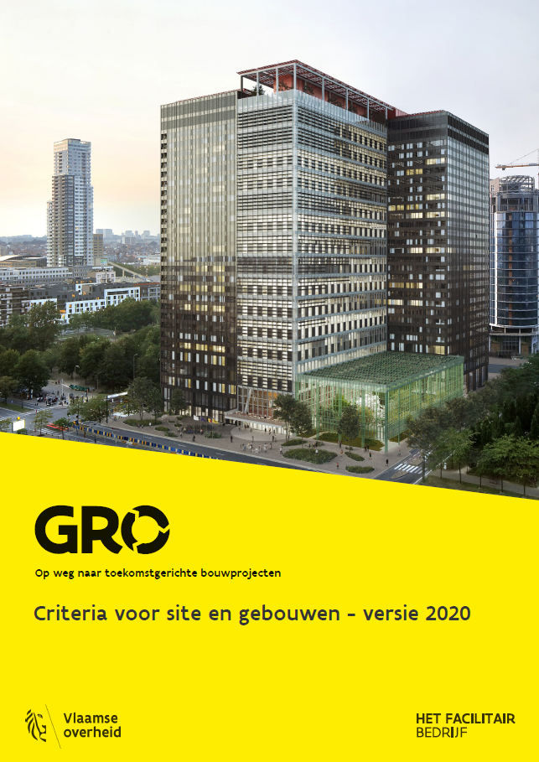
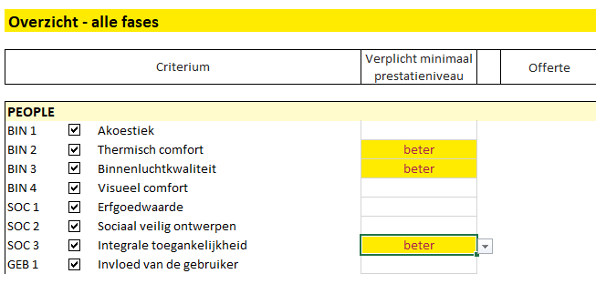
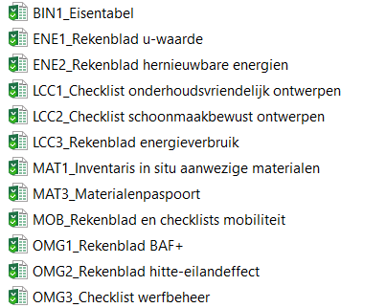
Documentation
Overviewfile
Criteria manual
Attachments

Slide 21
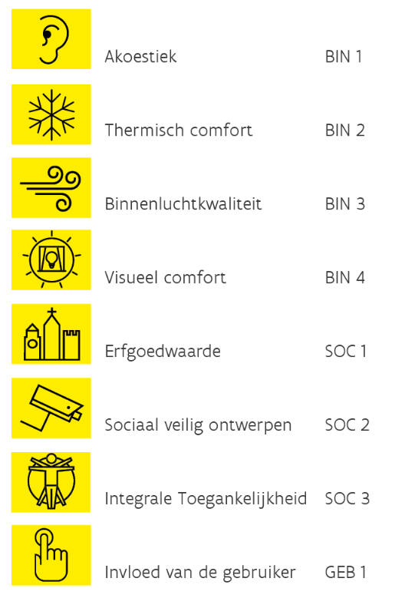
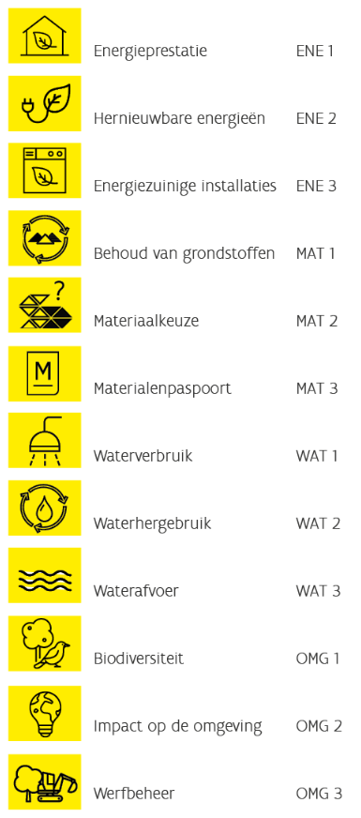
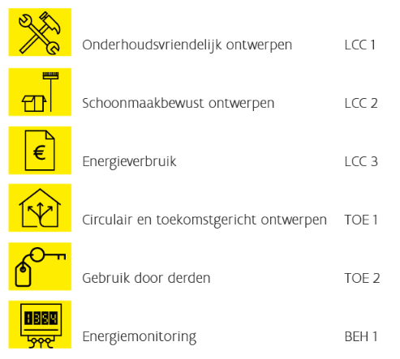
Building criteria
People
Planet
Profit

Slide 22
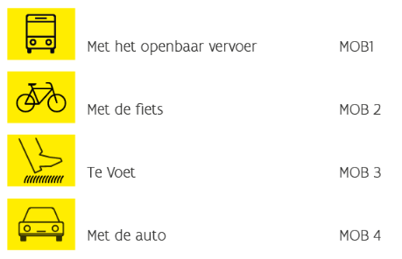
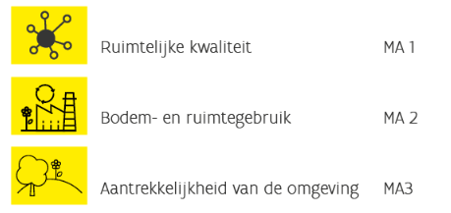
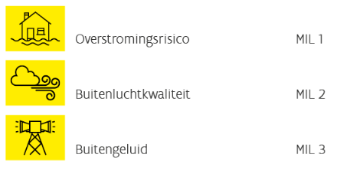
Site criteria
Mobility
Society
Environment

Slide 23
Breeam - GRO
Breeam
Certification Third-party evaluation Commercial Site and building together
Method depends on function
GRO
No certification Self-evaluation by the client Free to use Site and building separate Usable for all functions and scales

Slide 24
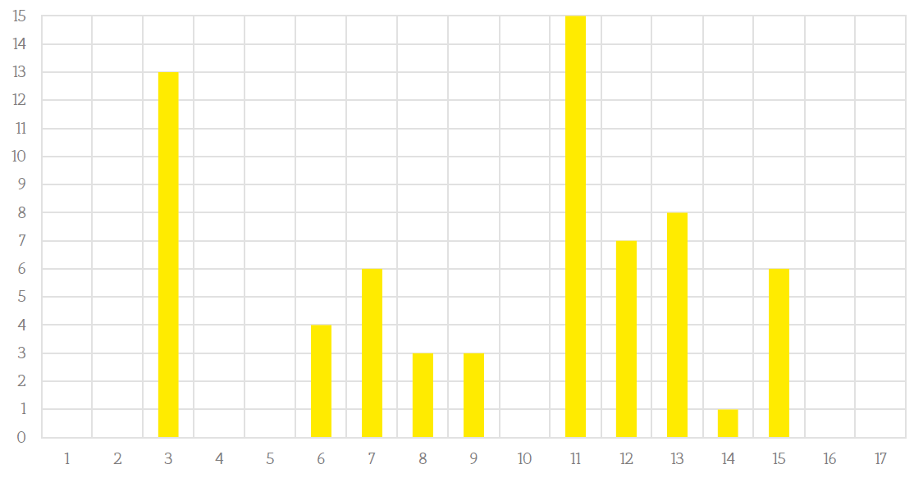
Linking GRO criteria – SDG goals
How well are the SDG goals represented in GRO?
Number of links with the GRO criteria
SDG goals

Slide 25
Analysis – which SDGs are most represented
3 – Health and well-being (indoor comfort, social safety, impact on the environment,...)
11 – Sustainable cities and communities (heritage, social safety, land use, adaptability, mobility, urban planning,...) 12 – Responsable consumption and production (waste prevention, water, site management, adaptability,...) 13 – Climate action (energy, CO2, choice of materials,...) 15 – Life on land (biodiversity, FSC wood,...) 7 – Affordable and clean energy (energy, maintenance,...)

Slide 26
Analysis – which SDGs are not represented
1 – No poverty through cooperation SIOD, public procurement, clauses on human rights violations (in specifications?), guide against social dumping 2 – Zero hunger in operation of a building (restaurant) but is not part of the design to be assessed. Possibly for GRO-in-use 4 – Quality education through HFB's HR policy. Possibly does the sensitizing character of GRO fall under this? 5 – Gender equality Gender neutrality is defined functionally, not through GRO 10 – Reduced inequalities through anti-discrimination clauses 16 – Peace Transparent operation, awareness-raising, communication 17 – Partnership Cooperation

Slide 27
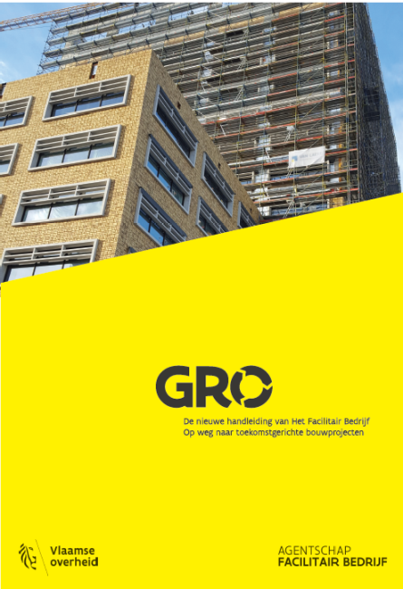
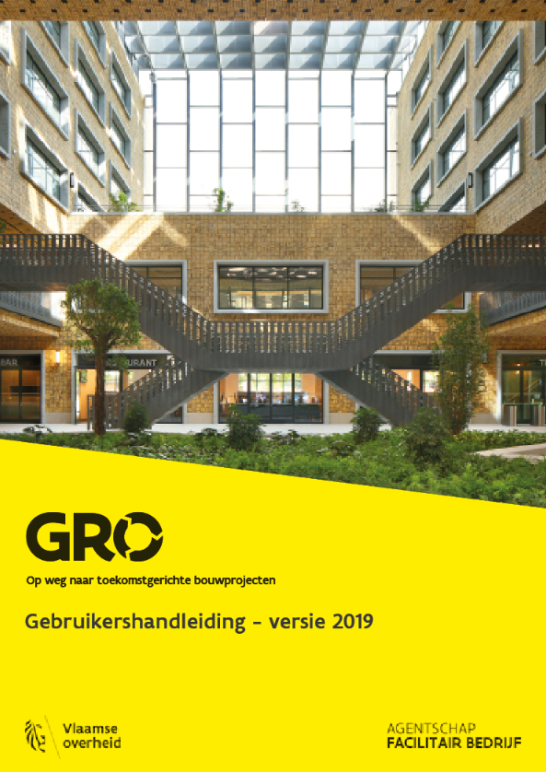
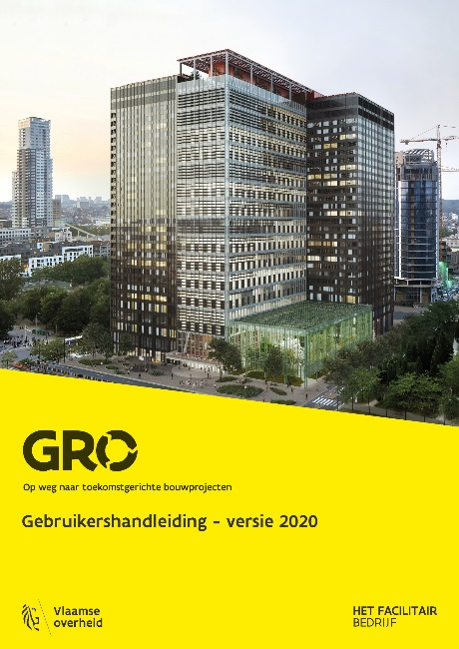
Evolution GRO
2017
2019
2020/2020.1
3 regions

Slide 28
Intergewestelijk

Slide 29
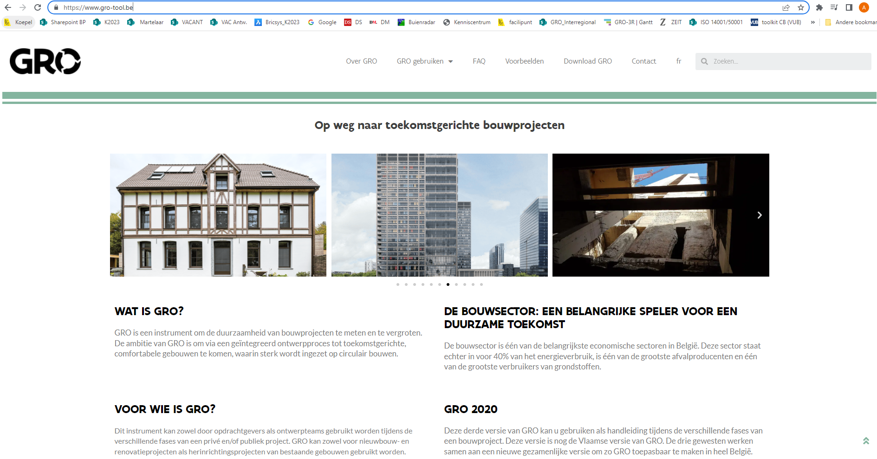

Slide 30
Marie-Elisabeth Belpairegebouw

Slide 31
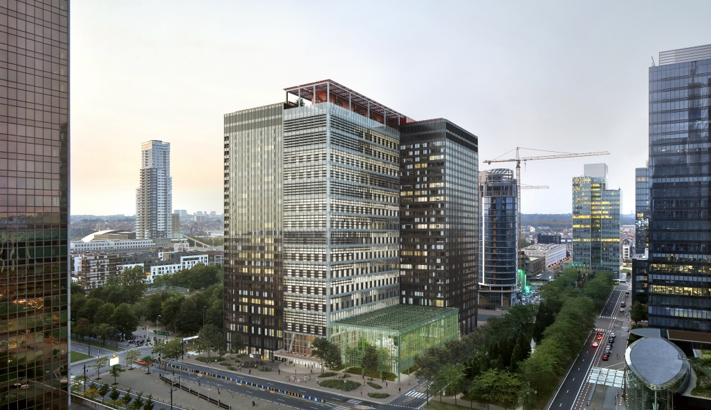
Circular concept
Urban mining
Circular use of materials
Circular procurement

Slide 32
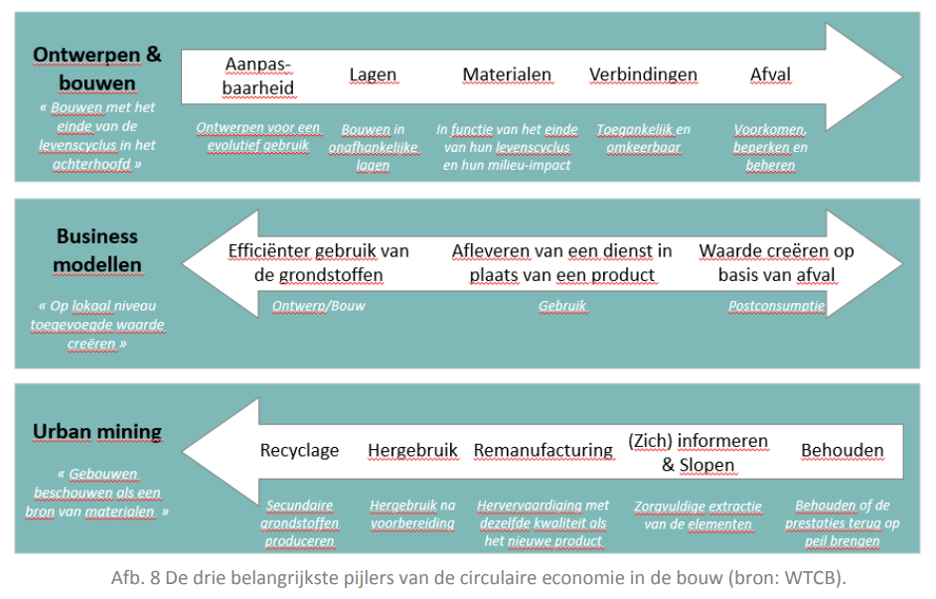
Circularity on different scales

Slide 33
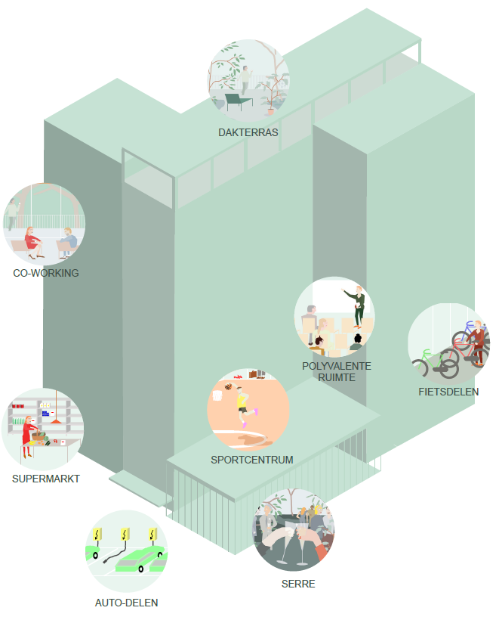
From mono to multifunctional
Neighborhood dominated by offices
→
Lively plinth No front/backside, multiple addresses Publicly accessible greenhouse Polyvalent use Main functions: office, residential, hotel
Afbeelding: 51N4E/Jaspers-Eyers/L’AUC

Slide 34
Neutrality
Hybrid building
Variable distribution of functions
Realised by
Structure as an enabler "Neutral" façade Reversible technical installation
→limited changes required for function switch
Afbeeldingen: 51N4E/Jaspers-Eyers/L’AUC

Slide 35
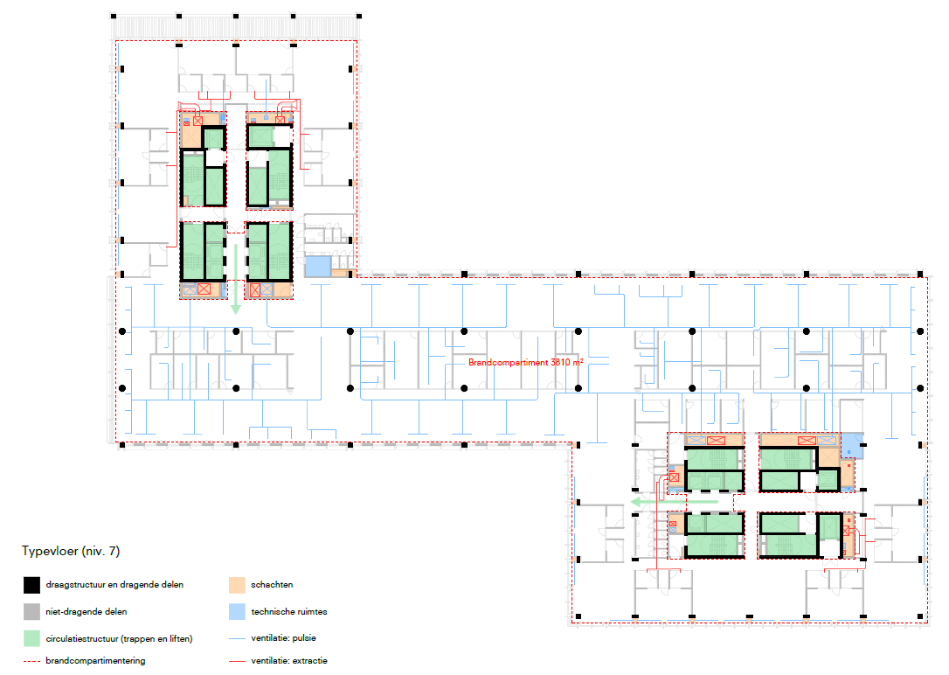
Structure of the building
(GRO TOE1)
Afbeeldingen: 51N4E/Jaspers-Eyers/L’AUC

Slide 36
The structure as an enabler
New floor slabs: getting rid of potential limitations for the future Circulation cores: working for different scenarios, separate flows Capacity of stairs: often determines occupancy of non-residential Volume capable: flexibility due to excess height

Slide 37
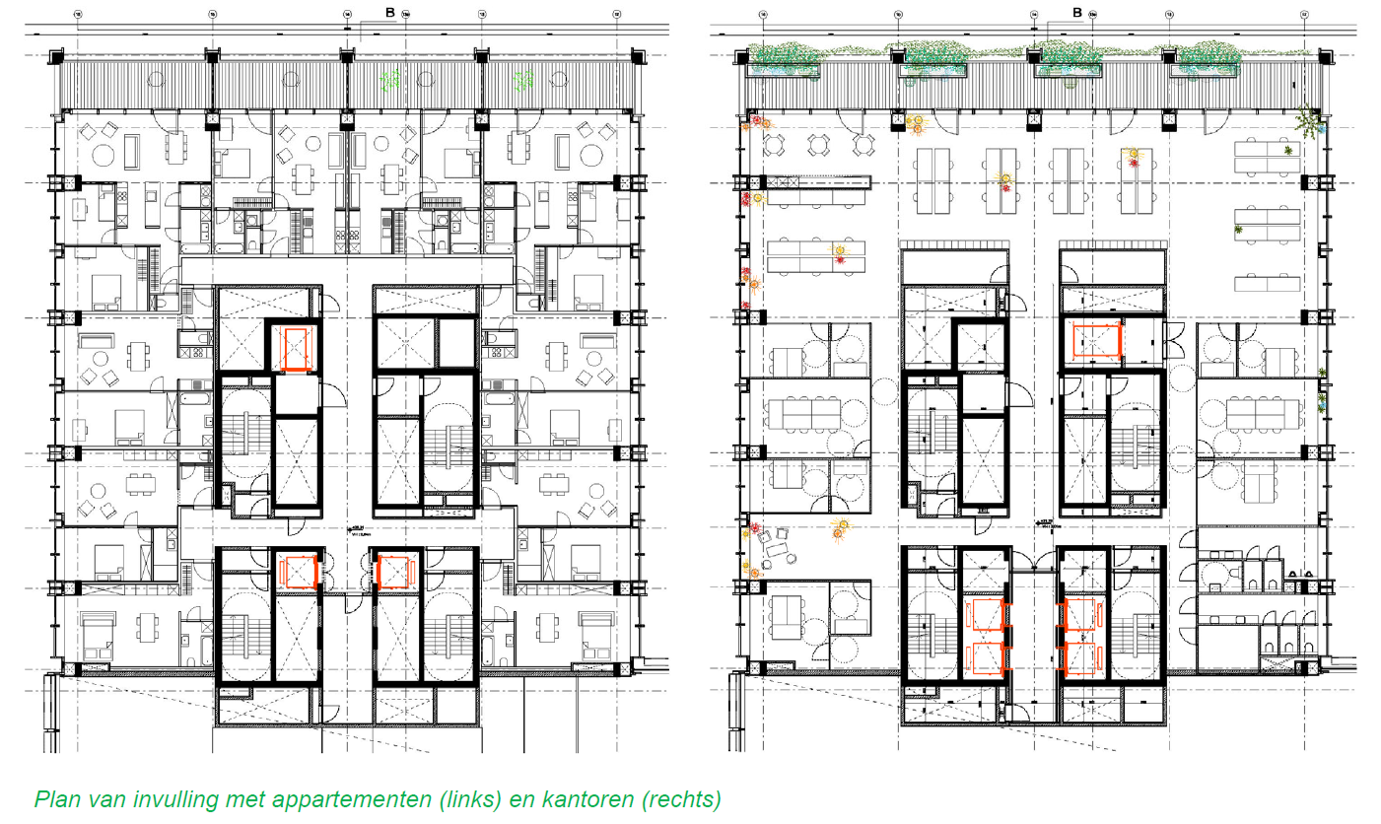
Reversible infill
No structural interventions required in the event of a function switch
Afbeeldingen: 51N4E/Jaspers-Eyers/L’AUC

Slide 38
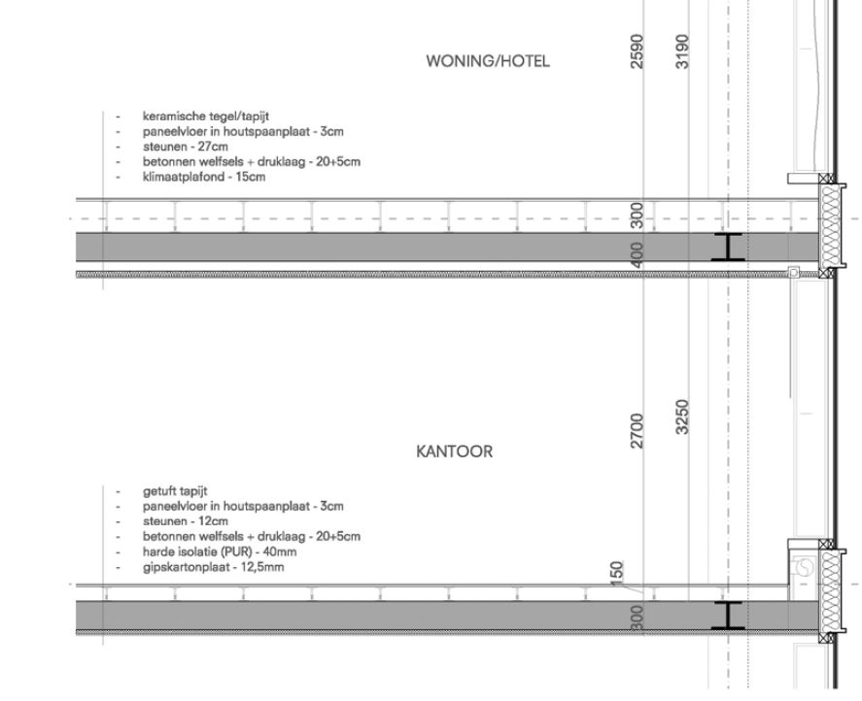
Reversible infill
Floor construction
Original: identical (dry) floor construction Not possible due to insulation requirement In façade design, different heights, floor structure and rhythm taken into account in relation to office and homes
Afbeeldingen: 51N4E/Jaspers-Eyers/L’AUC
Notes:
Lukt niet met EPB-eisen:
tussen wooneenheden en ruimten met een andere bestemming : 0,6

Slide 39
Reversible infill
HVAC
Concept works for both (non-)residential functions
Anticipating difference in ventilation rate residential / non-residential
Reduce simultaneous occupancy Replacement of the air handling unit
Elevator accesses can be adjusted
Very limited impact on electricity
Notes:
Pulsie aan de gevel, extractie aan de kern, verwarming en koeling via klimaatplafonds.
De kanalen hiervoor zitten zowel in de schachten ter hoogte van de kern als de ventilatieschachten aan de gevel reeds klaar aangezien de nieuwe verdiepingen tussen de reeds geïnstalleerde verdiepingen in zitten. Van deze hoofdkanalen wordt afgetakt.

Slide 40
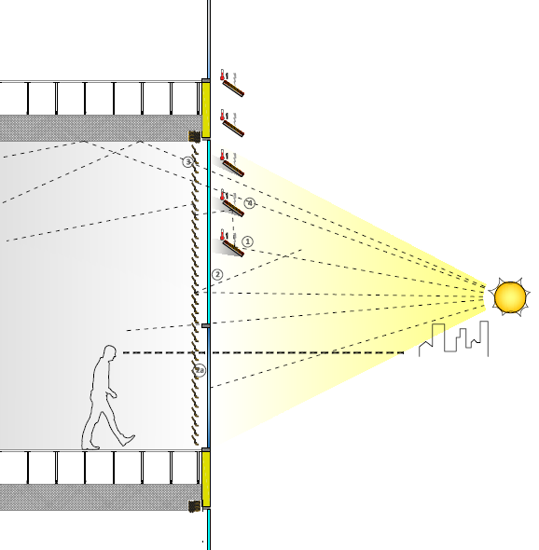
Façade design
Finding a balance between
Daylight Overheating Glare View out Energy generation (BIPV) Function neutrality
And other requirements such as
Insulation Fire safety Wind force Maintenance Safety Aesthetics …
Afbeelding: 51N4E/Jaspers-Eyers/L’AUC
Notes:
Lukt niet met EPB-eisen:
tussen wooneenheden en ruimten met een andere bestemming : 0,6

Slide 41
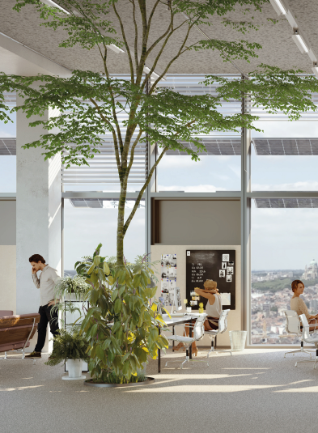
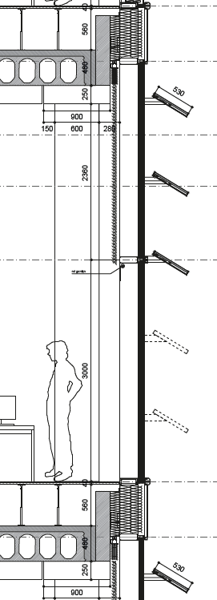
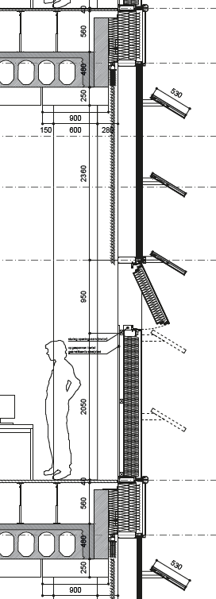
Façade design central zone
Afbeeldingen: 51N4E/Jaspers-Eyers/L’AUC

Slide 42
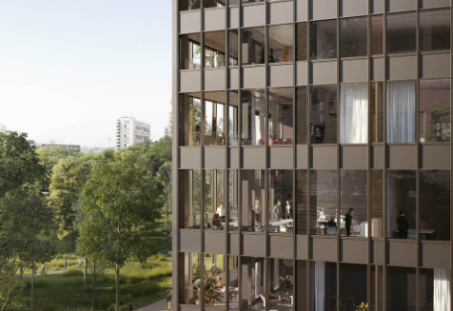
Façade design towers
Afbeeldingen: 51N4E/Jaspers-Eyers/L’AUC

Slide 43
Façade - use of materials
Aluminium profiles: C2C Silver Aluminum panels: C2C Silver Glass: C2C Bronze/Silver Blinds: C2C Silver

Slide 44
Urban mining
Analysis & inventory
What and where? In what quantity and condition? What is the reuse potential:
Demolition vs. preservation
Preserve
Reuse
Recycling
Dismantling
Afbeelding: 51N4E/Jaspers-Eyers/L’AUC

Slide 45
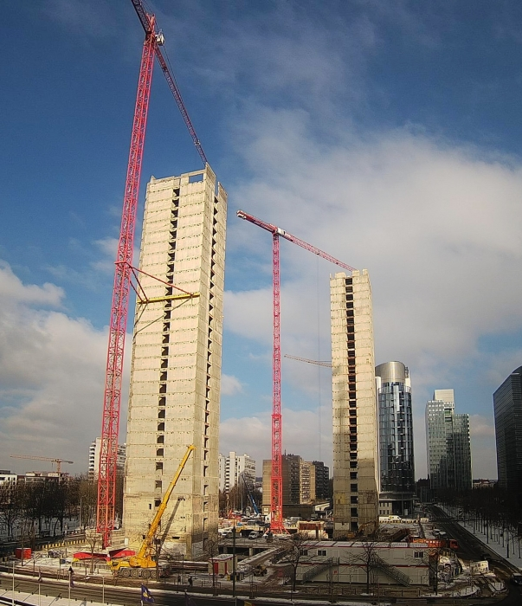
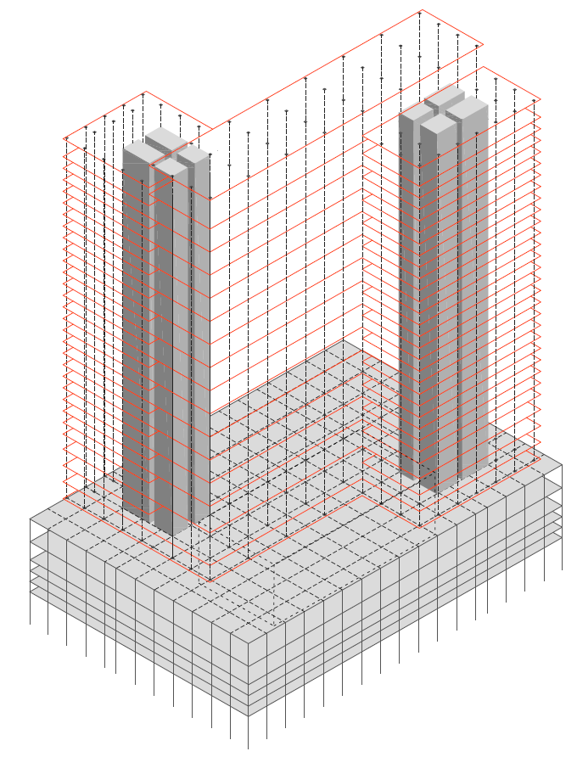
Demolition vs Preservation in Belpaire
Afbeelding: HFB
Preservation of floorslabs
Limited load-bearing capacity reinforcement would be necessary Restrictions in terms of fire safety, acoustics, free height, etc.
Conclusion
Too many technical limitations Limitation of adaptability in the future Difference in material impact limited (LCA)
Afbeelding: 51N4E/Jaspers-Eyers/L’AUC

Slide 46
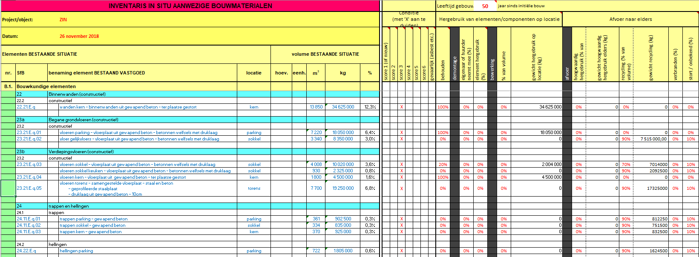
Inventories
(GRO MAT1)

Slide 47
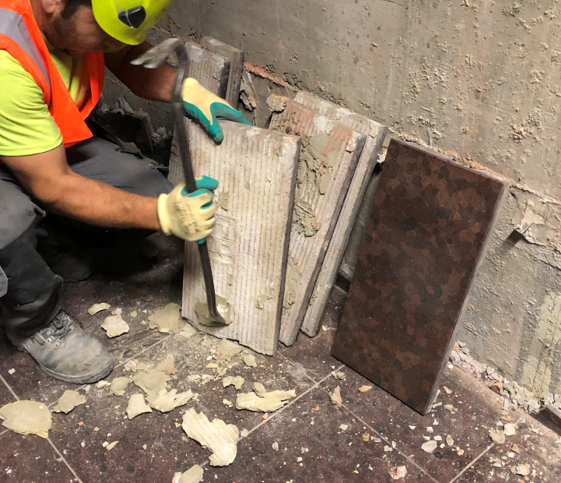
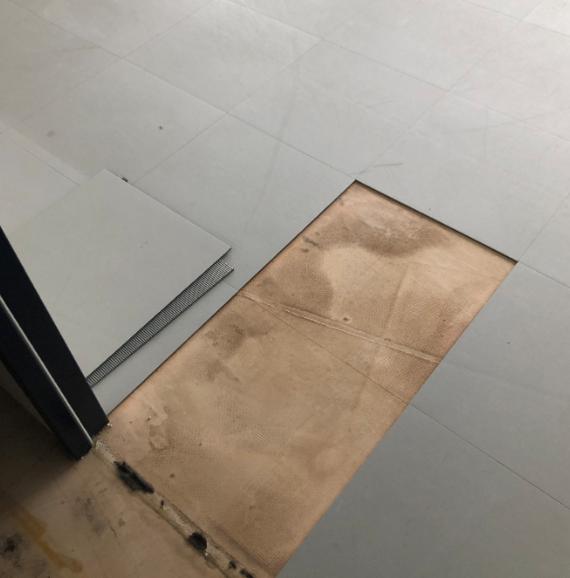
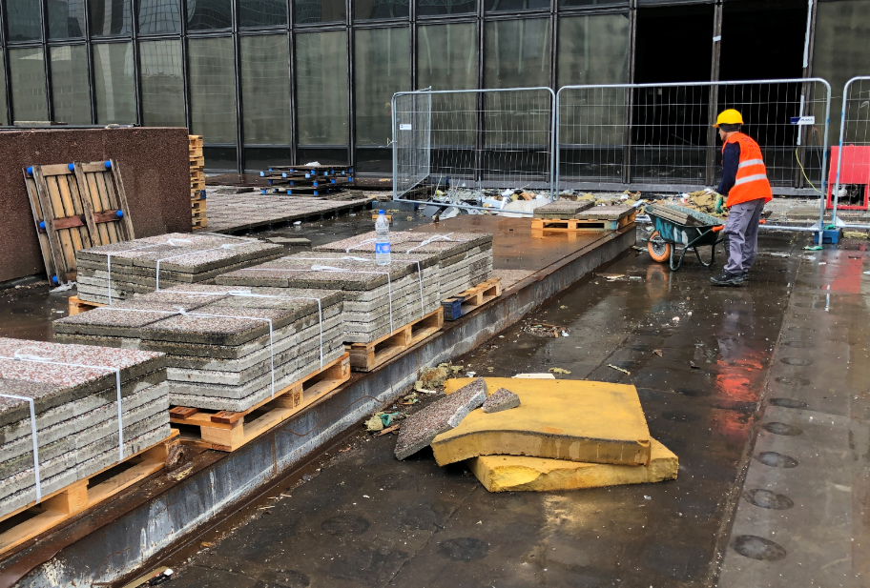
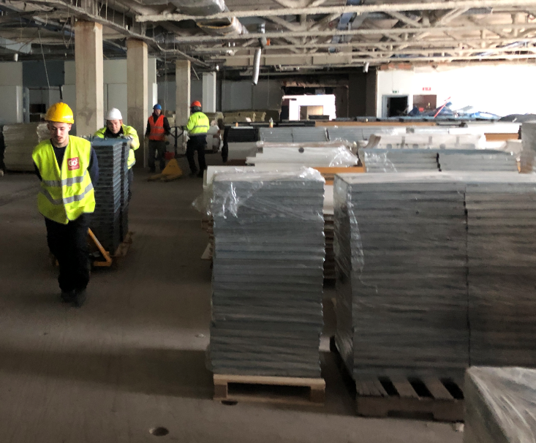
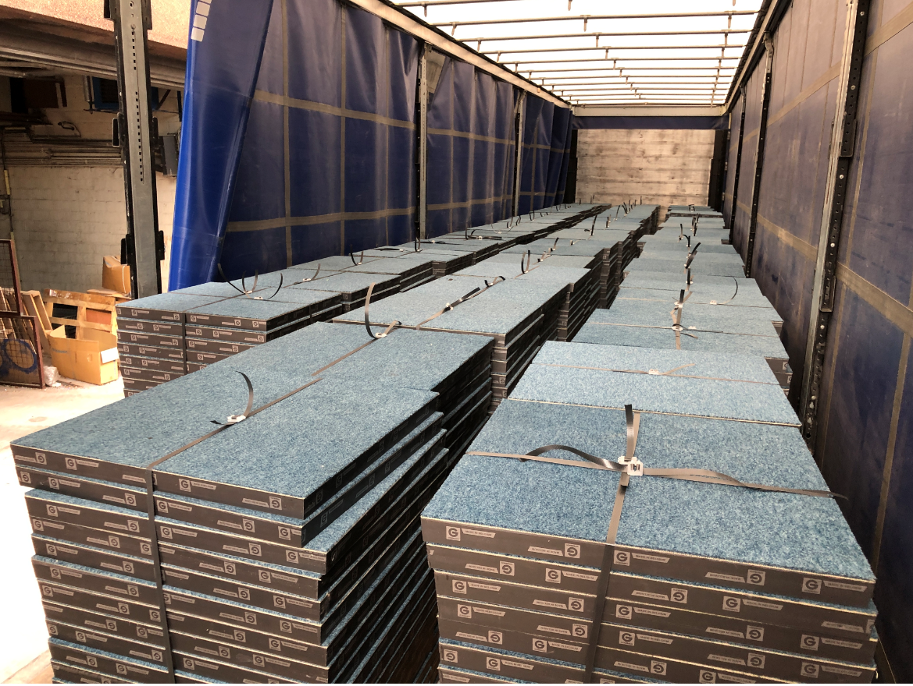
Dismantling
And storage
Afbeeldingen: Befimmo

Slide 48
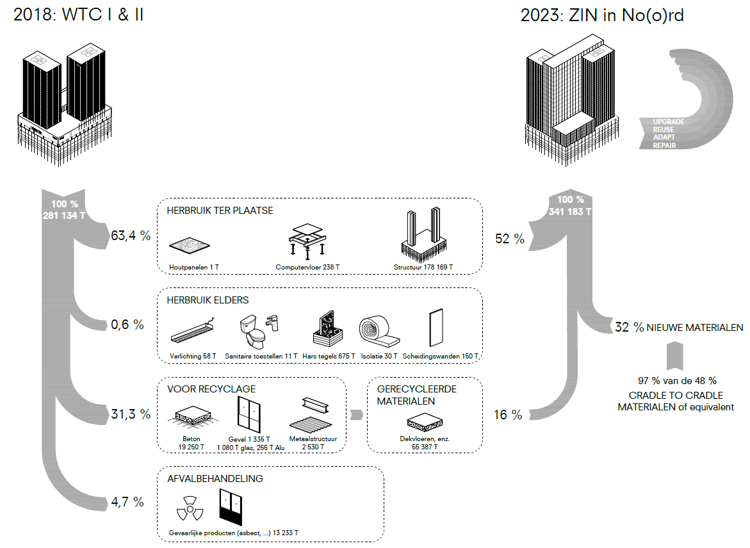
Material flows
Afbeelding: 51N4E/Jaspers-Eyers/L’AUC

Slide 49
Reuse potential
Preservation 65% Structure (core + basement)
Reuse 1% Mineral wool, natural stone, Raised floors,…
Recycling 30% Glass, aluminium, concrete
Landfill 5% Hazardous substances (asbestos)

Slide 50
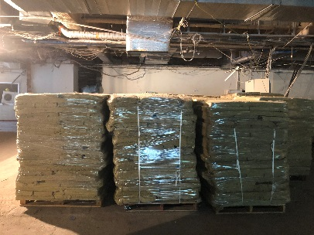
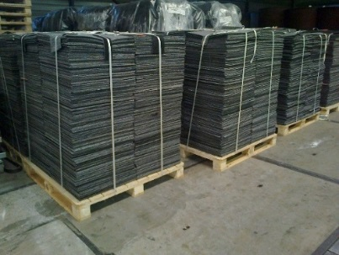
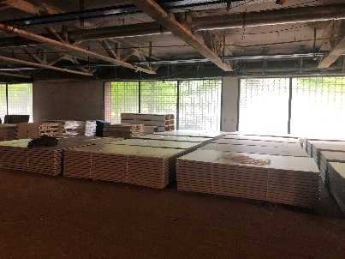
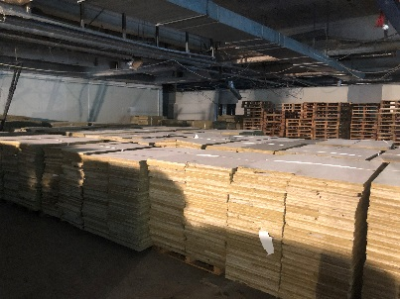
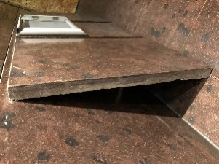
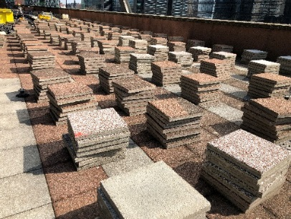
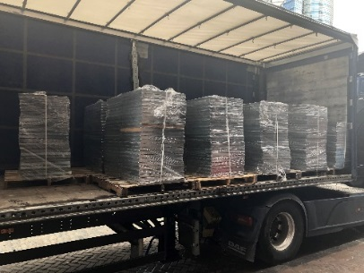
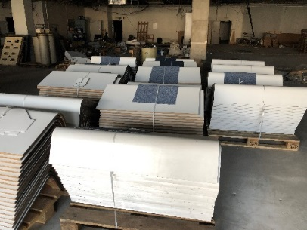
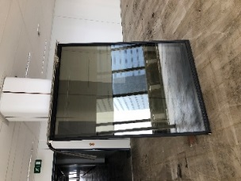
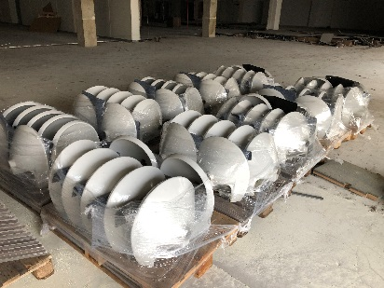
Repurposed materials
Afbeeldingen: Befimmo
(in/ex situ: 1% of total building weight)
Insulation (20.000 m2), 66 ton
Carpet Tiles (6.800m2), 41 ton
Partition wood panels (40.000m2), 475 ton
Mineral Tiles (35.000m2), 78 ton
Stone Tiles (1.800m2), 123 ton
Roof Tiles (4.975m2), 636 ton
Raised Floors (6.800m2), 240 ton
Wood Panels (2.860 stucks), 36 ton
Flatglass (14.000m2), 577 ton
Furnitures 59 ton

Slide 51
Convector casing
Afbeeldingen: Befimmo

Slide 52
Suspended ceilings
Afbeeldingen: Befimmo

Slide 53
Recycling
(30% of the total weight of the existing building)
Slight shift from reuse to recycling
Reuse as greenhouse glass
Main flows
Aluminium Glass Concrete

Slide 54
Glass recycling
Original ambition
Reuse as greenhouse glass
Technology & Impact
Existing recycling process Saving raw materials (sand) Energy saving
Point of attention
An unpolluted glass batch has more value Glass must be clean before recycling (difficult with broken glass)
Afbeelding: Befimmo

Slide 55
Paradigm shift

Slide 56
Rethinking our questions
"We require lighting"
Ask for solutions
Working in a team, developing a solution (or even program) together
Evolution from classic tendering procedures design & build formulas
Evolution from investment cost to life cycle cost
"We want adequate light in every room".

Slide 57
Knowledge
Circular construction requires both broad knowledge and detailed knowledge in order to
devise integrated solutions to be able to estimate what is feasible Detect risks …
© KaryaSarma

Slide 58
Reality check
Little experience regarding the feasibility of certain aspects. For example:
Reuse in/ex situ Certification of (non-standardized) materials Alternative construction methods How can it be disassembled? How circular does it need to be?
Measurability
Tools such as GRO, TOTEM, simulations, ...
Not everything is measurable → common sense and judgement

Slide 59
Sustainable collaboration
Trust is the key to success Dare to question things Open communication Expertise at the table

Slide 60
Circular concrete

Slide 61
Circular concrete
Concrete is the most widely used building material on earth Average CO2 emissions
Excl. sand and gravel: ~ 155 kg CO2/m³ concrete Incl. sand and gravel: ~ 160 kg CO2/m³ concrete
80% of CO2 emissions are related to cement

Slide 62
Concrete in the Belpaire building

Slide 63
The ‘new’ concrete
Recycled concrete aggregates A+ for floors Originating from the existing building, broken in Brussels cement CEM III where possible

Slide 64
Aggregates
30,000 tonnes demolished concrete → 3,500 tonnes A+ granulate →30,000 tonnes of ‘recycled' concrete
Sampling
Test cubes
Crushing concrete

Slide 65
Cradle-to-cradle concrete
A first in the Benelux: cast-in-place concrete (CCB)
Cradle-to-cradle – Silver
Precast concrete elements (Ergon, Prefaco)
Cradle-to-cradle - Silver

Slide 66
Living Lab Circular Concrete
HFB participates in living labs with several pilot projects

Slide 67
Questions?
<<<<<<<<<<<<<<<<<<<<<<<<<<<<<<<<<<<

