Slide 1
Circular workstation design
Fair ICT: Electronics Watch
Alexander Lemmens
Legal advisor
Agency for Facility Operations

Slide 2
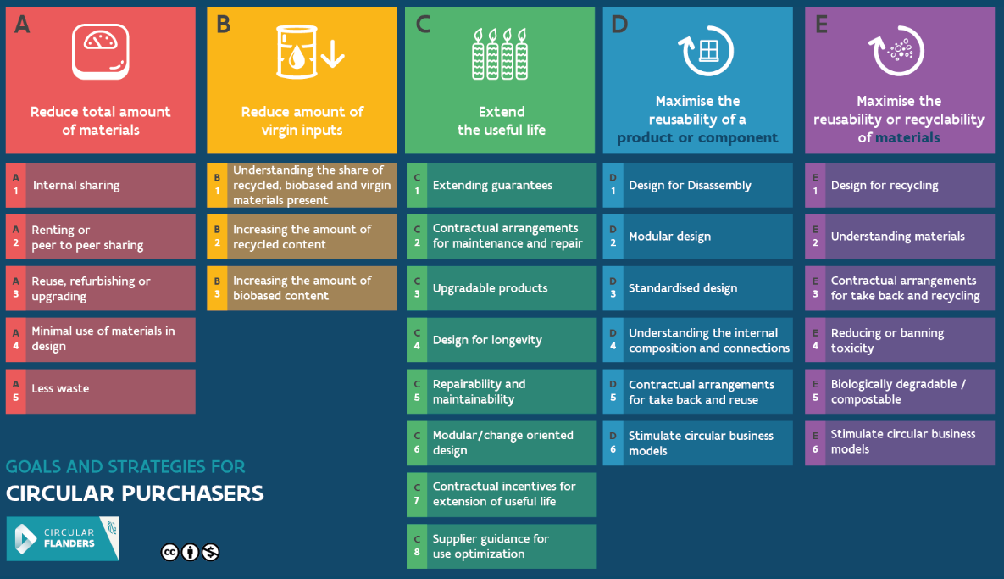
The circular ambition chart

Slide 3
The purchasing process for furniture
Central purchasing body: provides a generic offer through framework agreements: mobility, clothing, textiles, waste collection, cleaning, insurance, human resources contracts, ICT, and ... furniture.
Customers: Entities of the Government of Flanders and (for certain framework agreements) local authorities
→ Efficiency, scalability, uniformity, etc.
→ More rigid and effective purchasing policy (SME participation, green purchasing, circularity, professionalization, integrity, etc.)

Slide 4
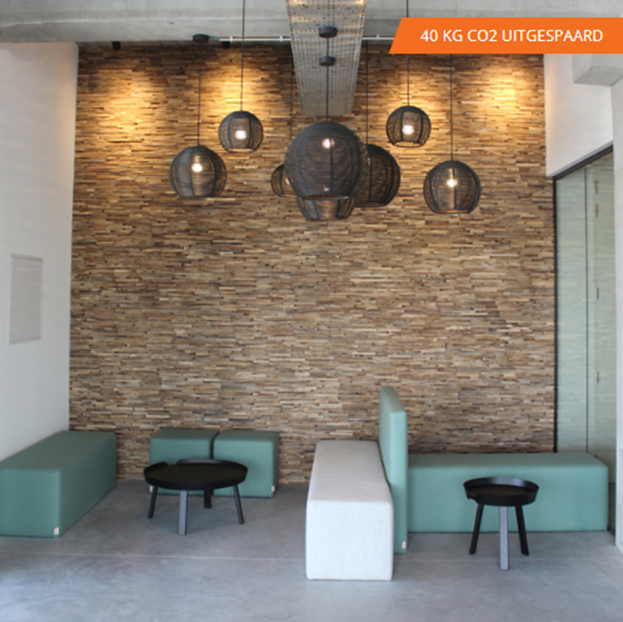
Framework agreements - refurbishment
One for refurbishment services - 4 years max.
Drawing up inventories
Studies
Interior design
Execution
One for refurbished off-the-shelf furniture (supplies) - 9 years max.

Slide 5
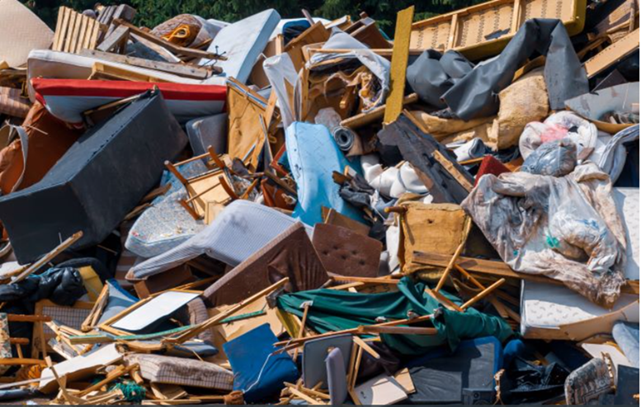
Why ?
Buying new furniture
Expensive
High CO₂-emissions
Use of expensive raw materials
Environmental impact (production, transport, …)
Furniture in waste collection
Expensive
High CO₂-emissions
Destruction of useful materials
Environmental impact (end of life)

Slide 6
For who?
All entities within the Government of Flanders can use the framework agreements
The framework agreement for services is also open to local authorities
→ Goal: Transversal integration/implementation of refurbishment in the public sector in Flanders

Slide 7
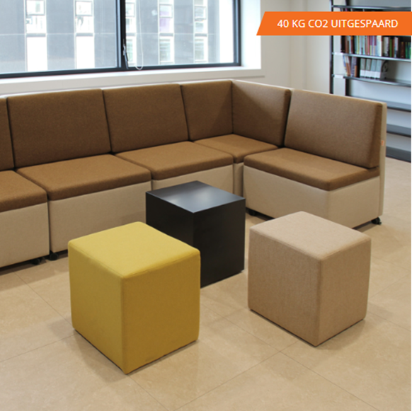
Awarding procedure
Competitive procedure with negotiation
2 steps (1. selection – 2. award)
Negotiations to optimise the offer and take account of the specific characteristics of the Government of Flanders
Negotiation method inspired by framework agreements for insurance (contract to be negotiated as an annex to the contract documents)
Discussion on reporting (CO₂-emissions, kilograms of reused materials, financial data, etc.)

Slide 8
Awarding phase
Information meeting → 4 interested companies (some as subcontractors)
Only one request to participate
Only one offer - Nearly New Office Facilities (NNOF)
Constructive and elaborate negotiation phase to create a long-term partnership (4 years - services / 9 years - supplies)

Slide 9
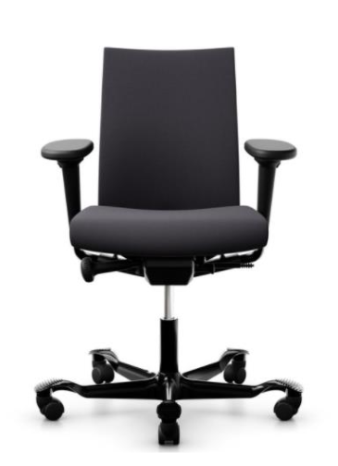
New furniture
Technical requirements and award criteria in the framework agreement
Encouraging reparability
5-year warranty, 10-year subsequent delivery warranty on compatible parts
Encouraging dismantling
Conversion of certain items of furniture
Favour raw materials from recycling
Wood : FSC/PEFC (or recycled wood) – Emission class E1
Textiles : EU-Ecolabel
Metal: powder coating

Slide 10
Reuse outside the Agency for Facility Operations and recycling
Warehouse
Framework contract for moving / circular disposal
Removal assignments (possibly in combination with circular disposal)
(Only) circular disposal

Slide 11
Fair ICT – Electronics Watch
Affiliation since 2020
Reducing risks of violations of human rights and worker rights in ICT-value chains
Uptake of model clauses in all our framework agreements for ICT-hardware
Due diligence
Pooling of purchasing power

Slide 12
Fair ICT – Electronics Watch
EW collaborates with “monitoring partners”
Southern Africa Resource Watch (SARW), South Africa
“Worker driven monitoring”
Until now no direct link between the ICT-hardware in our framework agreements and South Africa.
Future → more focus on raw materials and mining → higher chance of links with South Africa

Slide 13
Questions ?

