Slide 1

FROM STANDARDS TO INDICATORS
How to made the case of cycling thanks data

Slide 2

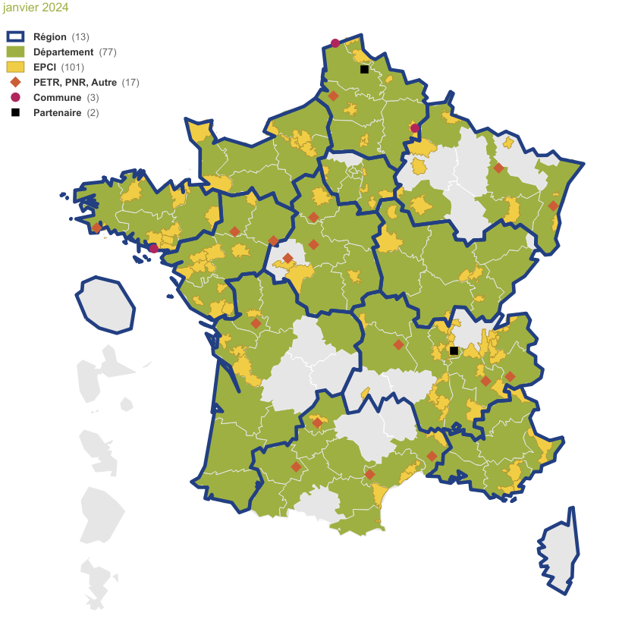
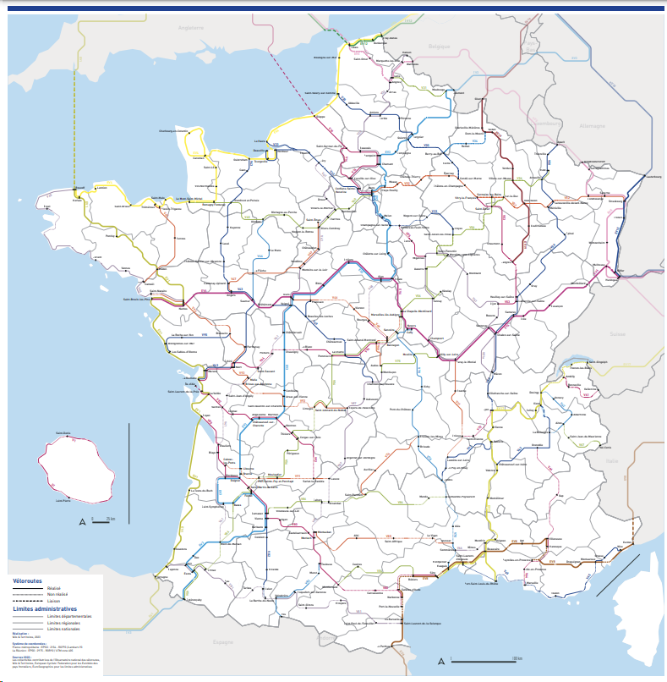

Vélo & Territoires
MISSIONS AND ACTIONS
Association : + 210 members
Main actions
Federate and coordinate a network of local authorities around the cause of cycling
Provide tools, inspiration and support to develop cycling mobility
Represent and defend the interests of local authorities committed to cycling
Measure the impact of cycling policies to convince
National coordination center for EuroVelo
National coordinator for national cycle routes scheme
59 cycle routes / 10 EuroVelo
EU Cycling Conference - Cycling data session | 30/01/2024

Slide 3

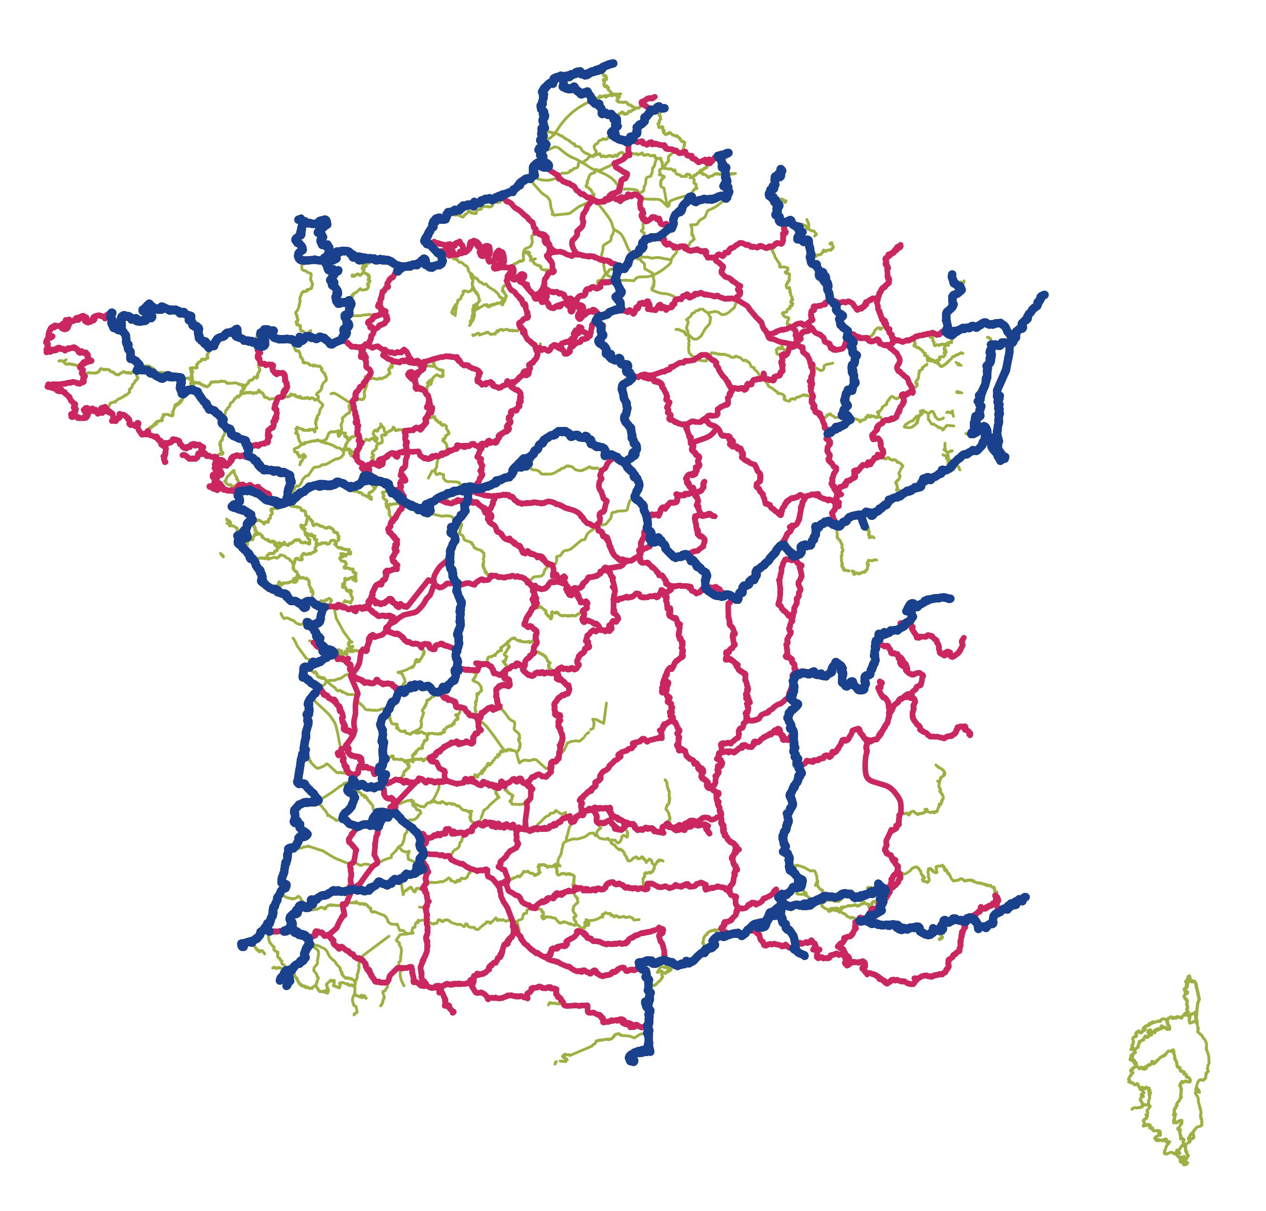
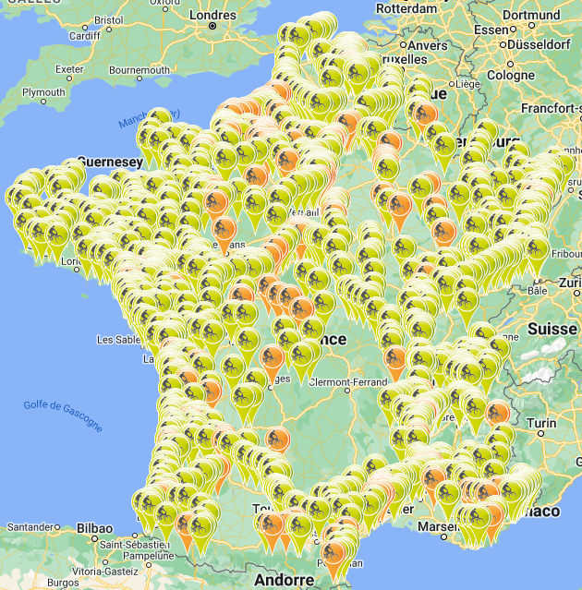
Cycling data and Vélo & Territoires
CYCLING DATA COLLECTION AND MONITORING
VELODATAMAP (web GIS)
Cycle routes
Infrastructures
Facilities
Anomalies
NATIONAL CYLCING TRAFFIC DATA PLATFORM
Traffic data per hour
EU Cycling Conference - Cycling data session | 30/01/2024

Slide 4











The French cycling data ecosystem
CYCLING DATA COLLECTION AND MONITORING
And local authorities, manufacturers, counter providers, …
EU Cycling Conference - Cycling data session | 30/01/2024

Slide 5
Cycling data and Vélo & Territoires
FACING THE CHALLENGE TO COLLECT THE DATA
Find and collect data
Local
data
Agregate data
EU Cycling Conference - Cycling data session | 30/01/2024

Slide 6















Standards topics in France
A COMMON LANGUAGE TO SHARE AND FACILITATE DATA USAGE
2014
2020
2021
2021
2021
Long-distance cycle routes
Cycling infrastructures
Bike services (services areas, rest areas…)
Bike parking
Mobility traffic count
Working group
Dissemination
Quality
Ressources : https://www.velo-territoires.org/politiques-cyclables/data-velo-modeles-donnees/
EU Cycling Conference - Cycling data session | 30/01/2024

Slide 7
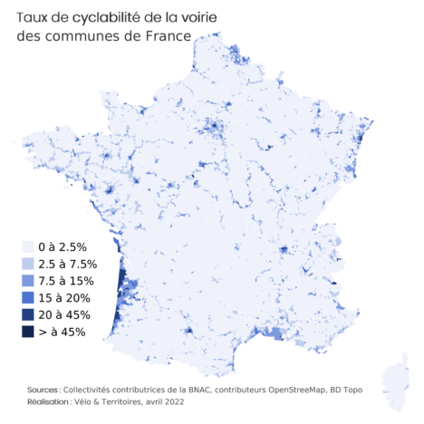
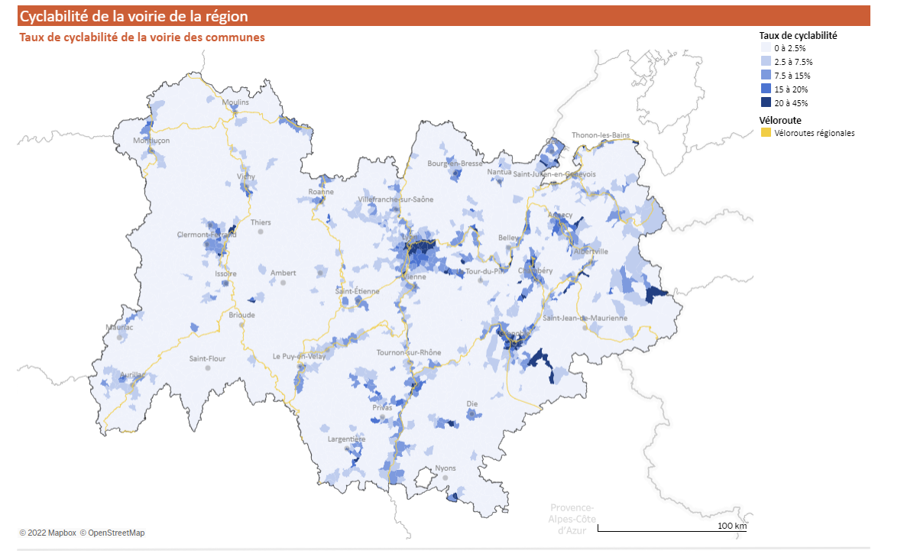

Data collection: a beginning, not an end
HOW TO PRIORITIZE DECISION AND MAKE THE CASE OF CYCLING
Create new indicators (cyclability index)
Data bases
EU Cycling Conference - Cycling data session | 30/01/2024

Slide 8
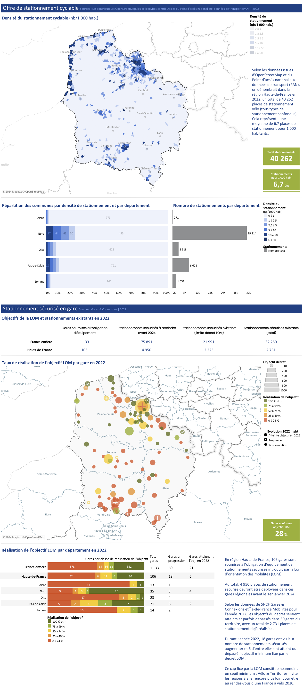
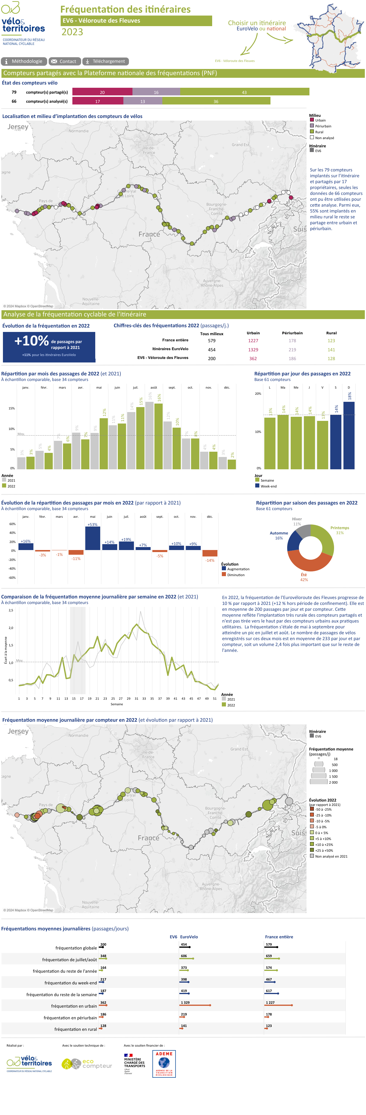

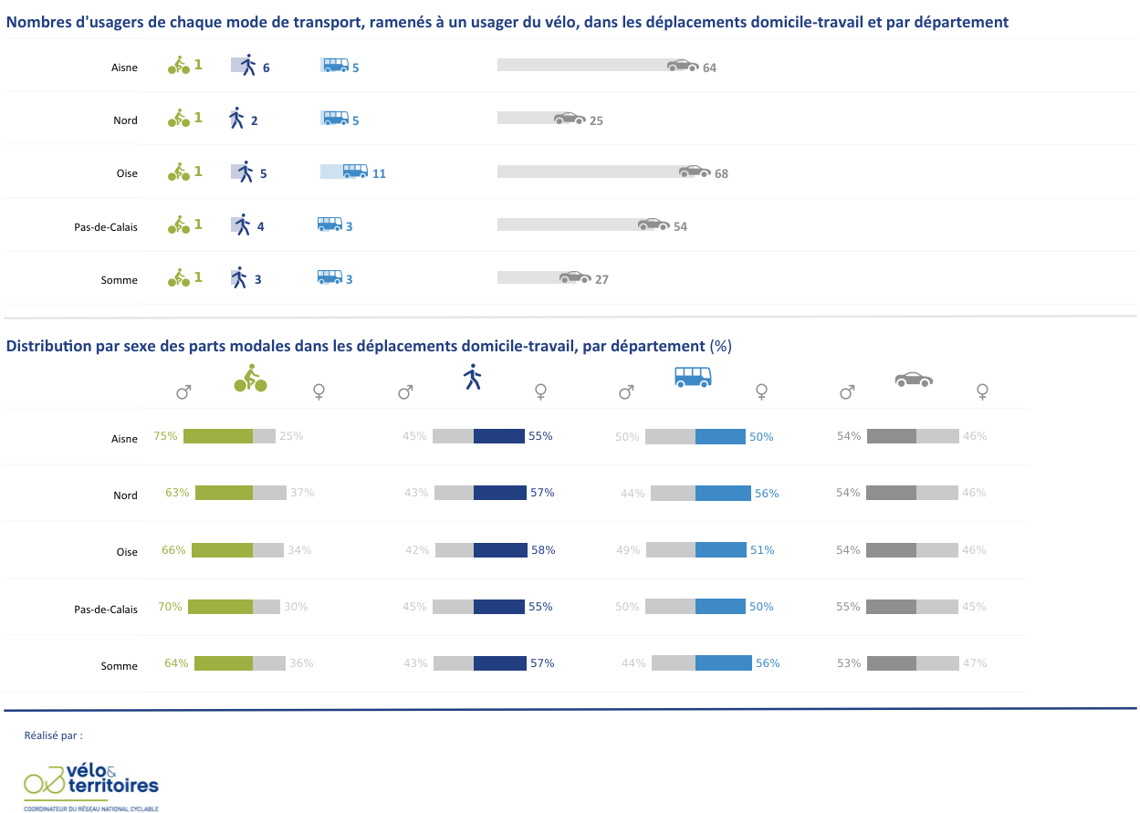
Data collection: a beginning, not an end
HOW TO PRIORITIZE DECISION AND MAKE THE CASE OF CYCLING
Create new indicators (cyclability index)
Data vizualisation
Data bases
EU Cycling Conference - Cycling data session | 30/01/2024

Slide 9
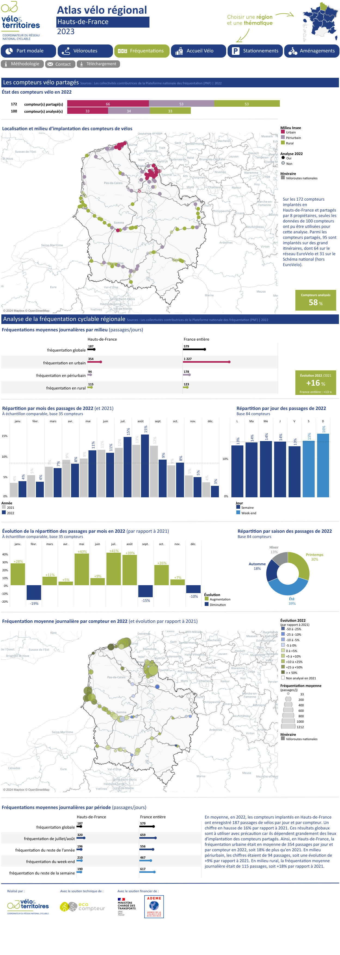

Data collection: a beginning, not an end
HOW TO PRIORITIZE DECISION AND MAKE THE CASE OF CYCLING
Create new indicators (cyclability index)
Data vizualisation
Showcase usage development
Data bases
NAPCORE - Cycling data session | 02/11/2022

Slide 10
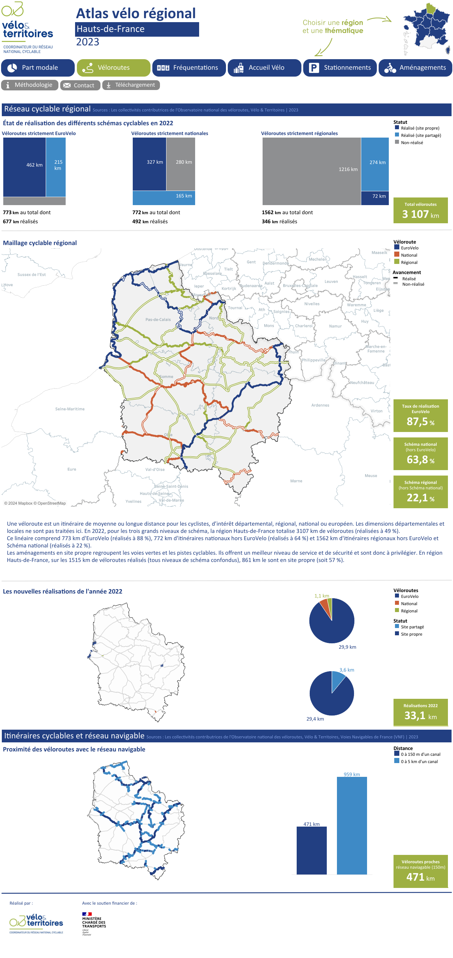
Data collection: a beginning, not an end
HOW TO PRIORITIZE DECISION AND MAKE THE CASE OF CYCLING
Create new indicators (cyclability index)
Data vizualisation
Showcase usage development
Data bases
Showcase infrastructure development
EU Cycling Conference - Cycling data session | 30/01/2024

Slide 11
Data collection: a beginning, not an end
HOW TO PRIORITIZE DECISION AND MAKE THE CASE OF CYCLING
Create new indicators (cyclability index)
Decision making
Evaluate policies
Data vizualisation
Justify fundings
Showcase usage development
Data bases
Convince for more cycling
Showcase infrastructure development
EU Cycling Conference - Cycling data session | 30/01/2024

Slide 12


Justify fundings for cycling
250 million euros in 2023
EU Cycling Conference - Cycling data session | 30/01/2024

Slide 13


Challenges for the future
A COMMON LANGUAGE TO SHARE AND FACILITATE DATA USAGE
EU Cycling Conference - Cycling data session | 30/01/2024

Slide 14


Thanks for your attention
Stéphanie MANGIN
stephanie.mangin@velo-territoires.org
+33 (0)9.78.31.32.42

