Slide 1
Doctoral Research: Employee Reactions to Talent Management
Brussels, 6 June 2023
Dr. Anand van Zelderen
Director of the Future of Work Virtual Reality Metaverse Lab
Senior Research Associate Organizational Behavior
www.leadthefuture.org

Slide 2
Agenda TM Workshop
1 | State of the art TM
2 | P1: Is exclusivity better?
3 | P2: How are talent programs best designed?
4 | P3: When does TM lead to conflict on the work floor?
5 | Discussion / Q&A

Slide 3
Talent Management Philosophies
y

Slide 4
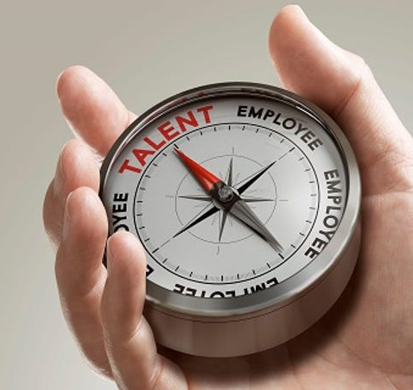
(EXCLUSIVE)
TALENT MANAGEMENT
The activities and processes that involve the identification of key positions which contribute to the organization’s sustainable competitive advantage, with the aim of filling these key positions with its most high-performing, high-potential employees, thus ensuring their continued organizational commitment (Collings & Mellahi, 2009)

Slide 5
CHARACTERISTICS
Prevalent 2/3 of organizations worldwide
Exclusive 1-10% of employees
Differentiate employees Talents vs. Non-Talents
Sensitive 2/3 organizations keep talent status a secret

Slide 6
Talent programs are becoming too exclusive (Swailes, 2013)
Talent programs’ secretive nature is detrimental to employees (Huang & Tansley, 2012)
CRITIQUE

Slide 7
Example case from practice: A.P. Moller-Maersk Group—a Danish-based global logistics provider with 100,000 employees in 130 countries—increased the proportion of employees in their talent pool from 1% to 30% in 2009, based on the belief that a more inclusive system would create more desirable employee reactions
(Hjordrup, Jensen, & Minbaeva, 2015)

Slide 8
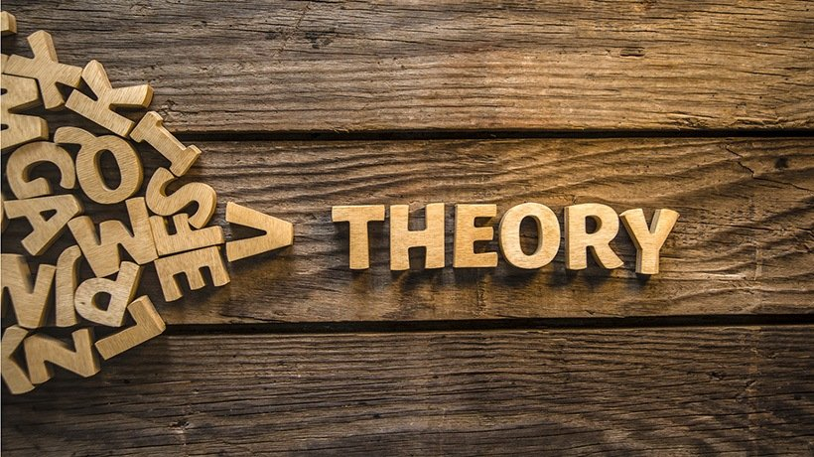
RESEARCH GAPS
There is no empirical causal evidence
(De Boeck, Meyers, & Dries, 2018)
There is little (psychological) theory development in the talent management literature
(Gallardo-Gallardo, Nijs, Dries, & Gallo, 2015)

Slide 9
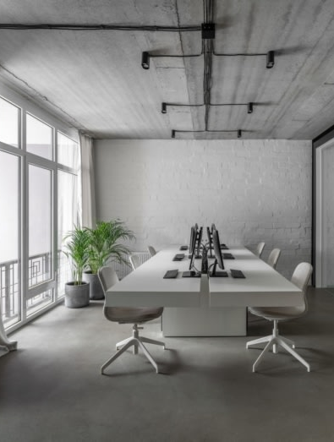
EXPERIMENTAL VIGNETTE METHDOLOGY
Imagine being employed at the organization below for a few years.
The Belgian supermarket chain DruCo was established in 1976. The company has been relatively successful these past 40 few years and continues to flourish.
Due to its success the HR-manager announced that they would introduce a talent management program in which a limited number of employees would be included.
Those that get selected will benefit from extra training, promotion opportunities and professional contacts within the sector. Those that do not get selected have fewer opportunities.
Today the HR-manager has decided to include [1% / 10% / 30% / 50%] of the employees in their talent program. You were informed that you were [(not) selected / unaware] for the talent program.

Slide 10
- PAPER 1 -
HARNESSING THE GENIUS EFFECT IN ELITE ORGANIZATIONAL TALENT PROGRAMS: CAN EXCLUSIVE, SECRET TALENT POOLS LEAD TO BETTER EMPLOYEE REACTIONS?
Van Zelderen, Dries, & Marescaux

Slide 11
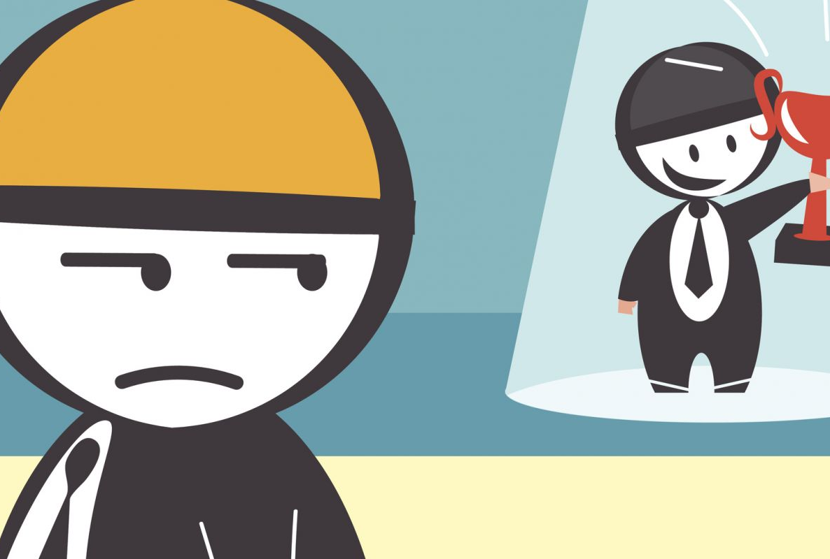
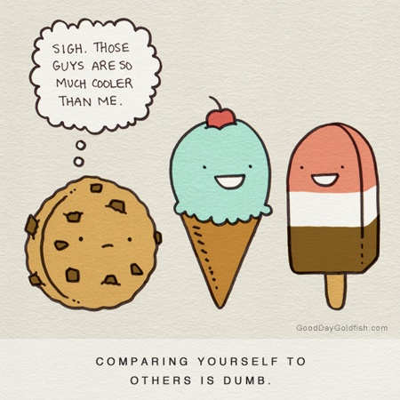
SOCIAL COMPARISON THEORY
Basic Premise Every individual compares him/herself with others to assess, or validate, the views one has of him- or herself (Festinger, 1954)
Upward
Intimidated, envious, lower self-worth
Downward
Proud, higher self-worth
Who do we (generally) compare with?
Similar; age/gender
Relevant; field/organization
Distance; difference in performance level

Slide 12
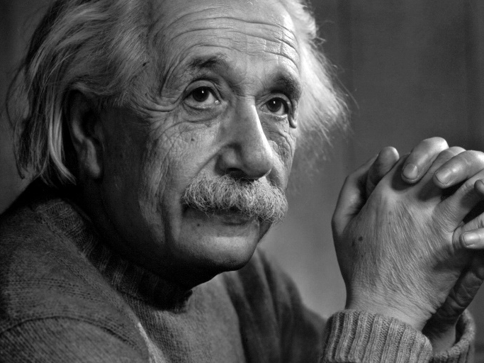
Genius Effect
Exaggerating the competencies of outperformers to make them more distant (Alicke, LoSchiavo, Zerbst, & Zhang, 1997)
Genius: A person endowed with extraordinary (i.e., top 2%) mental superiority
Prediction: The less exclusive the program, the less likely employees can justify and internalise the genius effect

Slide 13
STUDY DESIGN
STUDY 1
STUDY 2
STUDY 3
Managers’ Talent Philosophies
Non-talent Reactions
Talent Reactions
179 Talent Managers
Are they worried about negative reactions?
Do they accurately predict employee reactions?
576 Employees
How do non-talents actually react?
What if they do not know their (lack of) talent status?
306 Employees
How do talents actually react?
What is the ideal talent program design?
Notes:
Don’t forget status awareness

Slide 14
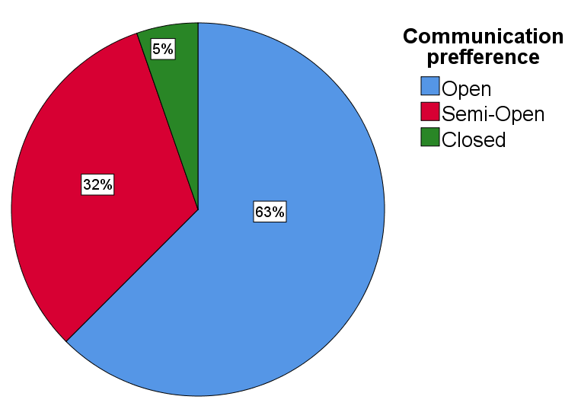
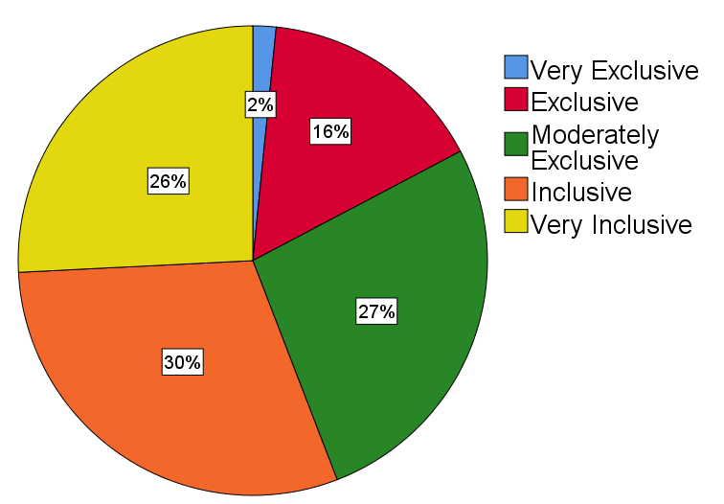
Manager Results
Talent Philosophies
y

Slide 15
Manager Results
Expected desire to be a talent at various % of inclusivity
y

Slide 16
Manager Results
Expected desire to be a talent at various % of inclusivity
y

Slide 17
Identity mismatch
How you identify may not always align with how others identify you.
Difference in values/expectations/stereotypes.
Not formally recognized.
Mismatch may lead to various negative emotions and behaviors (e.g., animosity, envy, uncertainty).
Issues with not being a talent potentially heightened because of the Dunning-Kruger effect.
y
Notes:
Values/expectations gamer.
Stereotypes women.
Negative can also be positive, try to adjust.

Slide 18
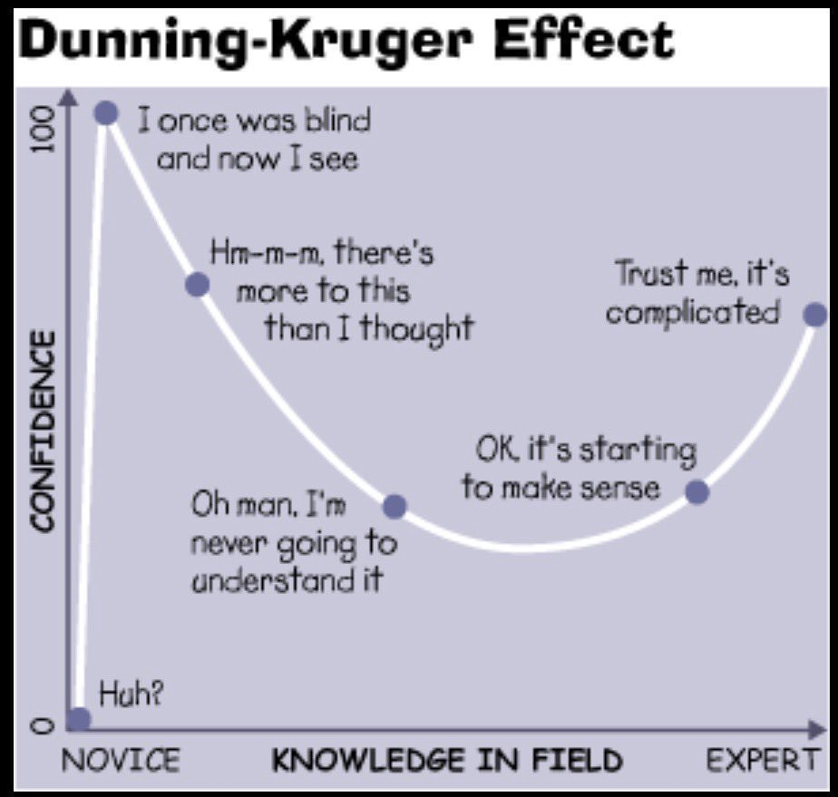
Dunning-Kruger Effect
Cognitive bias where people with low ability/knowledge have an illusion of superiority and therefore overestimate their actual ability/knowledge.
Do many employees actually consider themselves as a talent?
How strongly do you feel you want to be a talent and got what it takes?
[ 12% ] [ 78% ]
y
Notes:
Is it truly Dunning-Kruger effect?
Maybe…
Could be wrong interpretation of what talent entails. Everybody got talent?
Coincidentally surveyed lots of talents.

Slide 19
Desire to be a talent
Does a mismatch between identifying yourself as a talent and being formally identified as a talent result in negative employee reactions?
The more strongly someone believes they are a talent, the more fiercely they will react to being left out of the talent pool.
You cannot envy someone for something you don’t want.
y
Notes:
Work effort only worrisome for organisations if they inform their employees they aren’t considered as talents.
If dunning-kruger effect is present here, it also means a lot of incompetent people start putting less effort into their work. Will there be any hope for them then?

Slide 20
Manager Results
Expected employee reactions by managers
y

Slide 21
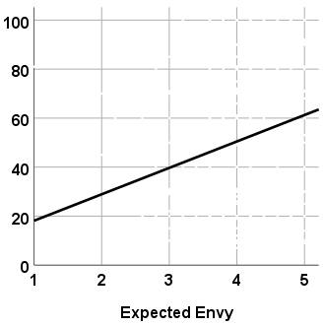
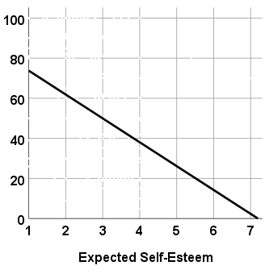
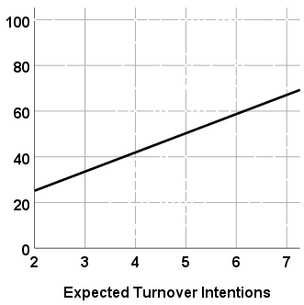
Manager Results
Managers that fear negative non-talent reactions prefer more inclusive talent management pools.
y

Slide 22
(STUDY 2) NON-TALENT REACTIONS
Non-talents react worse as talent programs become more inclusive

Slide 23
(STUDY 3) TALENT REACTIONS
Talents do not react differently at various levels of talent program inclusivity
Just content to not be excluded?

Slide 24
(Study 4) Field Data - 2023
402 Flemish employees (17% Government)
207 ‘Non-talents’
195 ‘Talents’
Inclusivity
Secrecy
Talents quit
Non-talents quit
8.4% ( 1 – 3 8 % )
25%
9.2%
33.3%
Non-talents learning about a secret program are 2.66 times more likely to quit.
Non-talents who believed themselves to be ‘talents’ were 2.92 times more likely to quit.

Slide 25
(Study 4) Field Data - 2023

Slide 26
Secrecy
Controversial topic; avenue to make ‘unpopular’ decisions but not considered a popular strategy by employees.
Progressive organizations ought to be radically transparent?
Boosts job satisfaction
Empowers employees
Lowers gender wage gap
Current generation more prone to leak sensitive information; consider Wikileaks for example
Can we truly be transparent about everything?
Trade secrets?
Reorganization?
y

Slide 27
COMBINED RESULTS
Talent program secrecy buffers the effect of inclusivity
Talents > Unaware > Non-Talents

Slide 28
(Study 4) Field Data - 2023

Slide 29
Conclusion
Managers worrying about negative reactions opt for more inclusive talent pools.
Yet, the higher the inclusivity of a talent pool, the worse employees excluded from the talent pool react in terms of envy, self-esteem and turnover intentions.
Employees who feel strongly about being a talent experience fiercer negative reactions when being excluded than those who do not.
Managers may consider keeping talent status a secret to ensure that negative reactions from non-talents are kept to a minimum.
y

Slide 30
All-inclusive TM
Hot debate whether this is considered as actual TM.
Pros:
Nobody feels excluded, so nobody leaves
Everybody benefits from being included and the training
Cons:
Costly. Or lower quality training.
Actual talents may end up leaving the organisation.
Talent is nothing special anymore
Training may be too hard for ‘low-potentials’ (burnout?)
y

Slide 31
- PAPER 2 -
ANTECEDENTS TO CO-WORKER ENVY IN TALENT MANAGEMENT
Van Zelderen, Dries, & Marescaux

Slide 32
Which talent management characteristics elicit envy amongst non-talents?
-BENIGN ENVY-
‘Leveling up’ yourself
-MALICIOUS ENVY-
‘Leveling down’ the outperformer
(Van de Ven, Zeelenberg, & Pieters, 2009)
Notes:
Admiration; reading about people similar to you who are successful motivates

Slide 33
Which talent management characteristics elicit envy amongst non-talents?
-BENIGN ENVY-
‘Leveling up’ yourself
Triggers
Hope, trust, justice
Fair implementation
Communicative; openly communicated
Distributive; balanced in/output
(Van de Ven, Zeelenberg, & Pieters, 2009)
Notes:
Admiration; reading about people similar to you who are successful motivates

Slide 34
Which talent management characteristics elicit envy amongst non-talents?
-MALICIOUS ENVY-
‘Leveling down’ the outperformer
Triggers
Fixed status, threat, inferiority
Poor implementation
Inferiority; too inclusive
Interdependence; their gains are my loss
(Van de Ven, Zeelenberg, & Pieters, 2009)
Notes:
Admiration; reading about people similar to you who are successful motivates

Slide 35
VIGNETTE MANIPULATIONS
BENIGN ENVY
Communication
Secret, Private, Public
Overreward inequity
Pay raise ÷ workload
MALICIOUS ENVY
Talent program inclusivity
1, 5, 10, 15… 95%
Zero-sum framing
Additional or repurposed program

Slide 36
STUDY DESIGN
SCREENER
STUDY 1
STUDY 2
Find Non-talents
Field Survey
Factorial Survey
2299 white-collar workers
719 (31%) have been a non-talent in their career
601 employees
27% inclusivity
33% secret
24% salary increase
15% additional workload
1.1 inequity ratio
25% zero-sum
472 employees
14,520 vignettes
2,832 observations
+justice -> +benign
+inferiority -> +malicious
+interdep. -> +malicious
Notes:
Don’t forget status awareness

Slide 37
RESULTS

Slide 38
RESULTS

Slide 39
- PAPER 3 -
OSTRACISM IN TALENT MANAGEMENT: OUT-GROUP EMOTIONAL RESPONSE AS A KEY DETERMINANT OF TALENT RETENTION
Van Zelderen, Dries, & Marescaux

Slide 40
EMPLOYEE TURNOVER
One of the primary goals of talent management is to enhance employee retention, yet empirical evidence is mixed
(De Boeck et al., 2018)
Effect of differentiation on employees
1. In-group favoritism
[minimal group paradigm]
(Tajfel, 1970)
2. Intergroup conflict
[Ostracism]
(Ashforth & Mael, 1989; Williams, 2007)

Slide 41
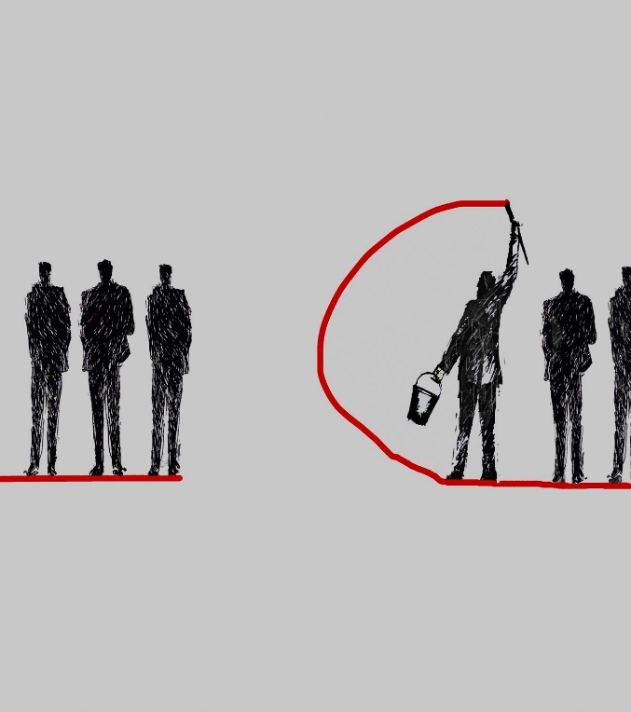
Upward mobility greatly fosters ostracism (Wu et al., 2016)
Ostracism largest predictor of turnover (O’Reilly et al., 2015)
TM causes employees to re-evaluate their social identity
Positive out-group co-worker responses signal no attack on social identity
Talent management is not recognized as a relational phenomenon (Al Ariss, Cascio, & Paauwe, 2014)
360 video vignettes
Emotions, and facial expressions, convey cues for ostracism (Kong, 2016)

Slide 42
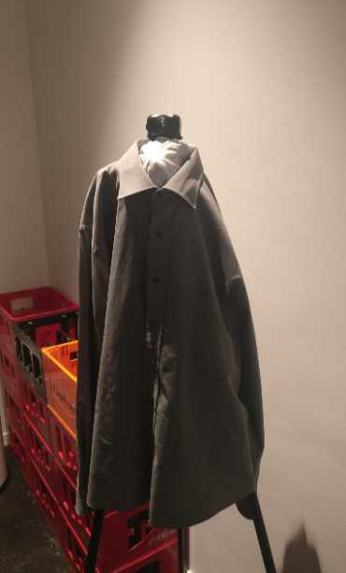
ROBIN THE 360 CAMERA

Slide 43
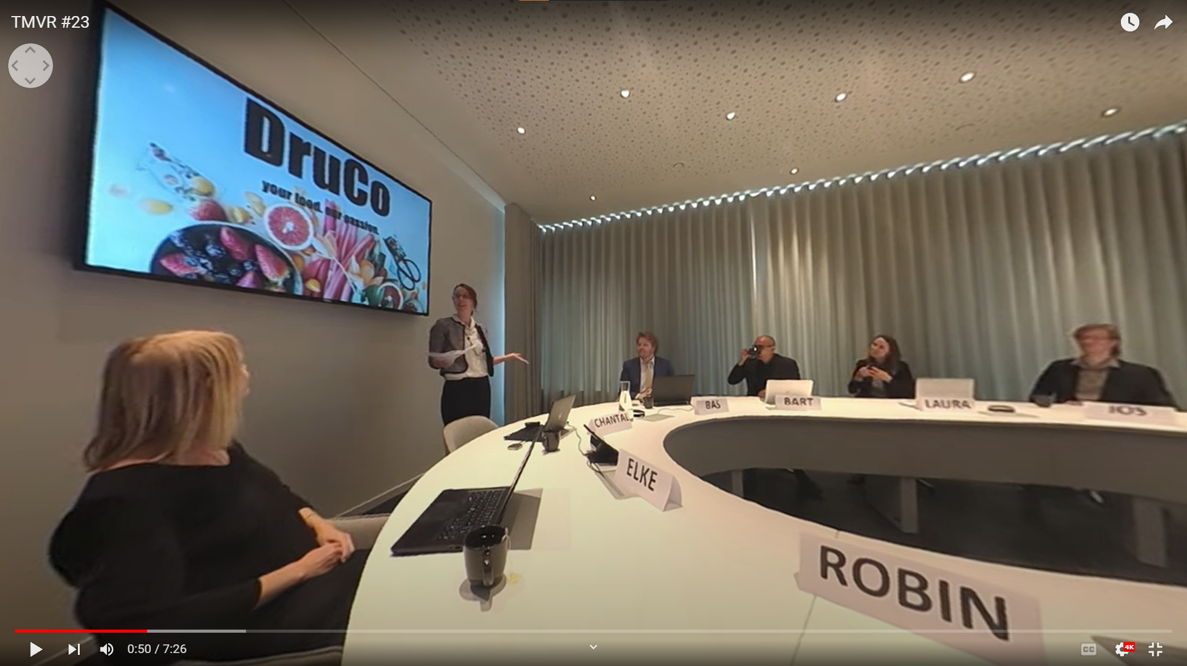
DruCo

Slide 44
RESULTS
Ostracism suppresses the relationship between talent identification and turnover
Talents are likely to leave the organization as non-talents, in practice, usually react poorly (Gelens, Dries, Hofmans, & Peperans, 2013; Malik & Singh, 2014)

Slide 45
IMPLICATIONS
Talent programs should be kept very exclusive (Paper 1 & 2)
Not knowing talent status buffers negative reactions (Paper 1)
Employees will improve themselves when managers are transparent (Paper 2)
Perhaps talent managers should be transparent in their secrecy?
Managers ought to be cautious when implementing talent programs to avoid intergroup conflicts thereby failing to retain talents (Paper 1 & 3)
CONTRIBUTIONS
Deleterious assumptions in the literature put to rest with causal evidence
Social comparison theory as fundamental framework for talent management
Genius effect can be harnessed to protect employees from superior performers
Social identity theory also important to consider
Exclusive talent programs reverse majority and minority group benefits
Notes:
Strategic ambiguity may even be transparent!

Slide 46
Recommendations for Organizations on Exclusive Talent Management
Focus on a small ‘elite’
Communicate expectations
Facilitate cooperation
Keep your talent pool limited to ‘the very best’ (i.e., < ~2%) to activate the genius effect amongst those excluded.
Let all employees know the ‘high’ demands and burdens that come with talent status (e.g., additional unpaid work)
To avoid conflict, and to let talents be seen as the company’s role models, create group projects that require the input of all employees
Define & value ‘talent’
Alternative: Secrecy
How much more do you value positive talent reactions in comparison to negative non-talent reactions?
Avoid negative reactions altogether by not telling non-talents about the talent program. However, if they find out their reactions are worse…

Slide 47
FUTURE STUDIES
To what extent do non-talents envy talents for not being seen as equals, and for missing out professional development opportunities
Can labels be used to diminish negative effects on ‘non-talents’
Social exchange theory studies
Vignettes manipulating benefits given to talents
Ecological validity
Opting for more life-like scenarios to enhance immersion and realism
Virtual Reality
Notes:
Strategic ambiguity may even be transparent!

Slide 48
“Critique”
Talent management is ALWAYS examined through surveys
It’s hard to imagine how to feel when I cannot even see my coworkers
Why not use a real organization instead?
Unreal
External validity??
I just cannot imagine it’s real
Your description of DruCo is, simply put, lacking
My experiences are way different
Too fake
Not very immersive…
y

Slide 49
Is experimental research necessary?
REQUIREMENTS
Research causality: X -> Y, or Y -> X?
Random allocation: Talents identified at random
Systematic variation: Numerous variables manipulated
ISSUES OF TRADITIONAL METHODS
Secrecy: Managers don’t openly talk much about TM
Ethics: Giving and taking away talent status for science
Feasibility: Readily requires hundreds of organizations (Study 2 would be 7,000)
Accuracy: Incorrect self-talent-identifications Tons of unaccountable confounds

Slide 50
Reactions to 360-video
Realistic
I would say 99% life-like!
I appreciate being able to focus on non-verbal communication, which would otherwise be impossible
It honestly felt quite real
87% positive experiences
This felt more realistic than many other studies I participated in
Amazing
This is not a gimmick
I felt as if I were truly present there for the meeting
It seems very interactive to me now
WAAW 360, sick!
y

Slide 51
Virtual Reality
Creating a fully interactive, life-like, organization in which researchers can manipulate (almost) everything.
Projects including talent management, as well as bias on the work floor, future of work and artificial intelligence.
y

Slide 52
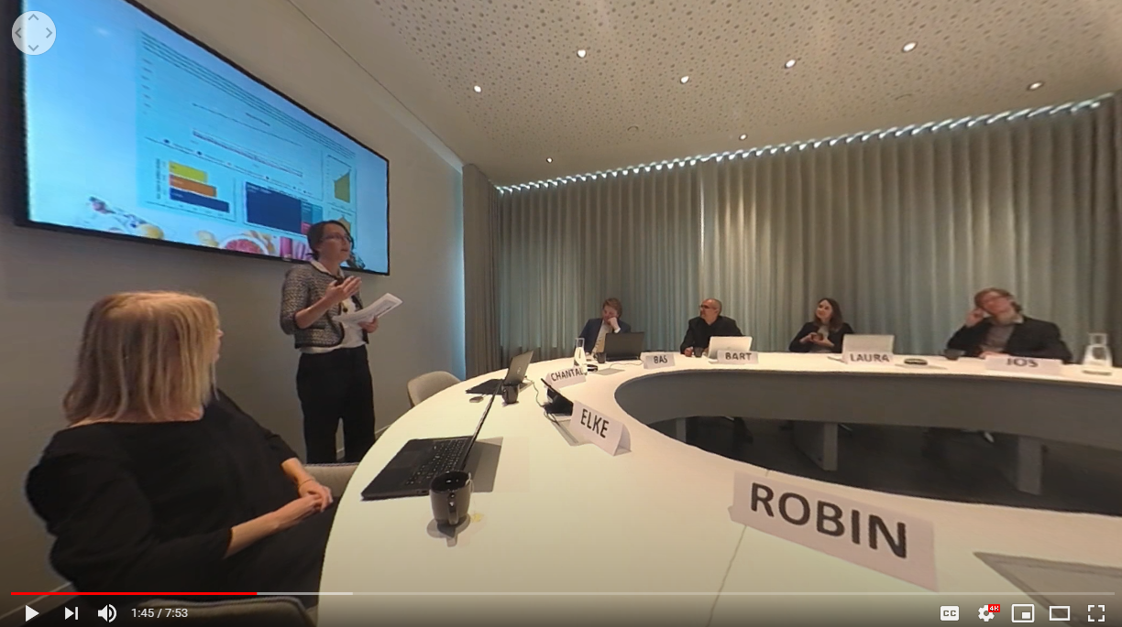
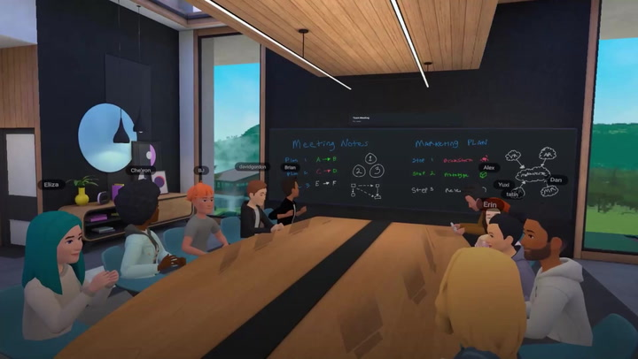
Virtual Reality

Slide 53
THANK YOU FOR LISTENING!

